Slide 1
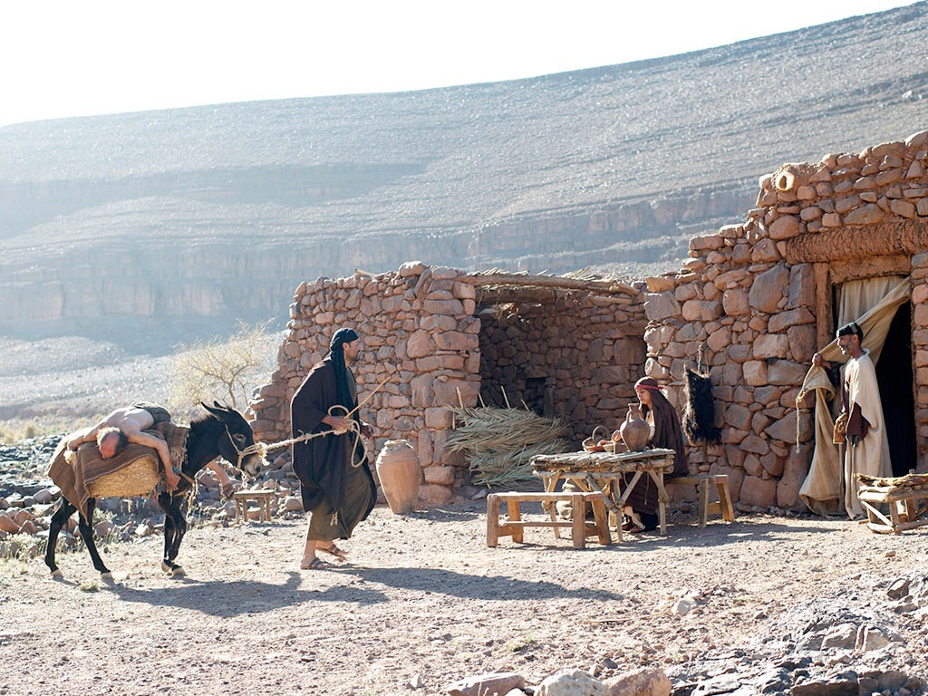
The Good Samaritan Part 3
Loving Everyone

Slide 2
Luke 10:27–29
27 And he answered, “You shall love the Lord your God with all your heart and with all your soul and with all your strength and with all your mind, and your neighbor as yourself.” 28 And he said to him, “You have answered correctly; do this, and you will live.”
29 But he, desiring to justify himself, said to Jesus, “And who is my neighbor?”

Slide 3
Luke 10:36–37
36 Which of these three, do you think, proved to be a neighbor to the man who fell among the robbers?” 37 He said, “The one who showed him mercy.” And Jesus said to him, “You go, and do likewise.”

Slide 5
3 Ways We Might Be a Bit Like Jonah

Slide 6
1. God may want me to reach out to someone who I’d rather not reach out to.

Slide 7
2. I may have found ways to avoid reaching out.

Slide 8
3. I may value an object more than I value people.

Slide 9
Money
No money
Care
No care
Concern
No concern

Slide 10
How God Taught Jonah

Slide 11
God shows Jonah the good in others.
GOOD
BAD
BAD
GOOD

Slide 12
GRACE
God shows Jonah grace.

Slide 13
God shows Jonah the good in others again.
BAD
GOOD

Slide 14
But Jonah still isn’t pleased with God’s grace toward others.
GRACE

Slide 15
So God shows Jonah grace again…
GRACE
…then takes it away.

Slide 16
The key to loving everyone
is to truly appreciate God’s love for me.

