Slide 1
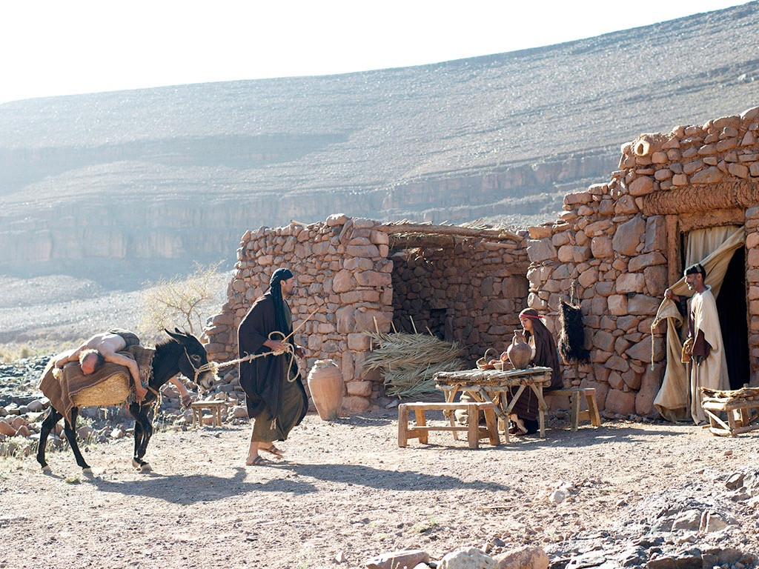
The Good Samaritan Part 4
Going the Extra Mile

Slide 2
Saw

Slide 3
Acts 6:1
Now in these days when the disciples were increasing in number, a complaint by the Hellenists arose against the Hebrews because their widows were being neglected in the daily distribution.

Slide 4
Saw
Felt

Slide 5
Romans 12:15
Rejoice with those who rejoice, weep with those who weep.

Slide 6
Saw
Felt
Went

Slide 7
Acts 9:38–39
Since Lydda was near Joppa, the disciples, hearing that Peter was there, sent two men to him, urging him, “Please come to us without delay.” So Peter rose and went with them. And when he arrived, they took him to the upper room. All the widows stood beside him weeping and showing tunics and other garments that Dorcas made while she was with them.

Slide 8
Saw
Felt
Went
Helped

Slide 9
Acts 20:35
In all things I have shown you that by working hard in this way we must help the weak and remember the words of the Lord Jesus, how he himself said, ‘It is more blessed to give than to receive.’ ”

Slide 10
Titus 3:14
And let our people learn to devote themselves to good works, so as to help cases of urgent need, and not be unfruitful.

Slide 11
Saw
Felt
Went
Helped
Used what he had

Slide 12
1 Peter 4:10
As each has received a gift, use it to serve one another, as good stewards of God’s varied grace:

Slide 13
Found additional help

Slide 14
Acts 11:25–26
So Barnabas went to Tarsus to look for Saul, and when he had found him, he brought him to Antioch. For a whole year they met with the church and taught a great many people. And in Antioch the disciples were first called Christians.

Slide 15
Found additional help
Invested time

Slide 16
Acts 12:5
So Peter was kept in prison, but earnest prayer for him was made to God by the church.
Acts 12:6
Now when Herod was about to bring him out, on that very night, Peter was sleeping between two soldiers, bound with two chains, and sentries before the door were guarding the prison.
Acts 12:12
When he realized this, he went to the house of Mary, the mother of John whose other name was Mark, where many were gathered together and were praying.

Slide 17
Found additional help
Invested time
$
Invested money

Slide 18
Luke 12:32–34
“Fear not, little flock, for it is your Father’s good pleasure to give you the kingdom. Sell your possessions, and give to the needy. Provide yourselves with moneybags that do not grow old, with a treasure in the heavens that does not fail, where no thief approaches and no moth destroys. For where your treasure is, there will your heart be also.”

Slide 19
Found additional help
Invested time
$
Invested money
Planned

Slide 20
1 Corinthians 16:1–4
Now concerning the collection for the saints: as I directed the churches of Galatia, so you also are to do. On the first day of every week, each of you is to put something aside and store it up, as he may prosper, so that there will be no collecting when I come. And when I arrive, I will send those whom you accredit by letter to carry your gift to Jerusalem. If it seems advisable that I should go also, they will accompany me.

Slide 21
Found additional help
Invested time
$
Invested money
Planned
Followed up

Slide 22
Acts 14:21–22
When they had preached the gospel to that city and had made many disciples, they returned to Lystra and to Iconium and to Antioch, strengthening the souls of the disciples, encouraging them to continue in the faith, and saying that through many tribulations we must enter the kingdom of God.

Slide 23
Acts 15:36 (ESV)
36 And after some days Paul said to Barnabas, “Let us return and visit the brothers in every city where we proclaimed the word of the Lord, and see how they are.”

Slide 24
Saw
Found additional help
Felt
Invested time
Invested money
Went
“Go and do likewise.”
$
Helped
Planned
Used what he had
Followed up

