Slide 1
What We Learn From
Being Sick

Slide 2
Helps us see our helplessness
What I Learn From Being Sick

Slide 3
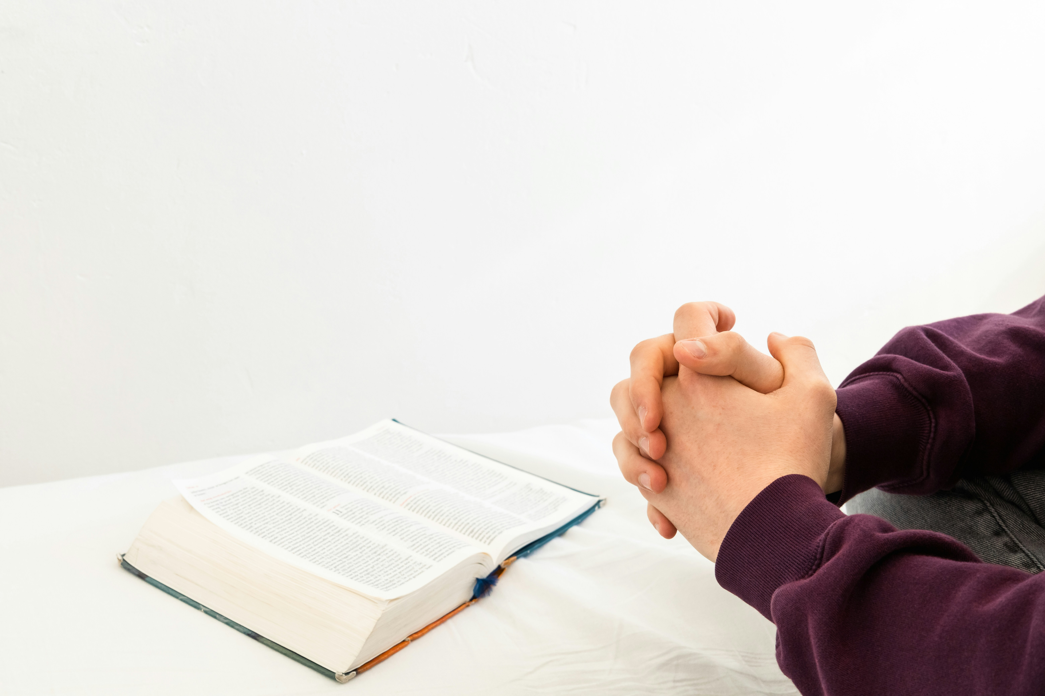
Helps us turn to something outside ourselves

Slide 4
Hezekiah

Slide 5
2 Kings 20:1-3
In those days Hezekiah became sick and was at the point of death. And Isaiah the prophet the son of Amoz came to him and said to him, “Thus says the Lord, ‘Set your house in order, for you shall die; you shall not recover.’ ” Then Hezekiah turned his face to the wall and prayed to the Lord, saying, “Now, O Lord, please remember how I have walked before you in faithfulness and with a whole heart, and have done what is good in your sight.” And Hezekiah wept bitterly.

Slide 6
Hezekiah
- Turned to God
Ahaziah

Slide 7
2 Kings 1:1-3
After the death of Ahab, Moab rebelled against Israel. Now Ahaziah fell through the lattice in his upper chamber in Samaria, and lay sick; so he sent messengers, telling them, “Go, inquire of Baal-zebub, the god of Ekron, whether I shall recover from this sickness.” But the angel of the Lord said to Elijah the Tishbite, “Arise, go up to meet the messengers of the king of Samaria, and say to them, ‘Is it because there is no God in Israel that you are going to inquire of Baal-zebub, the god of Ekron?

Slide 8
Hezekiah
- Turned to God
Ahaziah
- Turned to Idols
Asa

Slide 9
2 Chronicles 16:12
In the thirty-ninth year of his reign Asa was diseased in his feet, and his disease became severe. Yet even in his disease he did not seek the Lord, but sought help from physicians.

Slide 10
Hezekiah
- Turned to God
Ahaziah
- Turned to Idols
Asa
- Turned to doctors
Jeroboam’s wife

Slide 11
1 Kings 14:1–6
At that time Abijah the son of Jeroboam fell sick. And Jeroboam said to his wife, “Arise, and disguise yourself, that it not be known that you are the wife of Jeroboam, and go to Shiloh. Behold, Ahijah the prophet is there, who said of me that I should be king over this people. Take with you ten loaves, some cakes, and a jar of honey, and go to him. He will tell you what shall happen to the child.”

Slide 12
Jeroboam’s wife did so. She arose and went to Shiloh and came to the house of Ahijah. Now Ahijah could not see, for his eyes were dim because of his age. And the Lord said to Ahijah, “Behold, the wife of Jeroboam is coming to inquire of you concerning her son, for he is sick. Thus and thus shall you say to her.”
When she came, she pretended to be another woman. But when Ahijah heard the sound of her feet, as she came in at the door, he said, “Come in, wife of Jeroboam. Why do you pretend to be another? For I am charged with unbearable news for you.

Slide 13
Hezekiah
- Turned to God
Ahaziah
- Turned to Idols
Asa
- Turned to doctors
Jeroboam’s wife
- Wanted God to turn to her, but didn’t want to turn to God

Slide 14
Helps us depend on grace

Slide 15
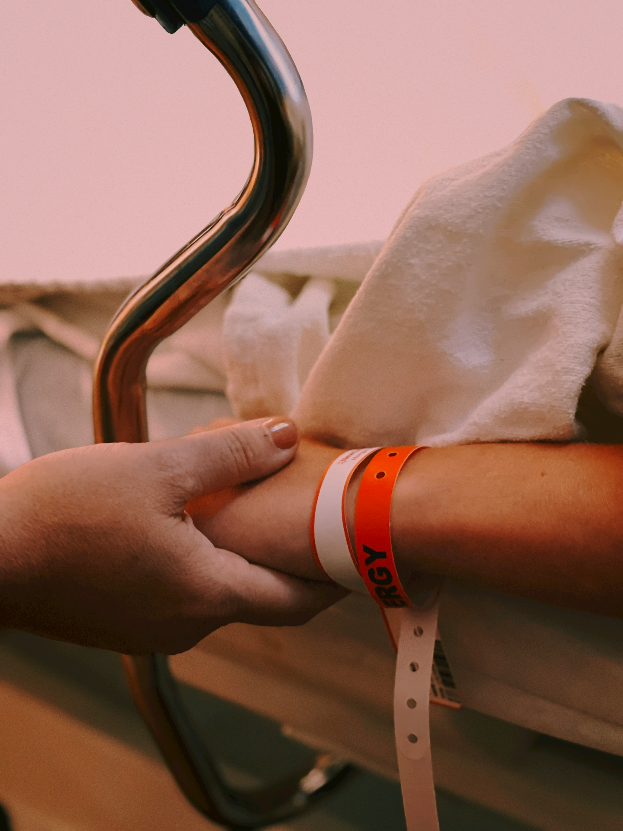
Helps us understand others

Slide 16
Helps us look forward to Jesus

