Slide 1
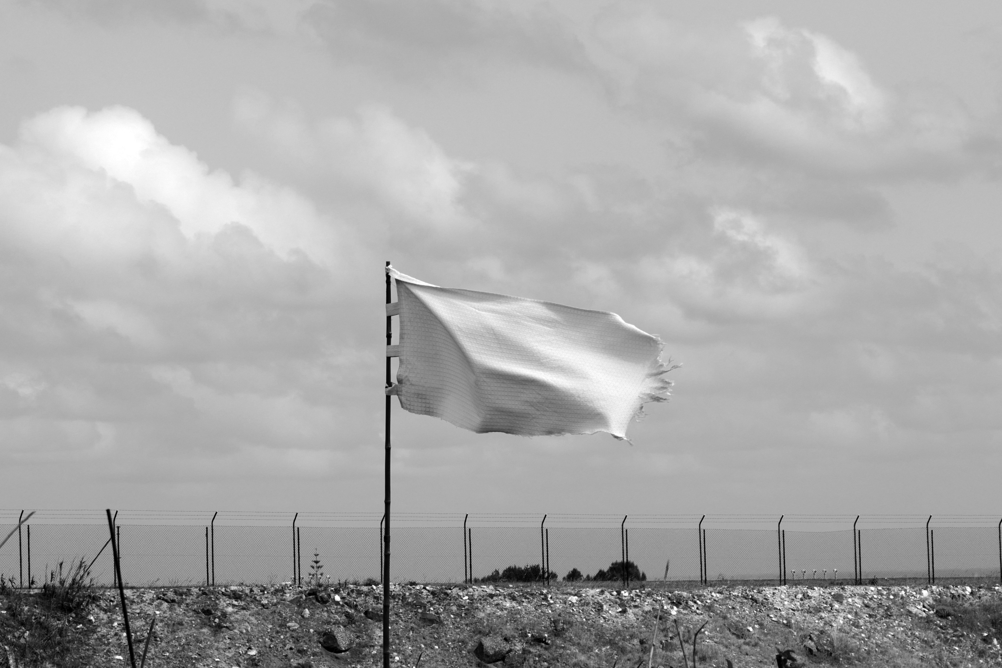
Are You Strong Enough to Surrender?

Slide 2
No One Wants to LOSE

Slide 3
City burned
Not escape
Life spared
City not burned
You and family live

Slide 4
Admit defeat
Surrender
Humility
Dishonor from the people who are closest to him
Danger of unknown
Trust in God
Salvation
No change
Rely on his strength
Stubbornness
Death

Slide 5
Matthew 16:24-25
Then Jesus told his disciples,
“If anyone would come after me, let him deny himself and take up his cross and follow me.
For whoever would save his life will lose it, but whoever loses his life for my sake will find it.”

Slide 6
David

Slide 7
David Hiding His Sin
David Confessing His Sin
Admit defeat
Surrender
Humility
Dishonor from the people who are closest to him
Danger of unknown
Trust in God
Salvation
No change
Rely on his strength
Stubbornness
Death

Slide 8
Prodigal Son

Slide 9
Stay feeding pigs
Choice to return home
Admit defeat
Surrender
Humility
Dishonor from the people who are closest to him
Danger of unknown
Trust in God
Salvation
No change
Rely on his strength
Stubbornness
Death

Slide 10
Rich Young Ruler

Slide 11
Rich man still rich
Rich man giving up wealth
Admit defeat
Surrender
Humility
Dishonor from the people who are closest to him
Danger of unknown
Trust in God
Salvation
No change
Rely on his strength
Stubbornness
Death

Slide 12
Paul

Slide 13
Paul the Persecutor
Paul the Christian
Admit defeat
Surrender
Humility
Dishonor from the people who are closest to him
Danger of unknown
Trust in God
Salvation
No change
Rely on his strength
Stubbornness
Death

Slide 14
What did Zedekiah do?

Slide 16
Runs
Defeated

Slide 17
Us

Slide 18
Me?
Or Me?
Admit defeat
Surrender
Humility
Dishonor from the people who are closest to him
Danger of unknown
Trust in God
Salvation
No change
Rely on his strength
Stubbornness
Death

