Slide 1
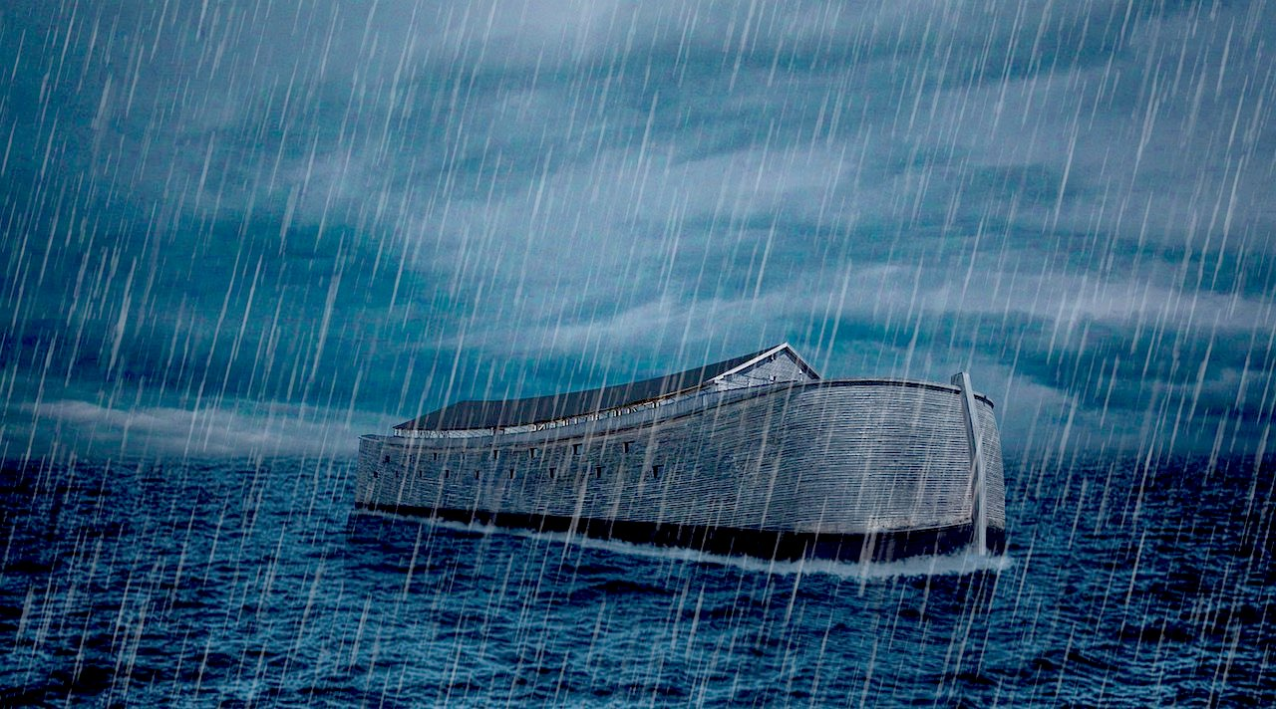
What If It’s Not About Noah?

Slide 2
What wasn’t included:
Laughed at
Struggle of faith
Danger from violence
Fear of the unknown
Discouragement
Trouble convincing family
Noah’s thoughts

Slide 3
How to get all the animals?
How to get all the wood?
How to get all the food?
What was life like on the ark?
What did the ark smell like?

Slide 4
What was included:
God seeing
God choosing
God regretting
God planning
God commanding
God promising
God remembering
God smelling
God deciding in His heart
God blessing

Slide 5
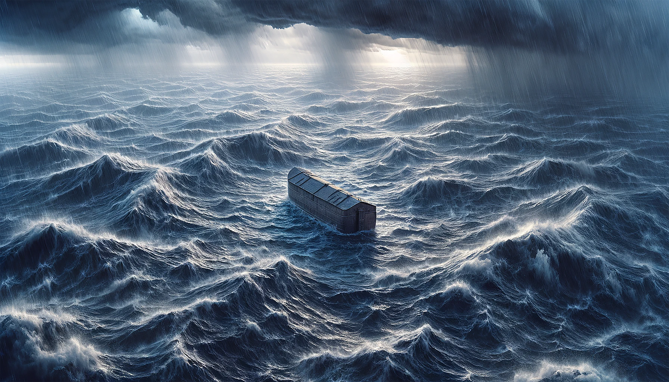
The account is written from a heavenly perspective

Slide 6
Choosing to leave
Seeing the earth
Smelling the worship
Feeling regret at making man
Telling Noah His plans
Making a decision to never curse the ground again
Making a covenant
Choosing to destroy His own creation
Blotting out life
Blessing people
Feeling favor toward Noah
Remembering Noah

Slide 7
The account is similar to Genesis 1

Slide 8
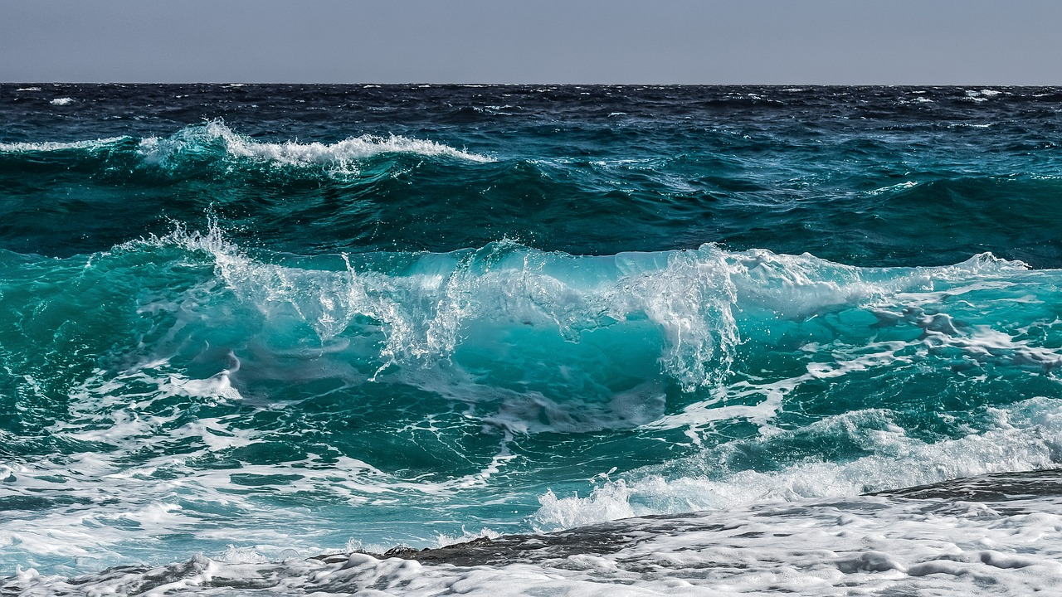
Earth covered with water
Separating water from land
Birds arrive
Animals and people arrive
Blessing

Slide 9
2 Peter 3:5–7
For they deliberately overlook this fact, that the heavens existed long ago, and the earth was formed out of water and through water by the word of God, and that by means of these the world that then existed was deluged with water and perished. But by the same word the heavens and earth that now exist are stored up for fire, being kept until the day of judgment and destruction of the ungodly.

Slide 10
The account includes
a lot of references to time

Slide 11
feels precisely timed.
Every
step

Slide 12
How this is so helpful for us:

Slide 13
God’s perspective
God creating the new
God’s timing
Our obedience

