Slide 1
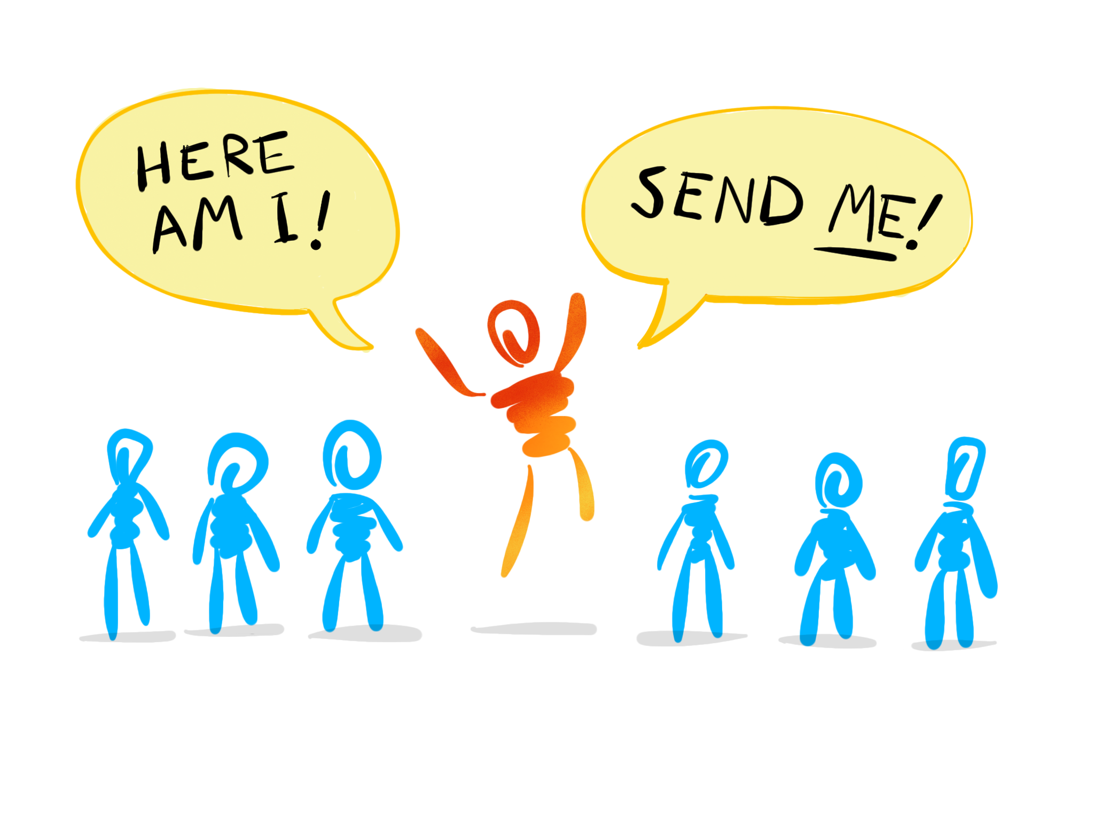

Slide 2
Teaching the lost
Teaching the saved
Encouraging
Serving Christians
Serving Non-Christians
Leading
Showing hospitality

Slide 3
Motivation
Awareness
Equipping

Slide 4
God’s Solution
to Problems

Slide 5
Problem
Solution
Slavery in Egypt
Moses
God Sends

Slide 6
Problem
Solution
Oppressed by enemies
Gideon
God Sends

Slide 7
Problem
Solution
Deep in sin
Isaiah
God Sends

Slide 8
Problem
Solution
Deep in sin
Jeremiah
God Sends

Slide 9
Problem
Solution
Deep in sin
Jonah
God Sends

Slide 10
God’s Bigger
Solution

Slide 11
John 7:28–29
So Jesus proclaimed, as he taught in the temple, “You know me, and you know where I come from. But I have not come of my own accord. He who sent me is true, and him you do not know. I know him, for I come from him, and he sent me.”

Slide 12
Problem
Solution
The whole world lost in sin
Jesus
God Sends

Slide 13
John 4:34
Jesus said to them, My food is to do the will of him who sent me and to accomplish his work.

Slide 14
John 8:42.
Jesus said to them, “If God were your Father, you would love me, for I came from God and I am here. I came not of my own accord, but he sent me.

Slide 15
John 11:41–42
So they took away the stone. And Jesus lifted up his eyes and said, “Father, I thank you that you have heard me. I knew that you always hear me, but I said this on account of the people standing around, that they may believe that you sent me.”

Slide 16
Problem
Solution
The whole world lost in sin
Us
Jesus sends

Slide 17
What Did People
Do When God Sent Them?

Slide 18
Please send someone else.
Problem
Solution
Slaves in Egypt
Moses
God Sends

Slide 19
How
can I save Israel? My clan is the weakest in Israel…
Problem
Solution
Oppressed by Enemies
Gideon
God Sends

Slide 20
Ah, Lord God!
I do not know how to speak, for I am only a youth.
Problem
Solution
Deep in sin
Jeremiah
God Sends

Slide 21
Problem
Solution
Deep in sin
Jonah
God Sends

Slide 22
Problem
Solution
Deep in sin
Jonah
God Sends

Slide 23
Problem
Solution
Deep in sin
Isaiah
God Sends

Slide 24
Problem
Here am I!
Send me!
Solution
Deep in sin
Isaiah
God Sends

Slide 25
Here am I!
Send me!
Isaiah
Let’s be an Isaiah.

Slide 26
Moses
Gideon
Jeremiah
Jonah
Isaiah
Which one will you be?

