Slide 1
Matthew 17:20
He said to them, “Because of your little faith. For truly, I say to you, if you have faith like a grain of mustard seed, you will say to this mountain, ‘Move from here to there,’ and it will move, and nothing will be impossible for you.”

Slide 2
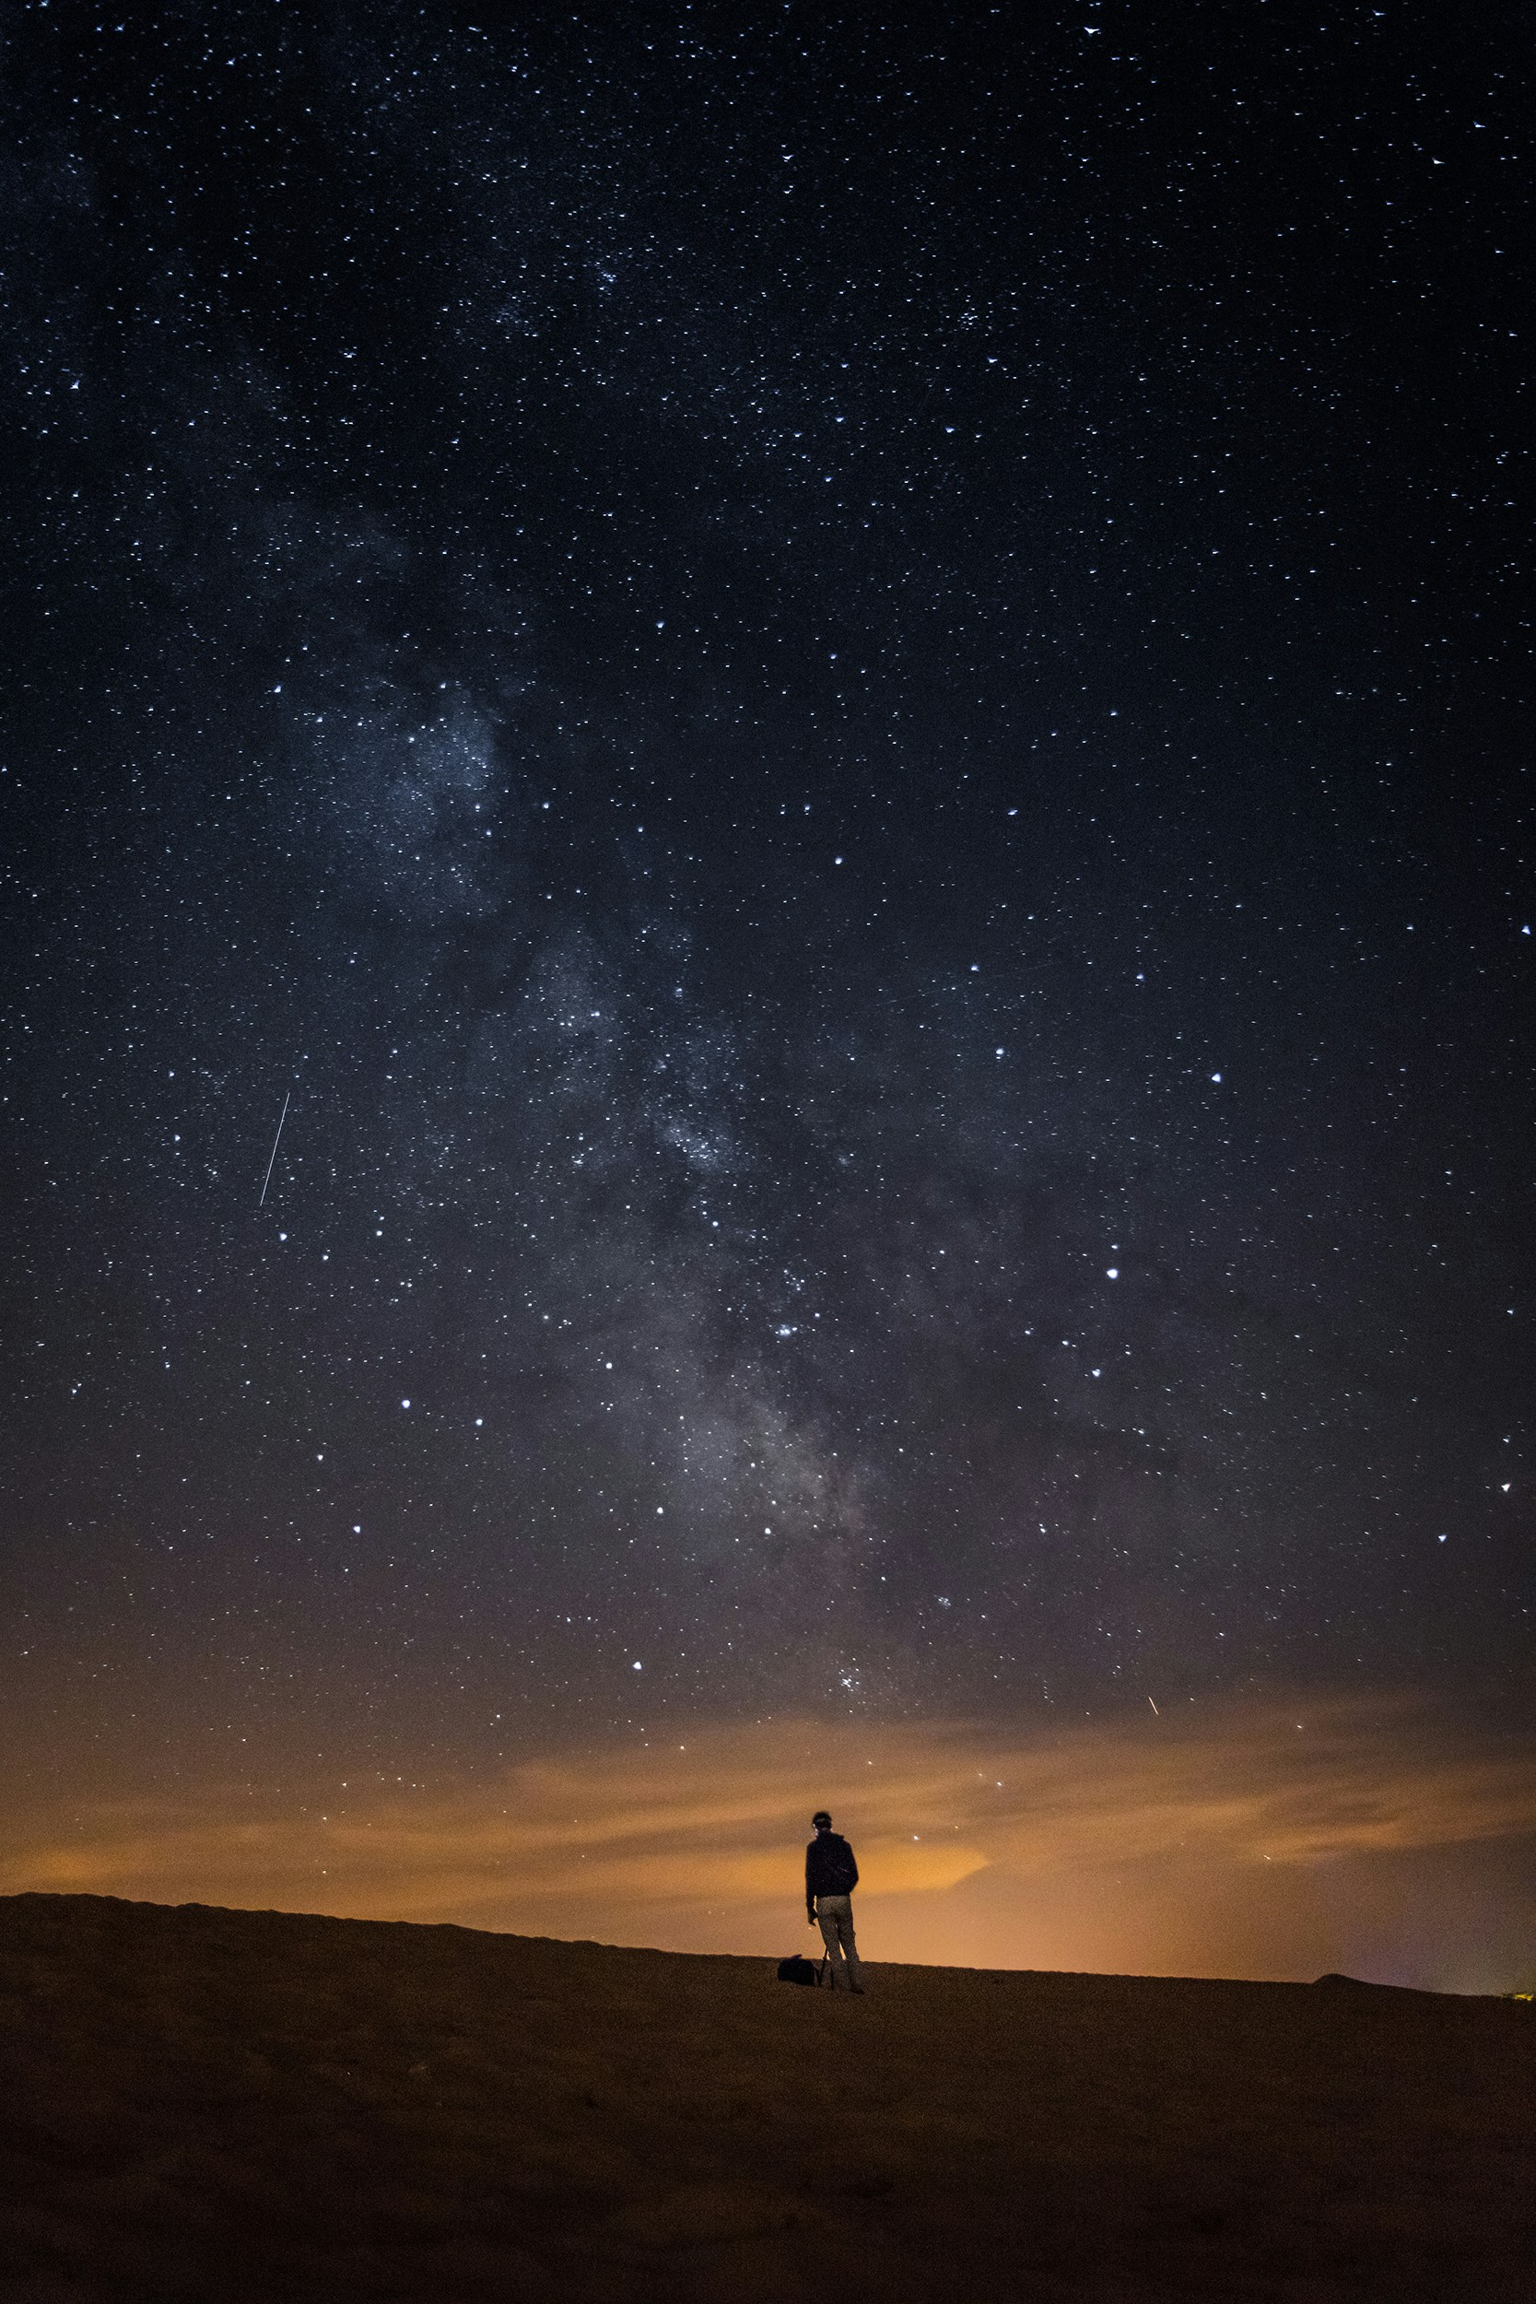
Do You Have Enough Faith
to Be Humble?
is a

Slide 3
No Faith
Faith
Jesus’ Power
His Power
His Power

Slide 4
No Faith
Faith

Slide 5
My Existence

Slide 6
No Faith
Faith
I am here because I exist.
Psalm 100:3
Know that the LORD,
He is God;
It is He who has made us,
and not we ourselves;
We are His people
and the sheep of His pasture.

Slide 7
No Faith
Faith
I am here because I exist.
I am here because God made me.

Slide 8
My Knowledge

Slide 9
No Faith
Faith
1 Corinthians 3:19–21
For the wisdom of this world is folly with God. For it is written, “He catches the wise in their craftiness,” and again, “The Lord knows the thoughts of the wise, that they are futile.” So let no one boast in men.
I know so much.

Slide 10
No Faith
Faith
I know so little compared to God.
I know so much.

Slide 11
My Confidence

Slide 12
No Faith
Faith
I prepared well so I can handle this.
Psalm 20:7
Some trust in chariots and some in horses, but we trust in the name of the LORD our God.

Slide 13
No Faith
Faith
I prepared well so I can handle this.
I need God’s help to handle this.

Slide 14
My Planning

Slide 15
No Faith
Faith
James 4:13–16
Come now, you who say, “Today or tomorrow we will go into such and such a town and spend a year there and trade and make a profit”— yet you do not know what tomorrow will bring. What is your life? For you are a mist that appears for a little time and then vanishes. Instead you ought to say, “If the Lord wills, we will live and do this or that.” As it is, you boast in your arrogance. All such boasting is evil.
I can plan
my future.

Slide 16
No Faith
Faith
My future is only if God wills.
I can plan
my future.

Slide 17
My Money

Slide 18
No Faith
Faith
I earn a lot of money.
Deuteronomy 8:17–18
Beware lest you say in your heart, ‘My power and the might of my hand have gotten me this wealth.’ You shall remember the Lord your God, for it is he who gives you power to get wealth.

Slide 19
No Faith
Faith
God gave me the power to get wealth.
I earn a lot of money.

Slide 20
My Generosity

Slide 21
No Faith
Faith
I gave a lot to others.
1 Chronicles 29:14
“But who am I, and what is my people, that we should be able thus to offer willingly? For all things come from you, and of your own have we given you.

Slide 22
No Faith
Faith
I gave a lot to others.
It all belongs
to God.

Slide 23
My Talents

Slide 24
No Faith
Faith
1 Peter 4:10
As each has received a gift, use it to serve one another, as good stewards of God’s varied grace: whoever speaks, as one who speaks oracles of God; whoever serves, as one who serves by the strength that God supplies—in order that in everything God may be glorified through Jesus Christ.
I am very talented.

Slide 25
No Faith
Faith
God blessed me with these talents.
I am very talented.

Slide 26
My Evangelism

Slide 27
No Faith
Faith
I converted that person.
1 Corinthians 3:5–6
I planted, Apollos watered, but God gave the growth.

Slide 28
No Faith
Faith
I planted.
God gave the increase.
I converted that person.

Slide 29
My Sin

Slide 30
No Faith
Faith
I’m a pretty good person.
Psalm 130:3-4
If you, O Lord, should mark iniquities,
O Lord, who could stand?
But with you there is forgiveness,
that you may be feared.

Slide 31
No Faith
Faith
I am unworthy, but God is forgiving.
I’m a pretty good person.

Slide 32
Faith problem
Pride problem
Pride problem
Faith problem

Slide 33
Let’s have the faith to see ourselves
as we really are.

