Slide 1
Crying Out For Mercy
is a

Slide 2
Coming to God like a helpless widow in distress

Slide 3
The Problem

Slide 4
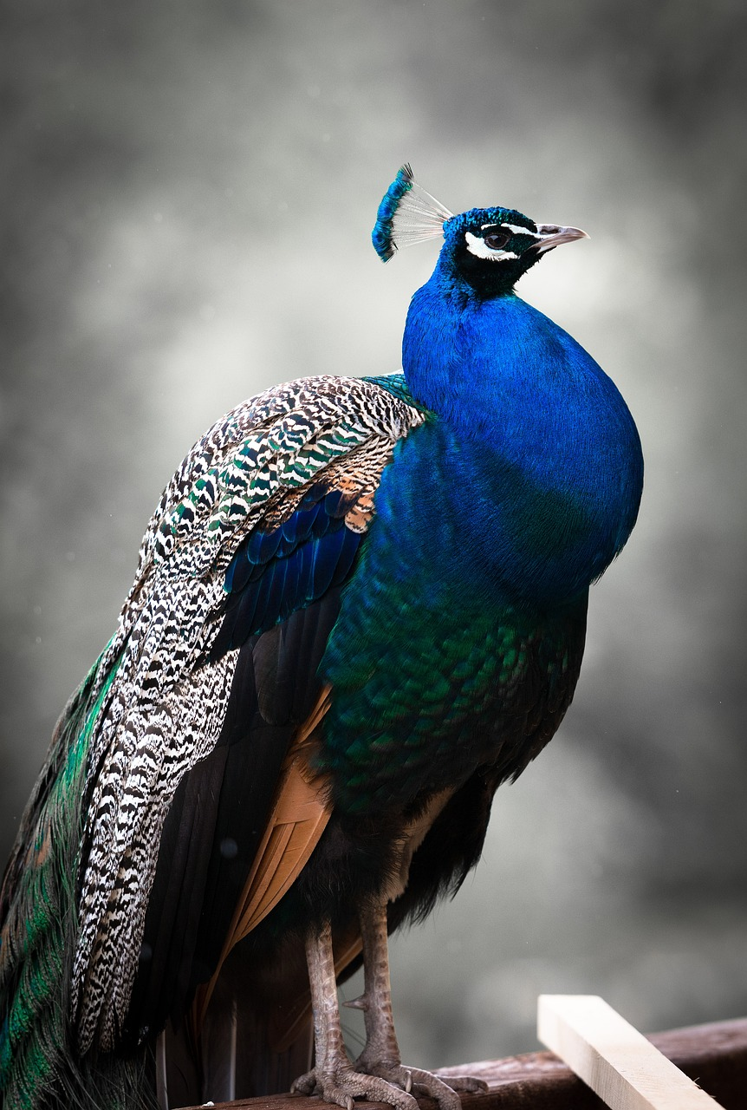
Pride gets in the way

Slide 5
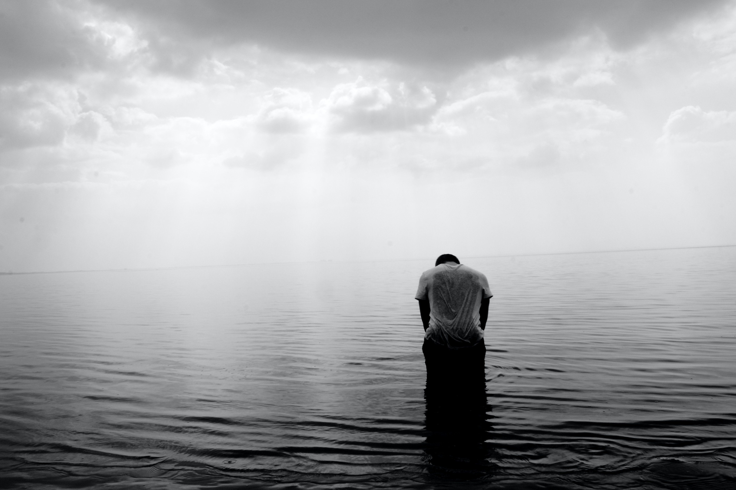
Coming to God like a tax collector

Slide 6
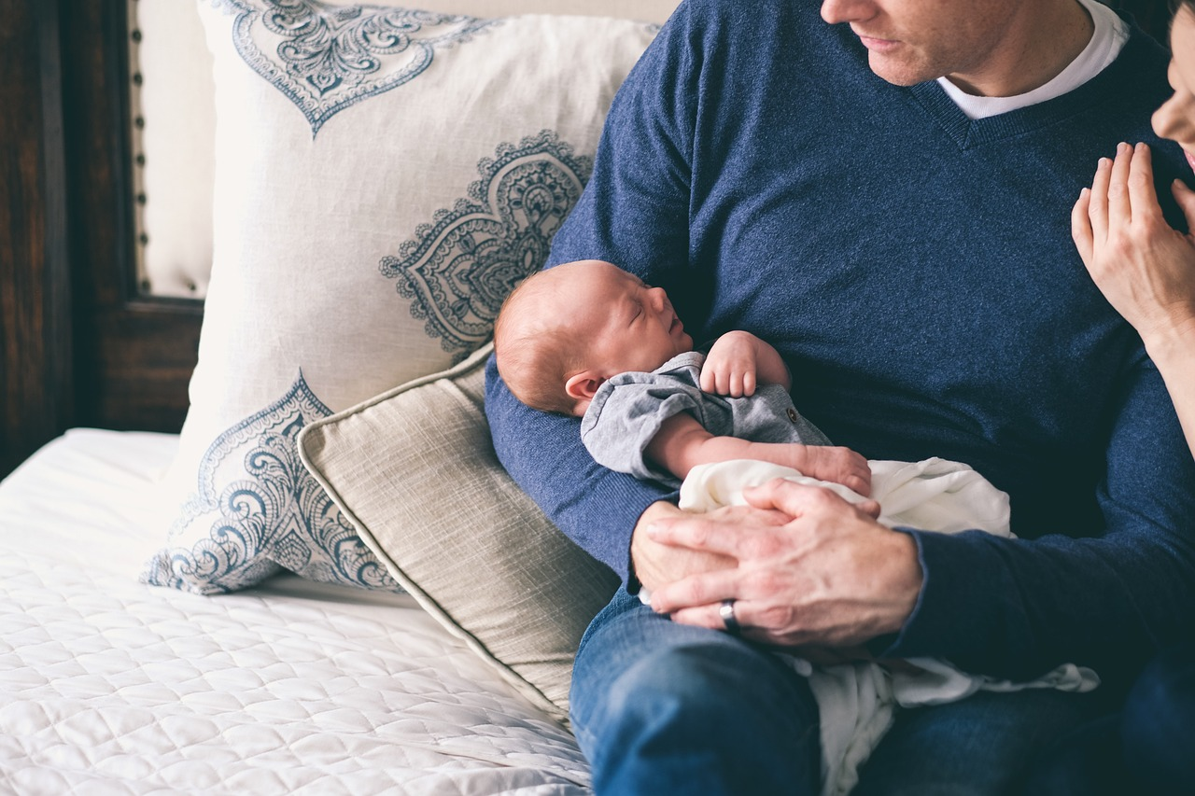
Coming to God like an infant

Slide 7
The Problem

Slide 8
Money gets in the way

Slide 9
Coming to God like Jesus on the cross

Slide 10
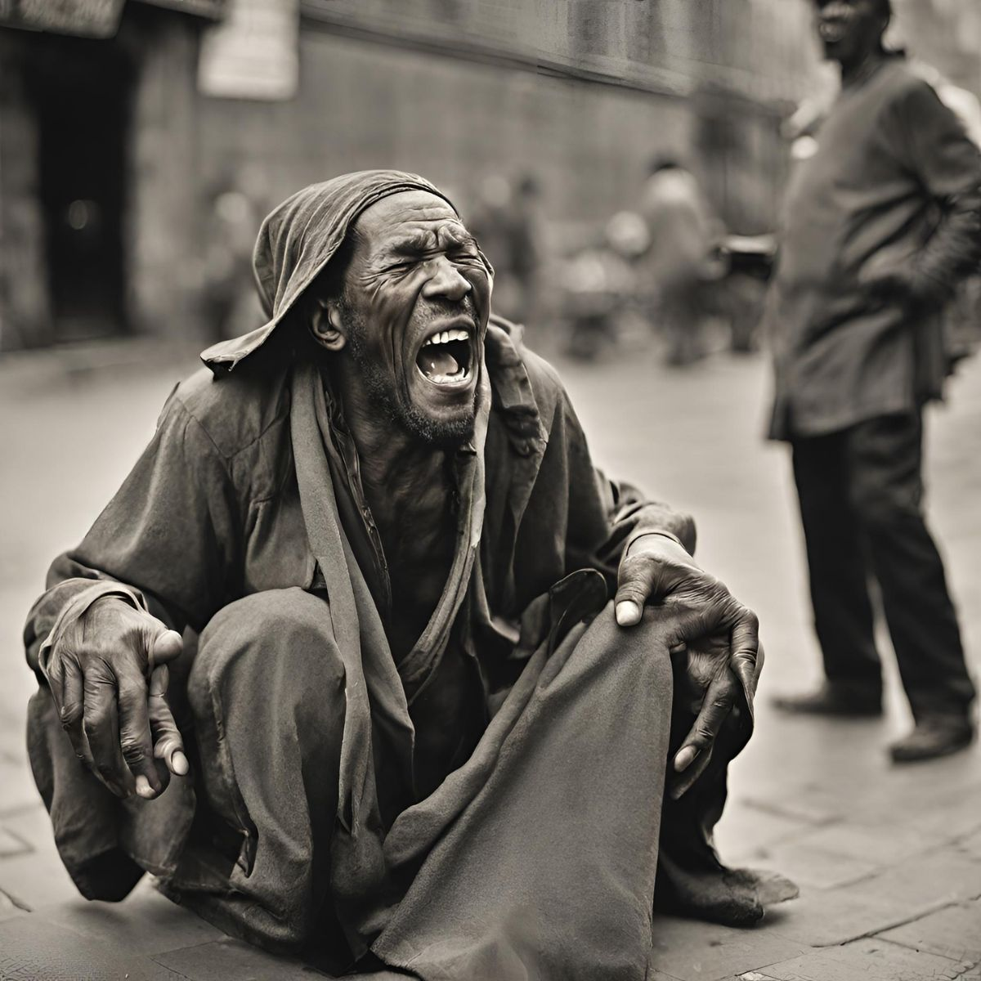
Coming to God like a blind beggar

Slide 11
Coming to God like a tax collector (again!)

Slide 12
Who do I most resemble?

