Slide 1
Agur’s Perfect Life

Slide 2
Just enough
Poor & steal
Full & deny God

Slide 3
The Concept of
Just Enough
in 1 & 2 Kings

Slide 4
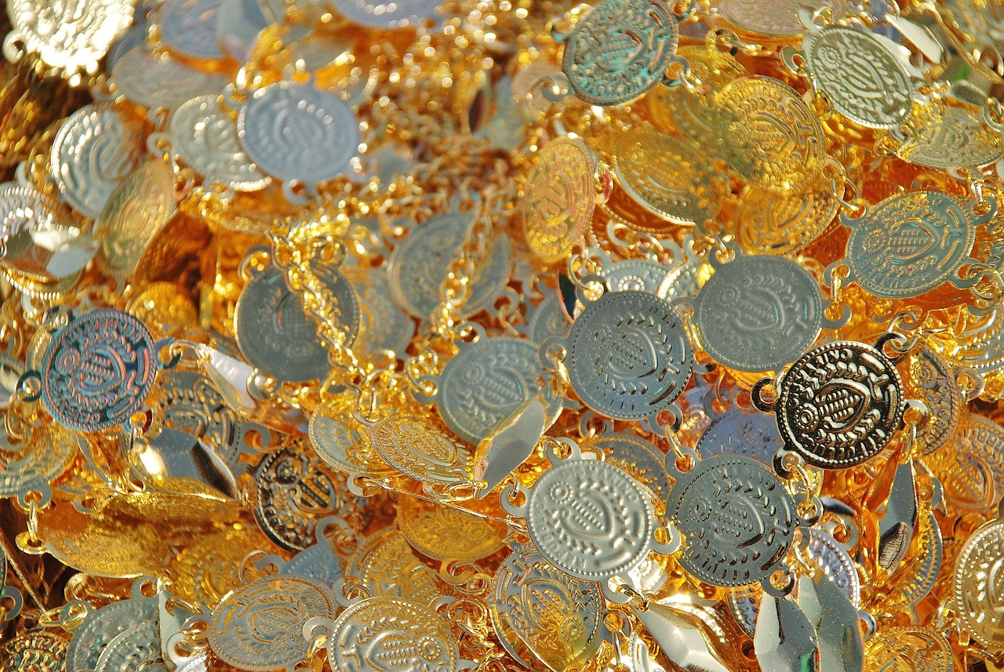
Solomon

Slide 5
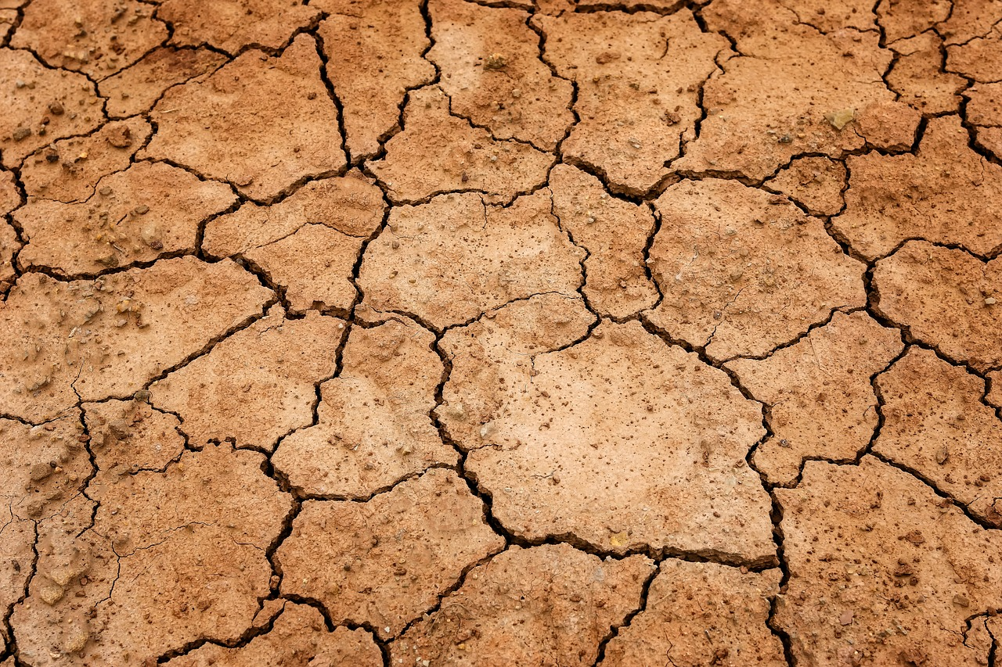
Elijah’s Message

Slide 6
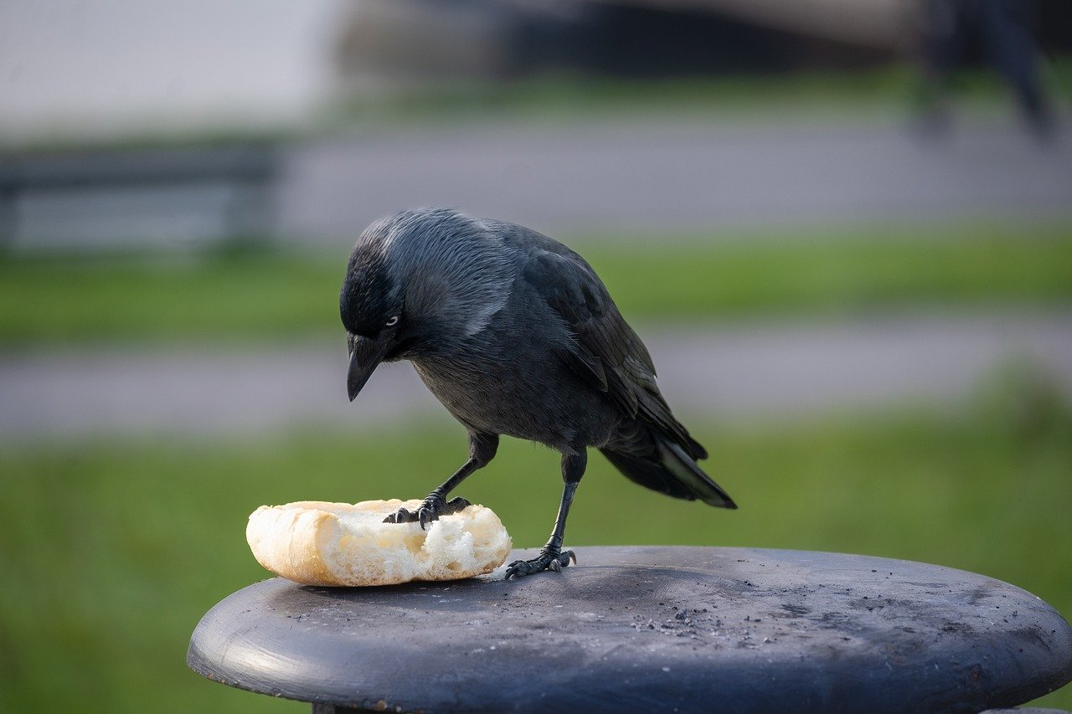
Elijah’s Life

Slide 7
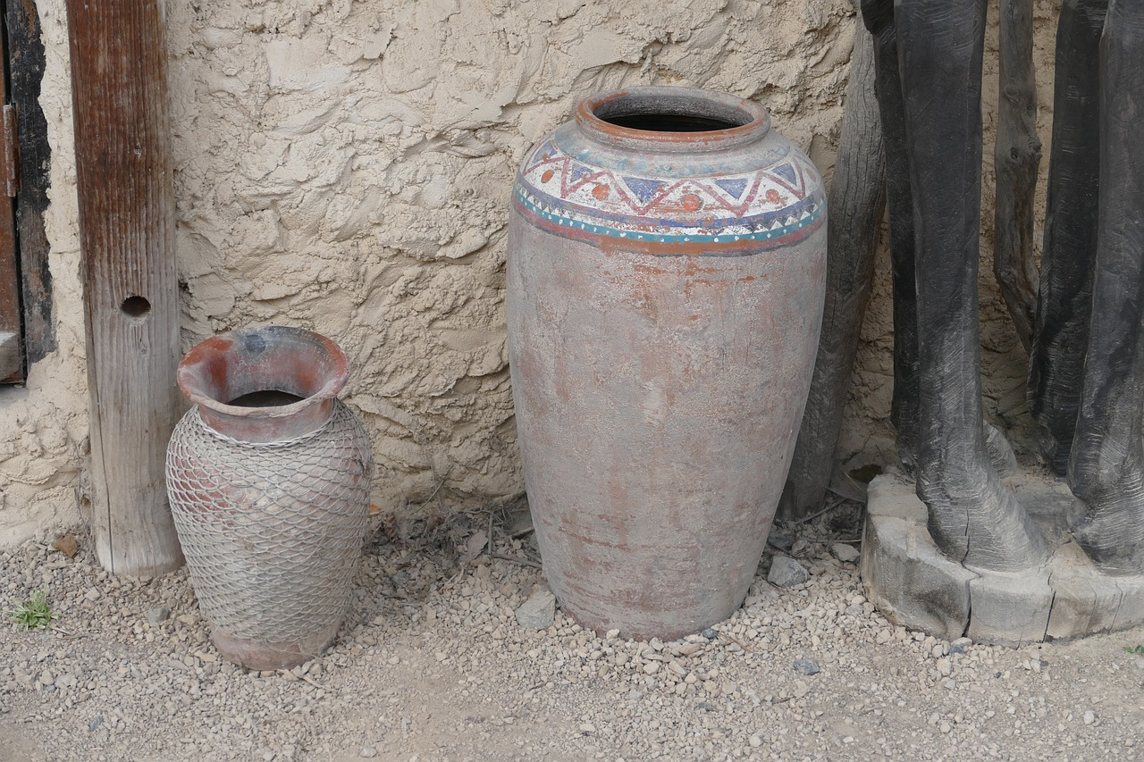
Widow

Slide 8
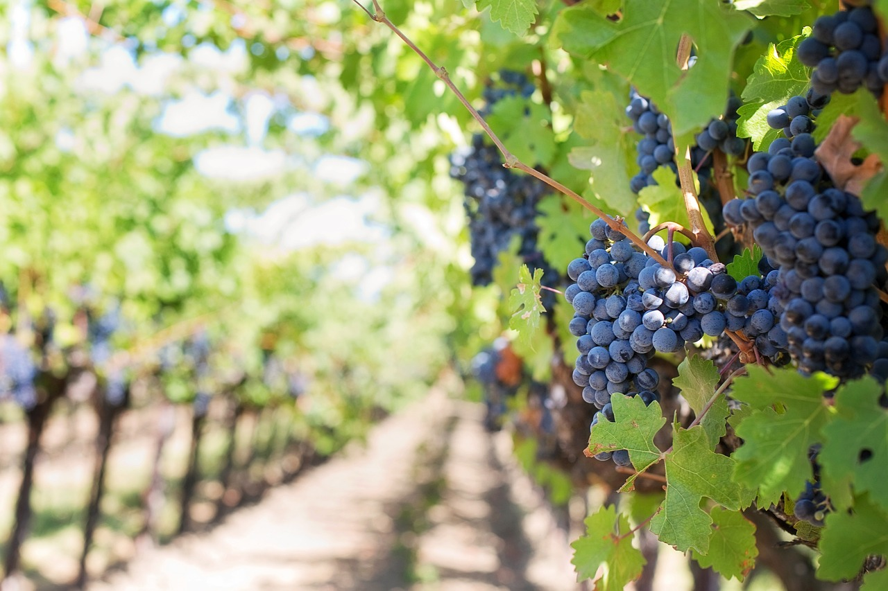
Ahab

Slide 9
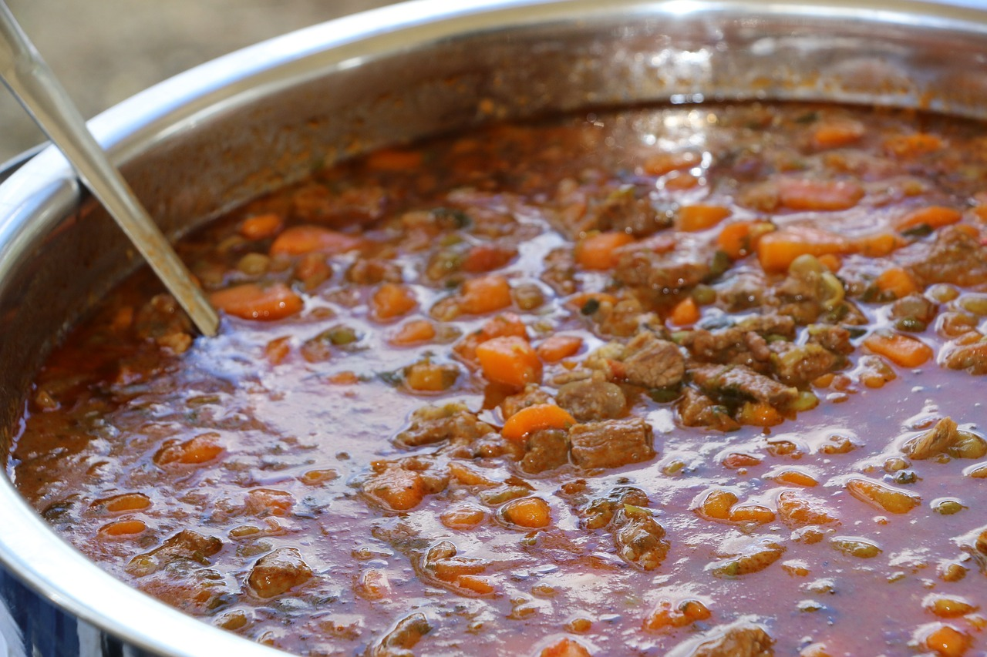
The Stew

Slide 10
Gehazi

Slide 11
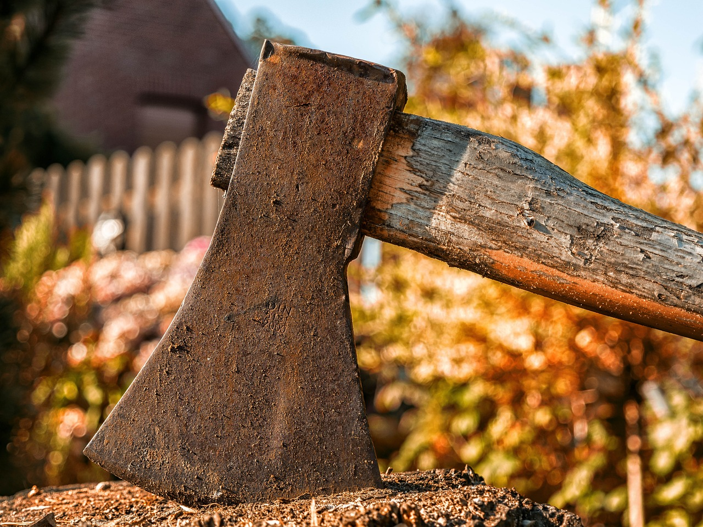
The Axe Head

Slide 12
Application
From The
New Testament

Slide 13
Prayer
Matthew 6:9-11
Pray then like this:
“Our Father in heaven, hallowed be your name.
Your kingdom come, your will be done, on earth as it is in heaven.
Give us this day our daily bread,

Slide 14
Contentment
1 Timothy 6:6-9
But godliness with contentment is great gain, for we brought nothing into the world, and we cannot take anything out of the world. But if we have food and clothing, with these we will be content. But those who desire to be rich fall into temptation, into a snare, into many senseless and harmful desires that plunge people into ruin and destruction.

Slide 15
Sharing
Luke 3:10-11
And the crowds asked him, “What then shall we do?” And he answered them, “Whoever has two tunics is to share with him who has none, and whoever has food is to do likewise.”

