Slide 1
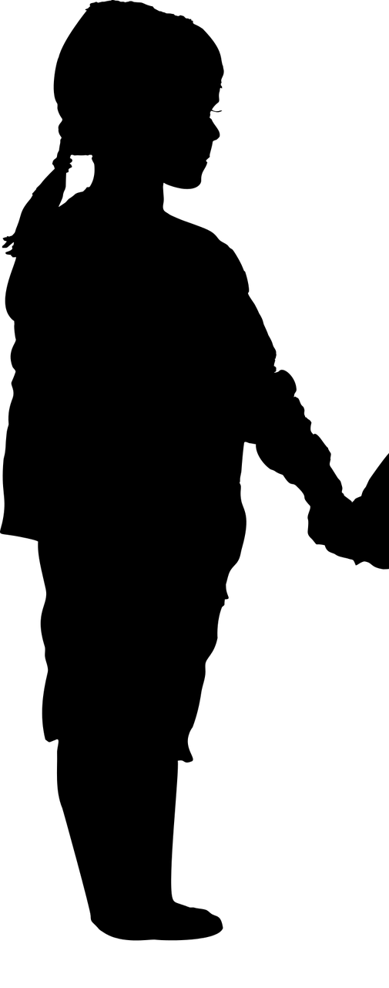
Unsung Heroes

Slide 2
Obadiah

Slide 3
Elijah
Obadiah

Slide 4
His Circumstances
Elijah
What He Did
What Made Him Great
Obadiah

Slide 5
Naaman’s Wife’s Servant Girl

Slide 6
Elisha
Servant Girl

Slide 7
Her Circumstances
Elisha
What She Did
What Made Her Great
Servant Girl

Slide 8
Emed-Melech

Slide 9
Jeremiah
Ebed-Melech

Slide 10
Jeremiah
His Circumstances
What He Did
What Made Him Great
Ebed Melech

Slide 11
What these heroes had in common:
1. Used their circumstances
2. Trusted God
3. Helped someone else
And they each made a lasting difference!

