Slide 1
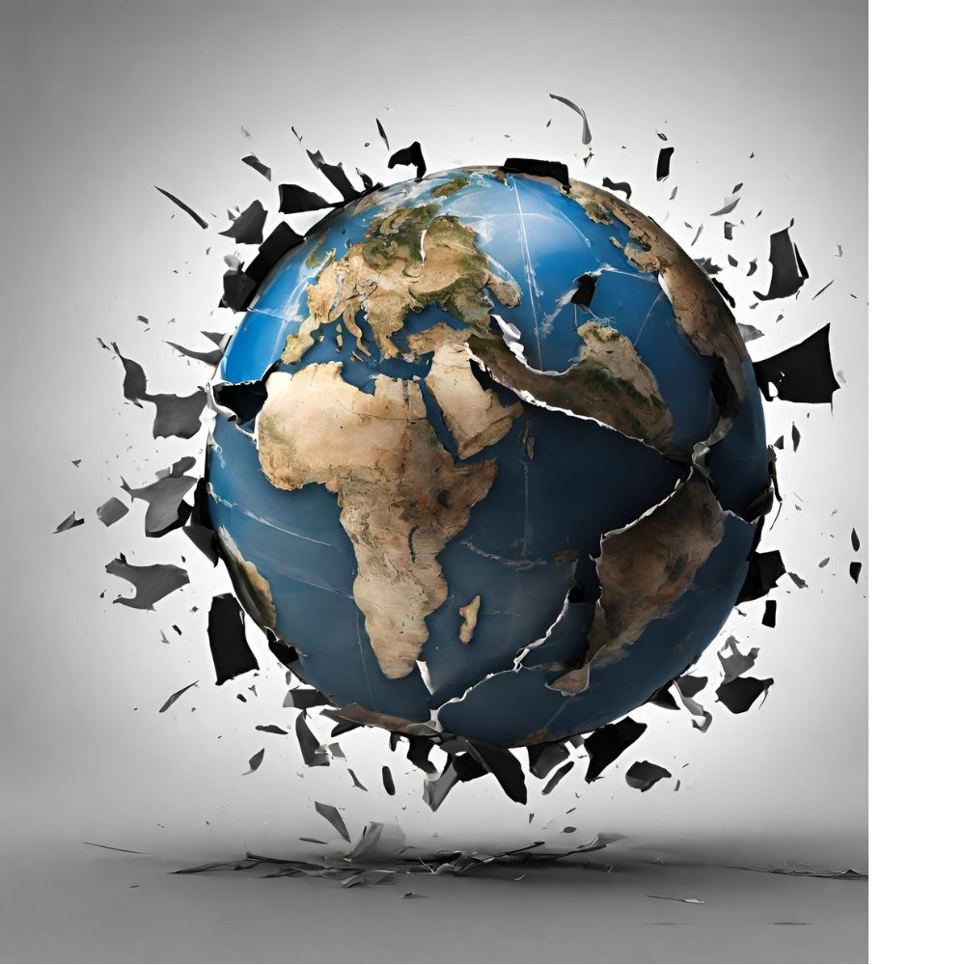
Living in a Broken World

Slide 2
How Jesus
Wants Us to Understand
the World

Slide 3
As a Sabotaged Farm
Matthew 13:24-30

Slide 4
Matthew 12:33-36
“Either make the tree good and its fruit good, or make the tree bad and its fruit bad, for the tree is known by its fruit. You brood of vipers! How can you speak good, when you are evil? For out of the abundance of the heart the mouth speaks. The good person out of his good treasure brings forth good, and the evil person out of his evil treasure brings forth evil. I tell you, on the day of judgment people will give account for every careless word they speak, for by your words you will be justified, and by your words you will be condemned.”

Slide 5
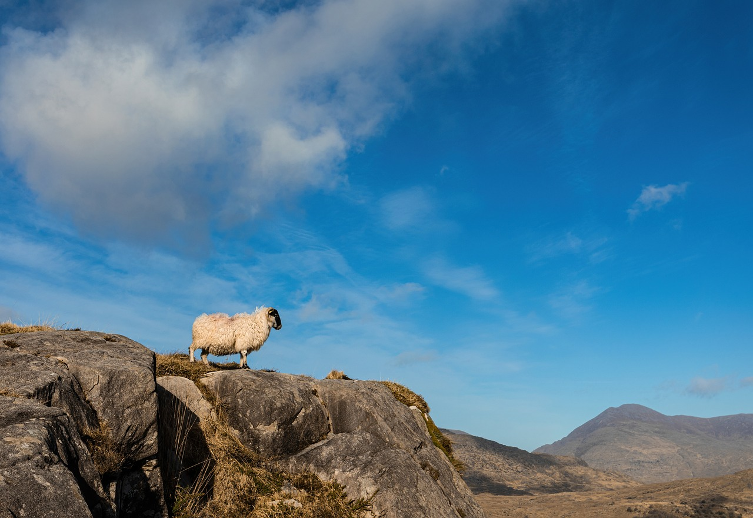
As a Scattered
Flock of Sheep

Slide 6
Matthew 9:36
When he saw the crowds, he had compassion for them, because they were harassed and helpless, like sheep without a shepherd.

Slide 7
Luke 15:3-5
So he told them this parable: “What man of you, having a hundred sheep, if he has lost one of them, does not leave the ninety-nine in the open country, and go after the one that is lost, until he finds it? And when he has found it, he lays it on his shoulders, rejoicing.

Slide 8
As a Scattered
Flock of Sheep
John 10

Slide 9
Matthew 18:12-15
What do you think? If a man has a hundred sheep, and one of them has gone astray, does he not leave the ninety-nine on the mountains and go in search of the one that went astray? And if he finds it, truly, I say to you, he rejoices over it more than over the ninety-nine that never went astray. So it is not the will of my Father who is in heaven that one of these little ones should perish. If your brother sins against you, go and tell him his fault, between you and him alone. If he listens to you, you have gained your brother.

Slide 10
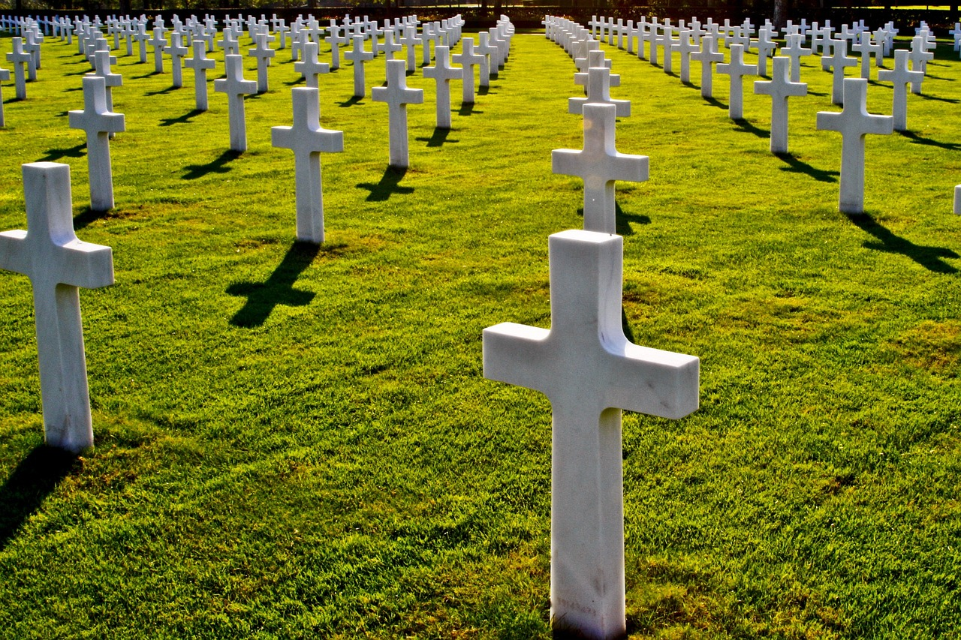
Luke 7:12-15
As Dying

Slide 11
Hebrews 2:14-15
Since therefore the children share in flesh and blood, he himself likewise partook of the same things, that through death he might destroy the one who has the power of death, that is, the devil, and deliver all those who through fear of death were subject to lifelong slavery.

Slide 12
Ephesians 2:1-6
And you were dead in the trespasses and sins in which you once walked, following the course of this world, following the prince of the power of the air, the spirit that is now at work in the sons of disobedience— among whom we all once lived in the passions of our flesh, carrying out the desires of the body and the mind, and were by nature children of wrath, like the rest of mankind. But God, being rich in mercy, because of the great love with which he loved us, even when we were dead in our trespasses, made us alive together with Christ—by grace you have been saved— and raised us up with him and seated us with him in the heavenly places in Christ Jesus

Slide 13
Colossians 3:1-4
If then you have been raised with Christ, seek the things that are above, where Christ is, seated at the right hand of God. Set your minds on things that are above, not on things that are on earth. For you have died, and your life is hidden with Christ in God. When Christ who is your life appears, then you also will appear with him in glory.

Slide 14
So how are we to live in a broken world?

Slide 15
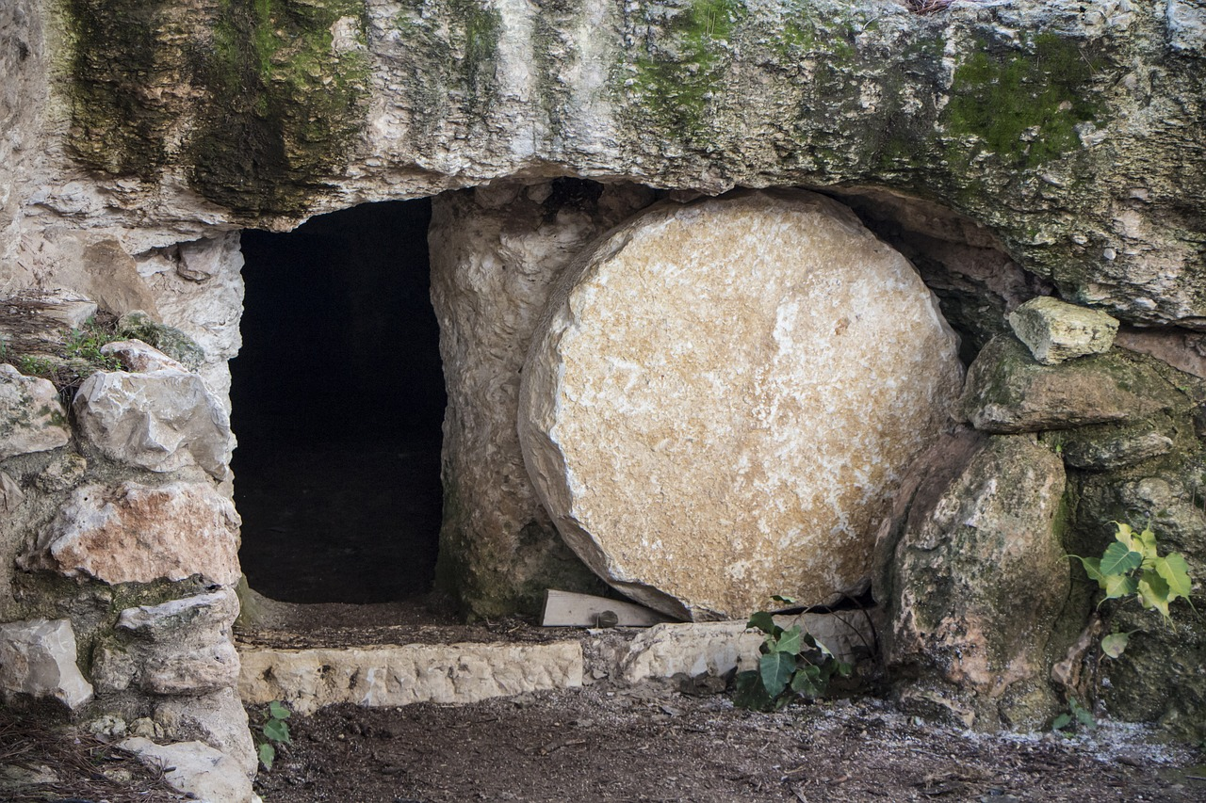
As plants producing good fruit
As a flock of sheep following a good shepherd
As those raised from the dead

