Slide 1
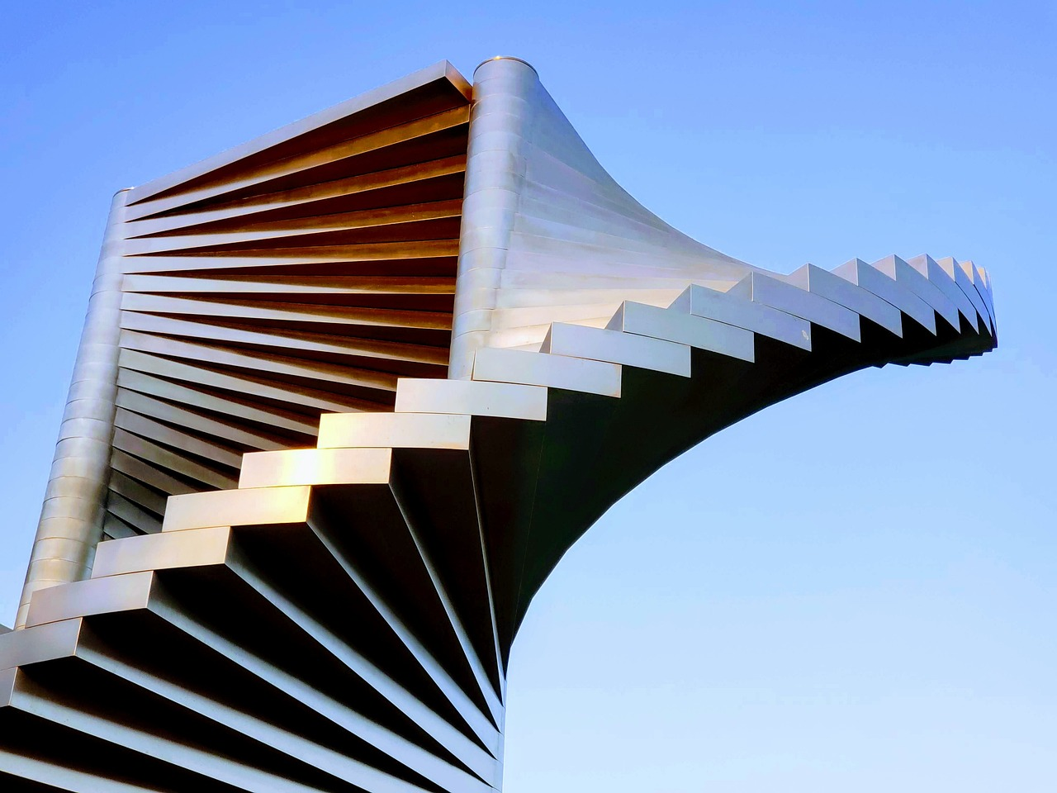
God’s Kingdom Looks Different
is a

Slide 2
God stops them
We are not dispersed
We make a name for ourselves
We build to heaven
We achieve something great for us

Slide 3
Jacob’s Life

Slide 4
Manipulates his brother and takes the birthright
Deceives his father and gets the blessing

Slide 5
Finds himself scared and alone

Slide 9
God will be with him
God stops them
Spread abroad
We are not dispersed
Others blessed through him
We make a name for ourselves
Angels coming down to him
We build to heaven
We achieve something great for us
God gives

Slide 10
Gets tricked into marrying a woman he didn’t want to marry
Tries to manipulate the breeding so he can get his father-in-law’s animals

Slide 11
Finds himself scared & alone again

Slide 12
The Wrestling Match

Slide 13
Gives up his idols.

Slide 14
And God blesses him.

Slide 15
The Difference Between the Two Kingdoms

Slide 16
Selfishly pursuing my goals.
Humbly, gratefully receiving God’s blessings.
Drawing attention to myself.
Sharing those blessings with others.

Slide 17
How Jesus Explained This

Slide 18
Luke 12:29-34
“And do not seek what you are to eat and what you are to drink, nor be worried. For all the nations of the world seek after these things, and your Father knows that you need them. Instead, seek his kingdom, and these things will be added to you. Fear not, little flock, for it is your Father's good pleasure to give you the kingdom. Sell your possessions, and give to the needy. Provide yourselves with moneybags that do not grow old, with a treasure in the heavens that does not fail, where no thief approaches and no moth destroys. For where your treasure is, there will your heart be also.”

Slide 19
Luke 18:9-14
He also told this parable to some who trusted in themselves that they were righteous, and treated others with contempt: “Two men went up into the temple to pray, one a Pharisee and the other a tax collector. The Pharisee, standing by himself, prayed thus: ‘God, I thank you that I am not like other men, extortioners, unjust, adulterers, or even like this tax collector. I fast twice a week; I give tithes of all that I get.’ But the tax collector, standing far off, would not even lift up his eyes to heaven, but beat his breast, saying, ‘God, be merciful to me, a sinner!’ I tell you, this man went down to his house justified, rather than the other. For everyone who exalts himself will be humbled, but the one who humbles himself will be exalted.”

Slide 22
Which kingdom does my
life look most like?

