Slide 1
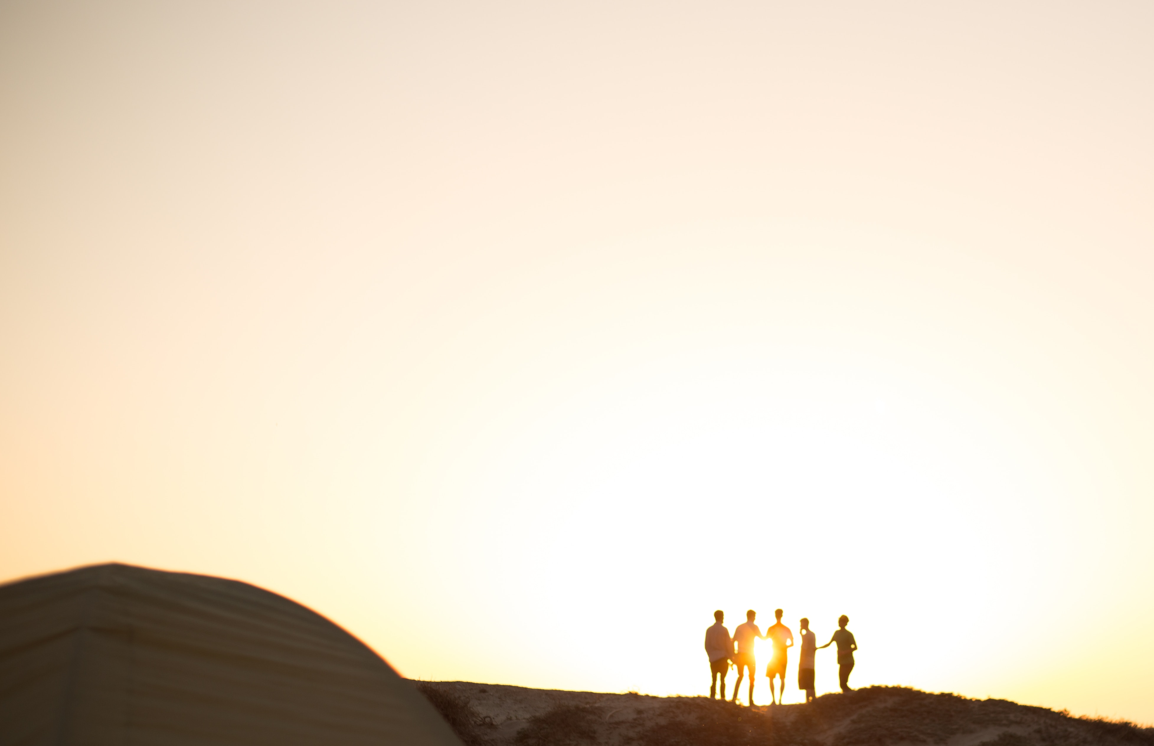
When God’s People Seek God TOGETHER

Slide 2
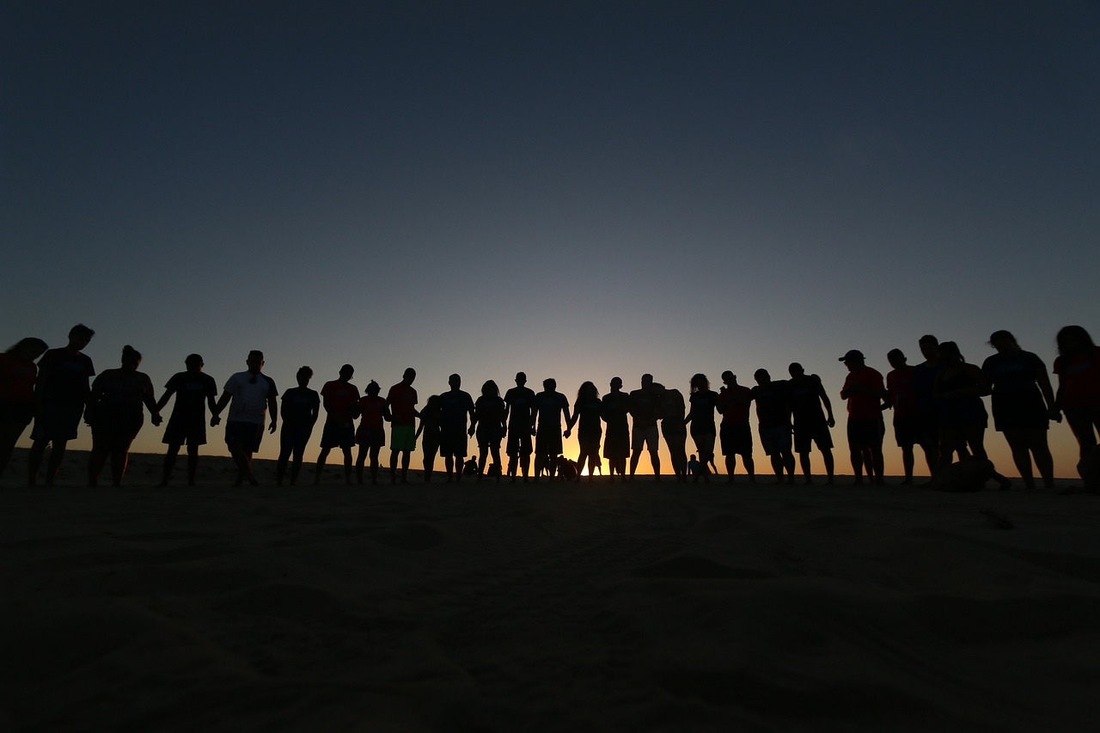
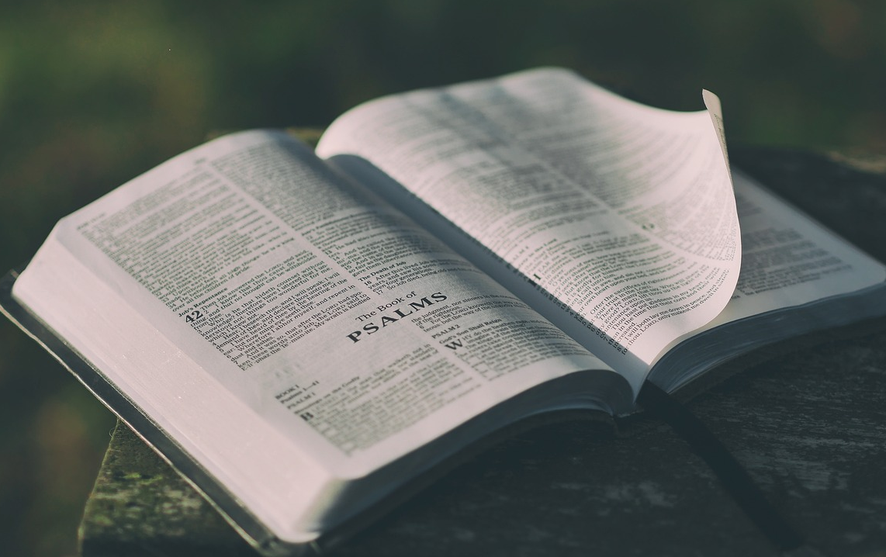
Starts with
God’s word.

Slide 3
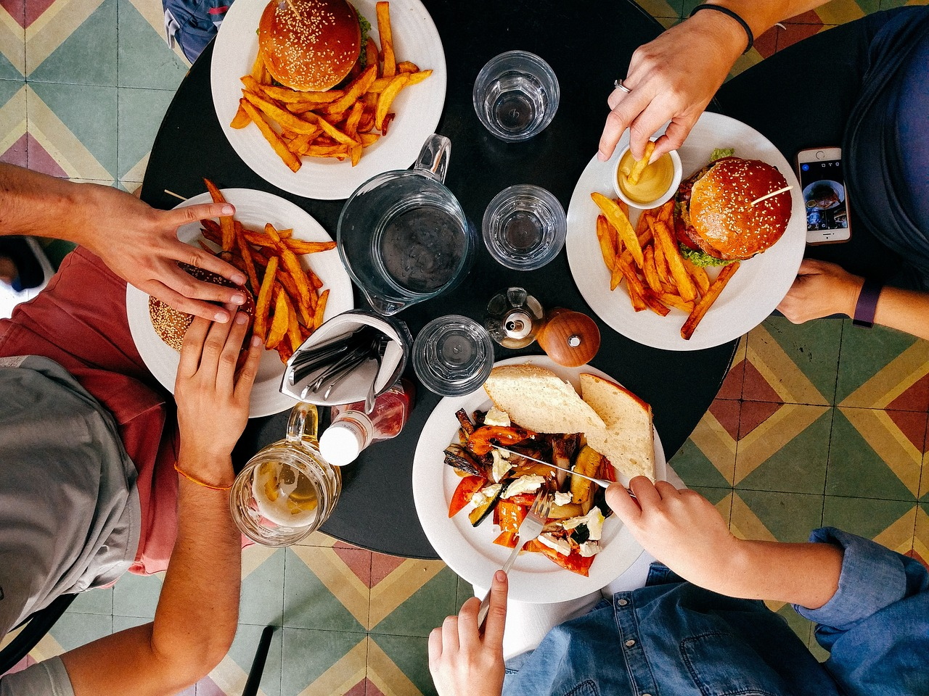

Slide 4
Joy

Slide 5
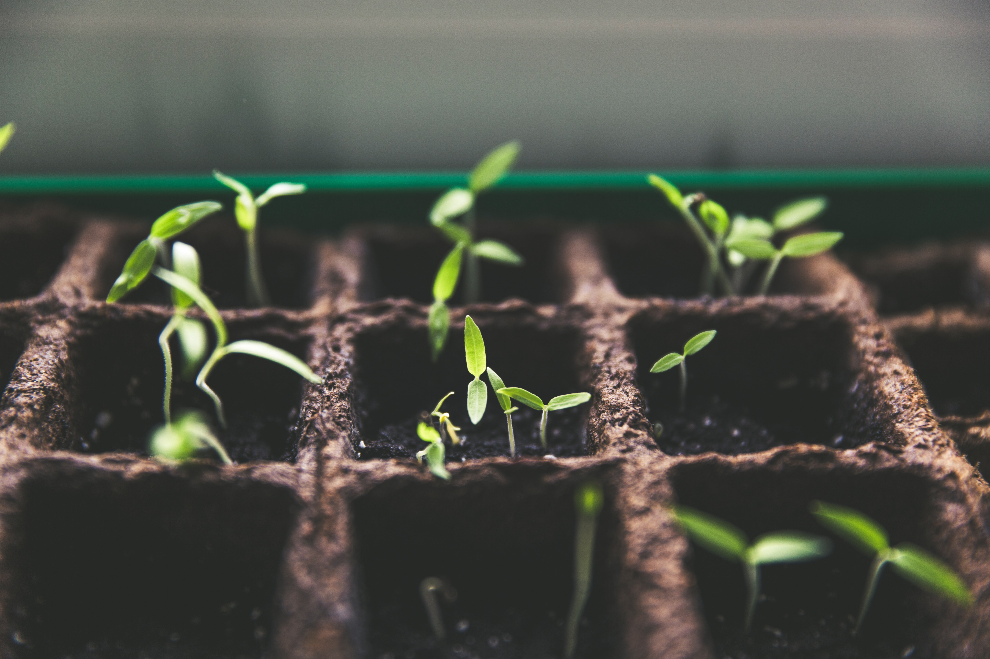

Slide 6
Growth

Slide 8
Repentance

Slide 9
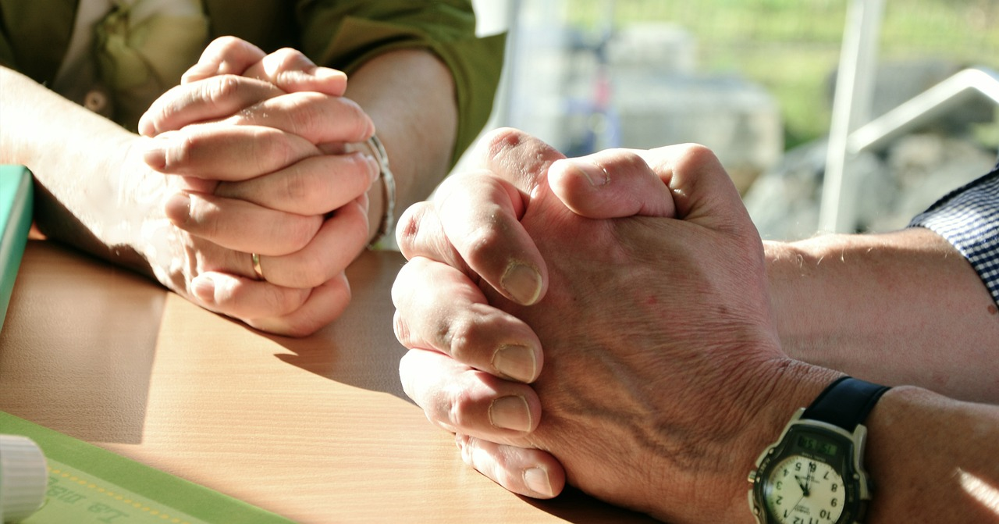

Slide 10
Worship

Slide 12
New Life

