Slide 1
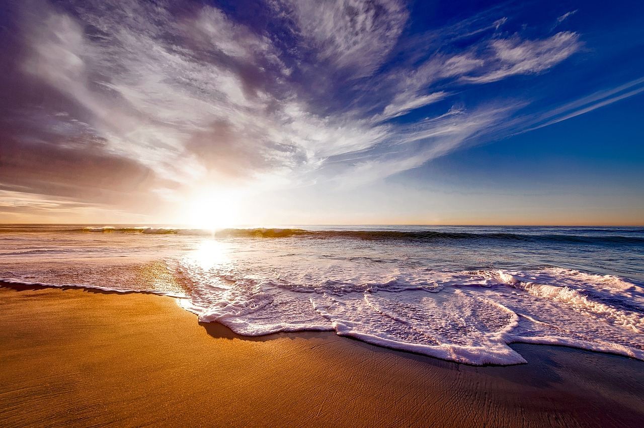
Tell of His Salvation From Day to Day

Slide 2
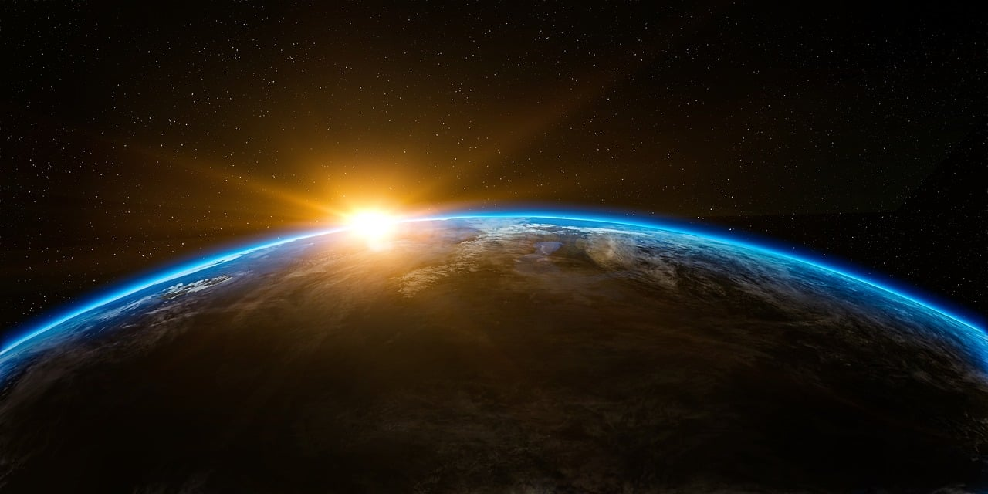
Everyone Should Worship God

Slide 3
Acts 4:20
“We cannot stop speaking of what we have seen and heard.”

Slide 4
Telling Others
Salvation
Glory

Slide 5
John 1:14
And the Word became flesh and dwelt among us, and we have seen his glory, glory as of the only Son from the Father, full of grace and truth.

Slide 6
Telling Others
Salvation
Glory
Works

Slide 7
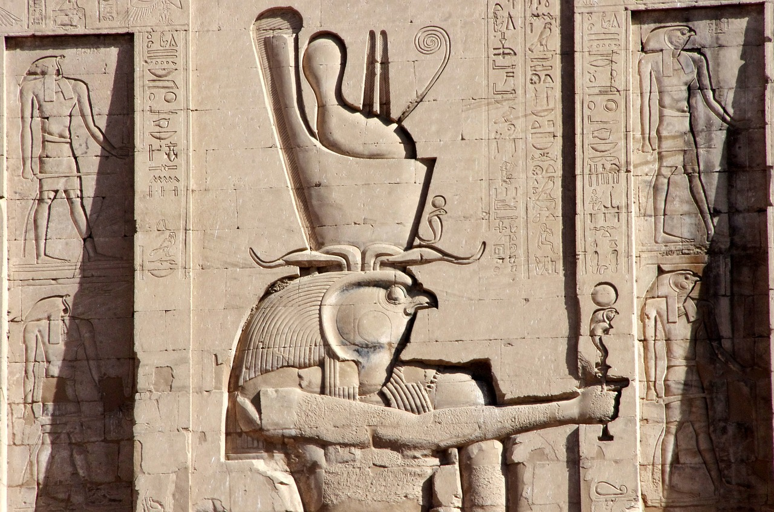
The Problem of Idolatry

Slide 8
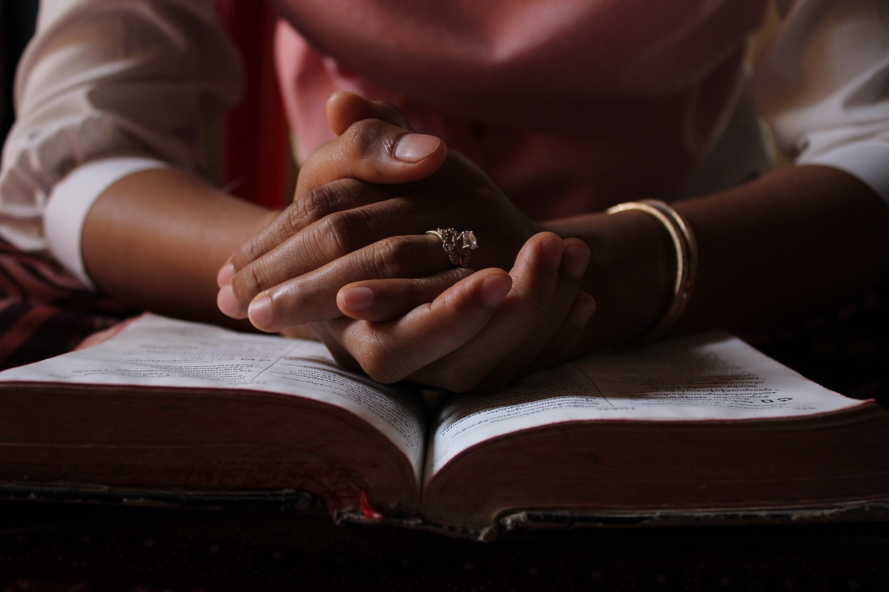
The Right
Kind of Worship

Slide 9
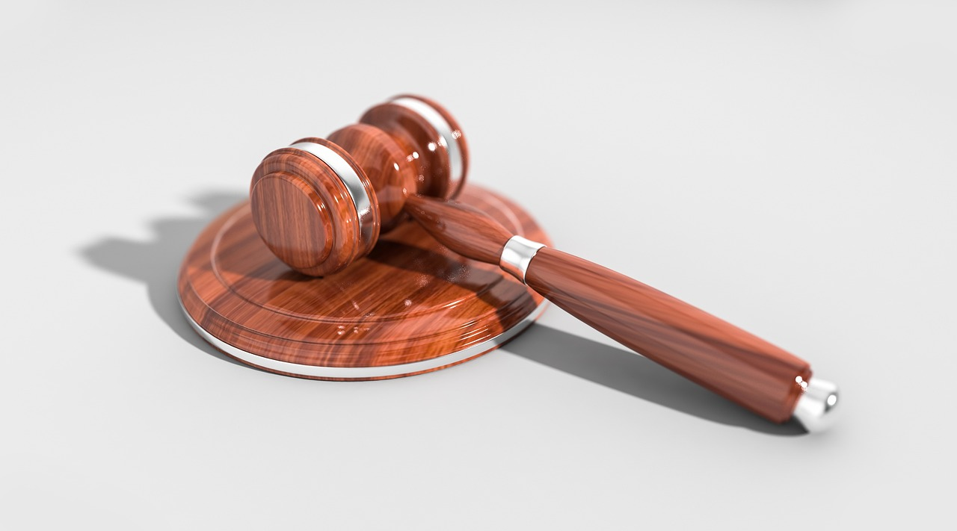
God’s Judgment

Slide 10
Matthew 28:18-19
And Jesus came and said to them, “All authority in heaven and on earth has been given to me. Go therefore and make disciples of all nations, baptizing them in the name of the Father and of the Son and of the Holy Spirit…

Slide 11
God’s Judgment

Slide 12
Acts 17:31
because he has fixed a day on which he will judge the world in righteousness by a man whom he has appointed; and of this he has given assurance to all by raising him from the dead.”

Slide 13
Acts 24:25
And as he reasoned about righteousness and self-control and the coming judgment, Felix was alarmed and said, “Go away for the present. When I get an opportunity I will summon you.”

Slide 14
God’s Judgment

Slide 15
Do you love God enough to want to tell others
about Him?

