Slide 1
People

Slide 2
Christians
Church visitors
Total strangers
Rude people
Different Religion
Coworkers
Friends
Customers
People in the news
Drivers
Family
People I’ve never met
Person on the Internet
Rich
Poor
Different Race
Neighbors
People I’ve heard bad things about

Slide 3
How we might think about people

Slide 4
As someone like me
As a friend/foe
As a tool
As a thing

Slide 5
How God wants us to think about people

Slide 6
As
Someone Who
Resembles God

Slide 7
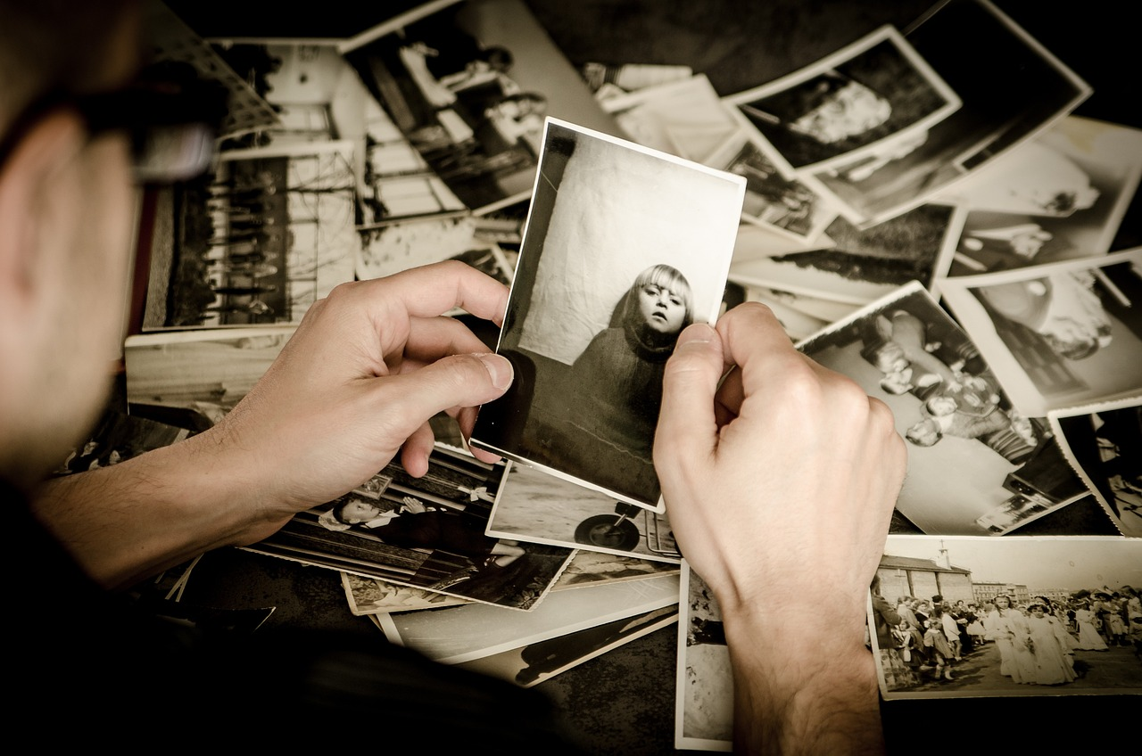
Genesis 1:26-27
Genesis 9:3-6

Slide 8
As someone loved by God

Slide 9
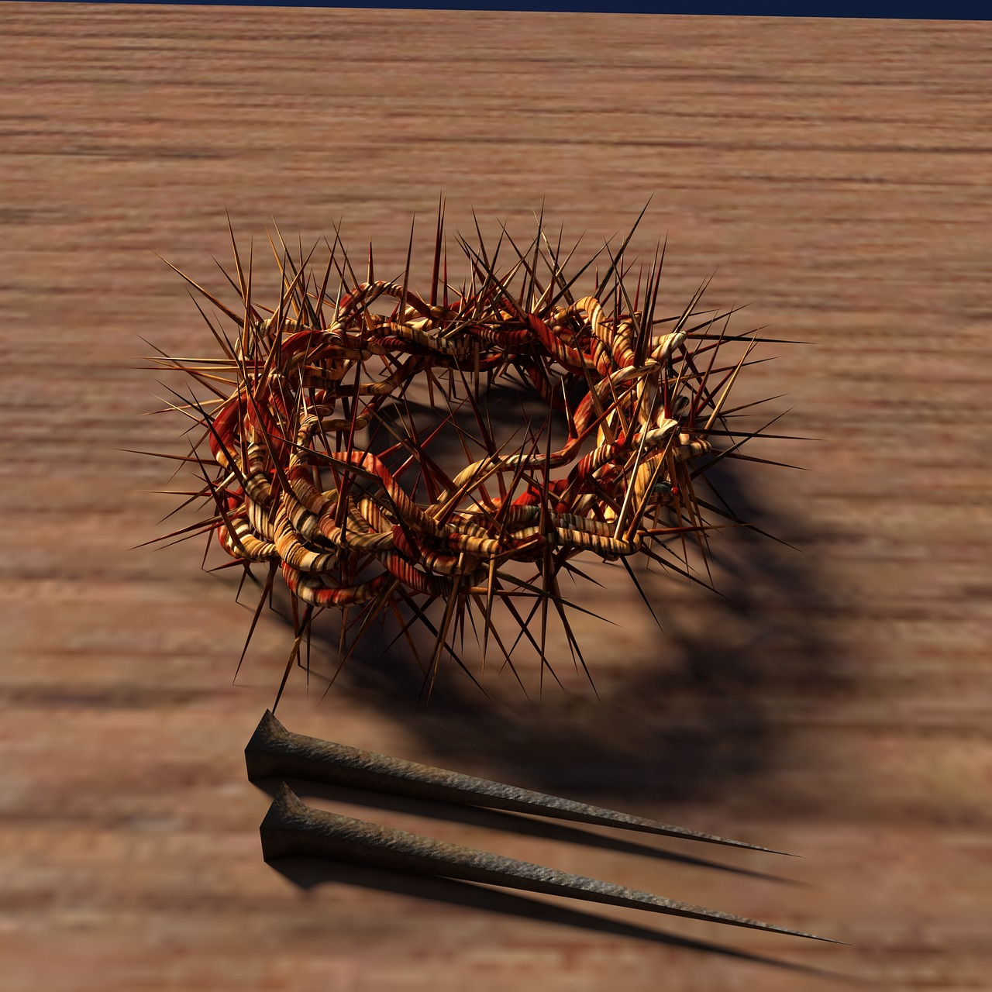
Romans 5:6-8
Matthew 5:43-48

Slide 10
As someone with an eternal destination

Slide 11
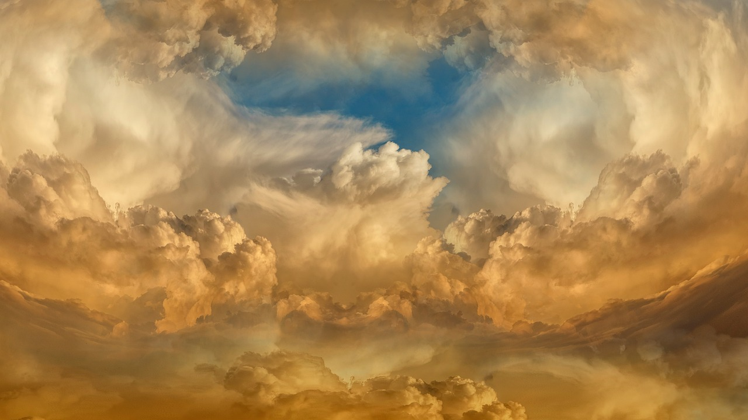
Matthew 25:46
Jude 22-23

Slide 12
“There are no ordinary people. You have never talked to a mere mortal. Nations, cultures, arts, civilizations - these are mortal, and their life is to ours as the life of a gnat. But it is immortals whom we joke with, work with, marry, snub and exploit - immortal horrors or everlasting splendors.”
- C. S. Lewis

Slide 13
As someone who is lost and needs direction

Slide 14
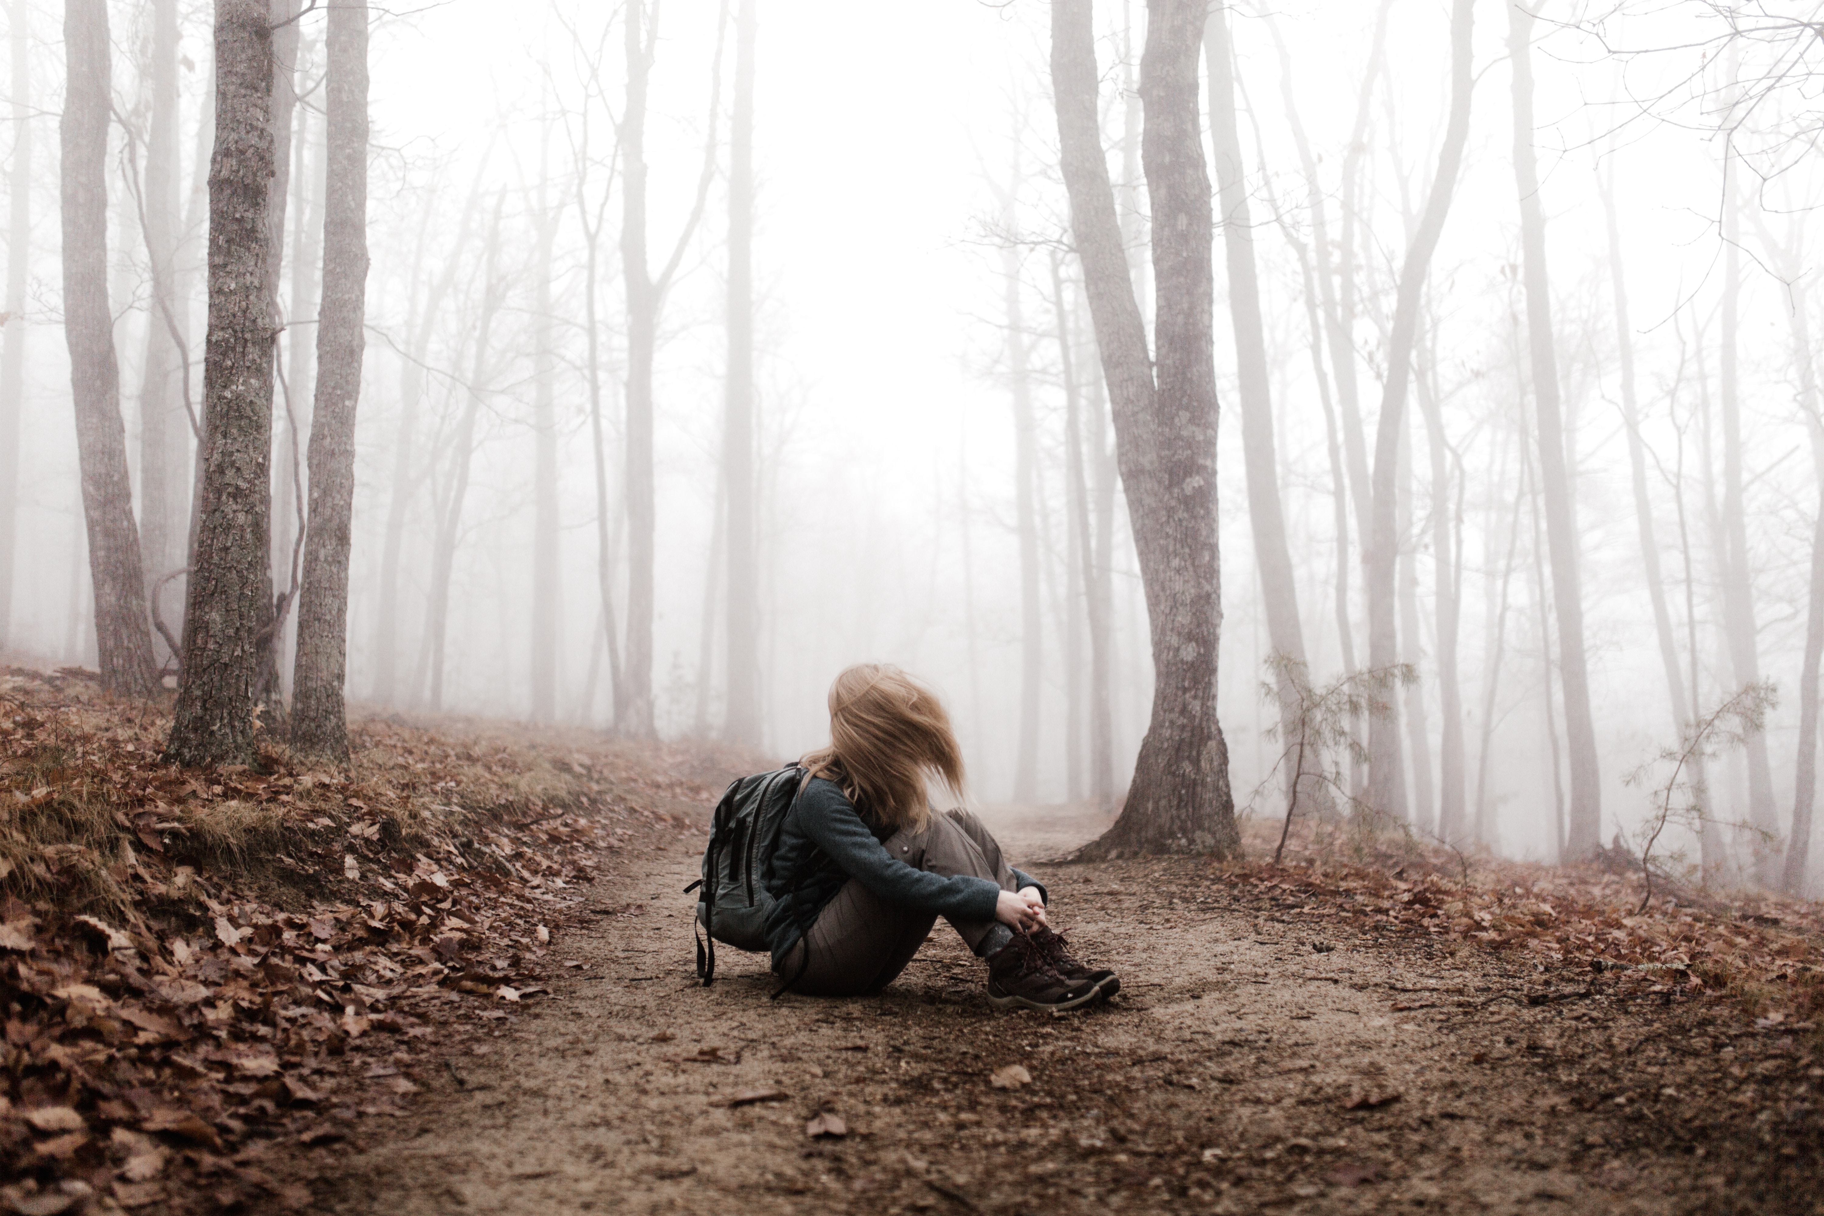
Luke 15:1-7
Luke 19:1-10

Slide 15
How This Should Shape Our Lives

Slide 16
Time with People

Slide 17
John 4:9-10
9 The Samaritan woman said to him, “How is it that you, a Jew, ask for a drink from me, a woman of Samaria?” (For Jews have no dealings with Samaritans.) 10 Jesus answered her, “If you knew the gift of God, and who it is that is saying to you, ‘Give me a drink,’ you would have asked him, and he would have given you living water.”

Slide 18
Time with People
Helping People

Slide 19
Luke 10:27-37
31 Now by chance a priest was going down that road, and when he saw him he passed by on the other side. 32 So likewise a Levite, when he came to the place and saw him, passed by on the other side. 33 But a Samaritan, as he journeyed, came to where he was, and when he saw him, he had compassion. 34 He went to him and bound up his wounds, pouring on oil and wine. Then he set him on his own animal and brought him to an inn and took care of him.

Slide 20
Time with People
Helping People
Teaching People

Slide 21
Mark 16:15-16
15 And he said to them, “Go into all the world and proclaim the gospel to the whole creation. 16 Whoever believes and is baptized will be saved, but whoever does not believe will be condemned.

Slide 22
Time with People
Helping People
Teaching People

