Slide 1
Getting
Good
at Life

Slide 2
Getting Started

Slide 3
Do you want to learn?
Do you fear God?

Slide 4
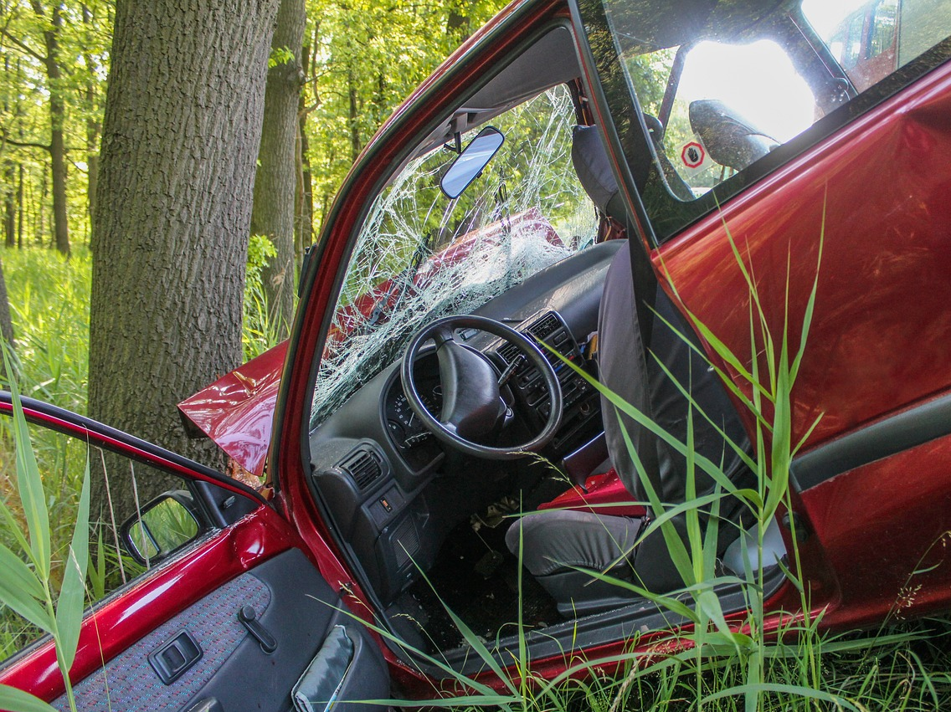
A Story of Taking the Wrong Path

Slide 5
Why is It So Hard to Make Good Choices Sometimes?

Slide 6
Because…
There’s a lot of other noise.
It’s fun to be dumb.
It’s not fun to be corrected.

Slide 7
Another Story of Taking the Wrong Path

Slide 8
A Story of Taking the Right Path

Slide 9
The Pursuit
The Discovery
The Result

Slide 10
The Key
Don’t lean on your own understanding.
Trust in
the Lord.

Slide 11
The best way to
get good at life
is to realize
you’re not good at life
but you
know someone who is.

