Slide 1
Jeremiah 2:10-11
For cross to the coasts of Cyprus and see, or send to Kedar and examine with care; see if there has been such a thing. Has a nation changed its gods, even though they are no gods?

Slide 2
Jeremiah 2:32
Can a virgin forget her ornaments, or a bride her attire? Yet my people have forgotten me days without number.

Slide 3
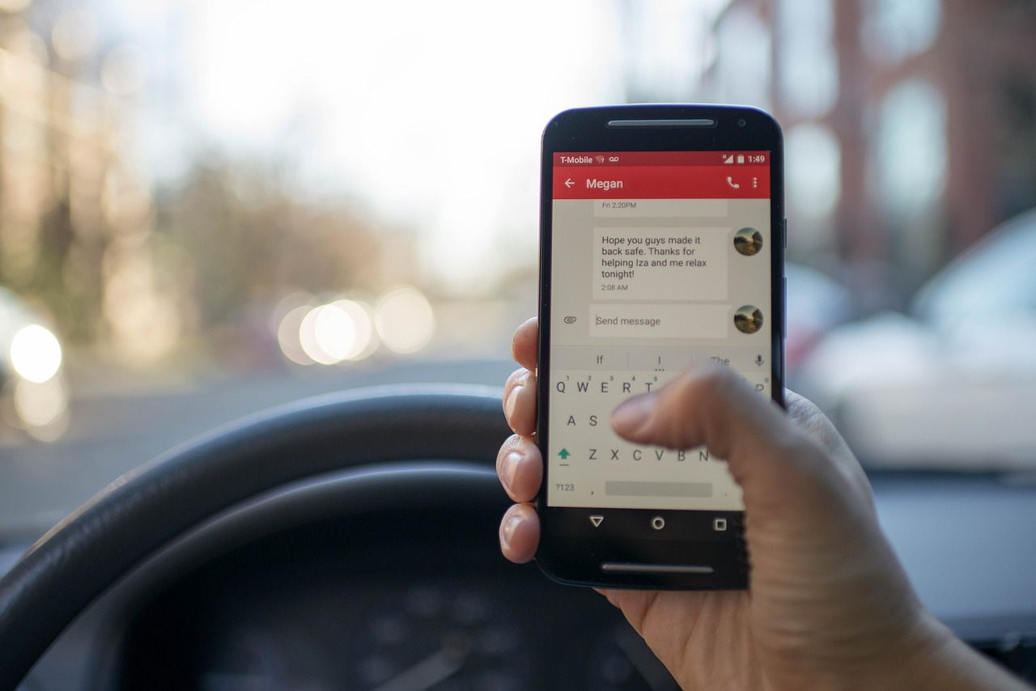
5 Things to Think About When You Get Distracted

Slide 4
1. Think About What God Has Done for You
Gift
Gift
Other Things
God
Gift

Slide 5
2. Think About Yourself Honestly
Other Things
God

Slide 6
3. Think About What You’re Pursuing
Other Things
God

Slide 7
4. Think About How These Pursuits are Shaping You
Other Things
God

Slide 8
5. Think About How God is Pursuing You
Other Things
God

