Slide 1
Feeling What God Feels
God’s Grief

Slide 2
God’s Grief in the Old Testament

Slide 3
The Flood
Genesis 6:5-6

Slide 4
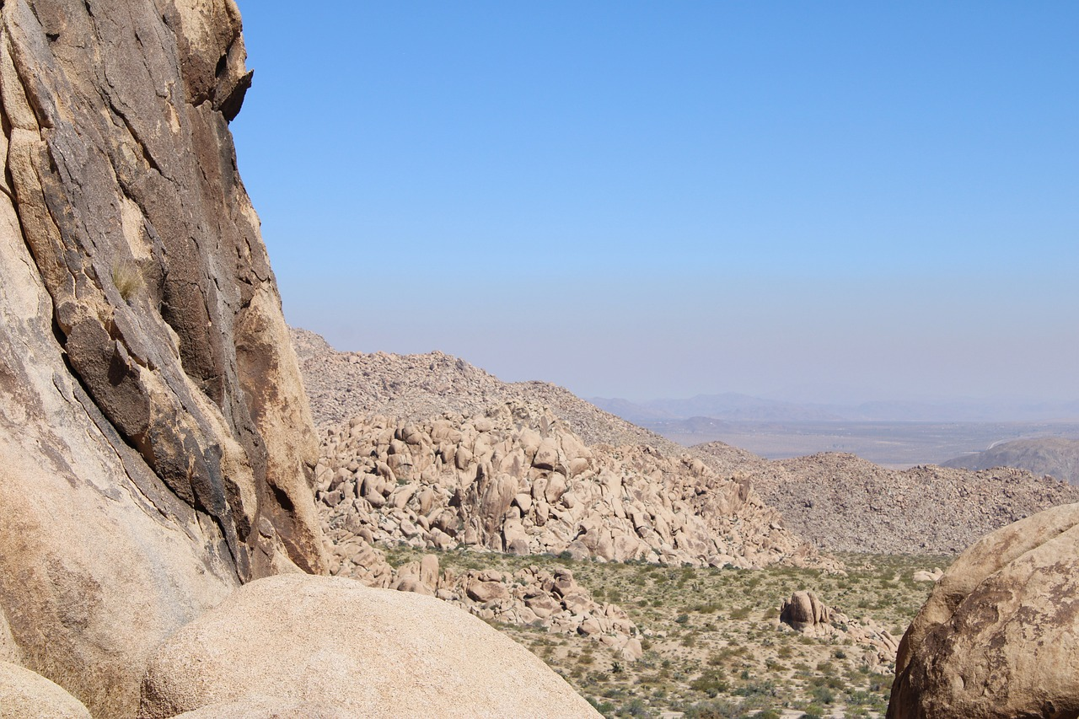
Wilderness
Psalm 78

Slide 5
God’s Grief in Christ

Slide 6
Jesus Felt God’s Grief
Mark 3

Slide 7
Jesus Bore That Grief
Isaiah 53

Slide 8
Our Grief

Slide 9
1.
We Need to Feel Grief Over Our Sin

Slide 10
James 4:8-10
Draw near to God, and he will draw near to you. Cleanse your hands, you sinners, and purify your hearts, you double-minded. Be wretched and mourn and weep. Let your laughter be turned to mourning and your joy to gloom. Humble yourselves before the Lord, and he will exalt you.

Slide 11
2.
We Need to Feel Grief Over Others’ Sin

Slide 12
Ezra 10:6
Then Ezra withdrew from before the house of God and went to the chamber of Jehohanan the son of Eliashib, where he spent the night, neither eating bread nor drinking water, for he was mourning over the faithlessness of the exiles.

Slide 13
3.
Seeing God’s Grief Should Keep Us From Sin

Slide 14
Isaiah 63:7-14
Ephesians 4:30
And do not grieve the Holy Spirit of God, by whom you were sealed for the day of redemption.

Slide 15
4.
Seeing God’s Grief Should Lead Us to Repentance

Slide 16
Ezekiel 6:8-9
“Yet I will leave some of you alive. When you have among the nations some who escape the sword, and when you are scattered through the countries, then those of you who escape will remember me among the nations where they are carried captive, how I have been broken over their whoring heart that has departed from me and over their eyes that go whoring after their idols. And they will be loathsome in their own sight for the evils that they have committed, for all their abominations.”

