Slide 1
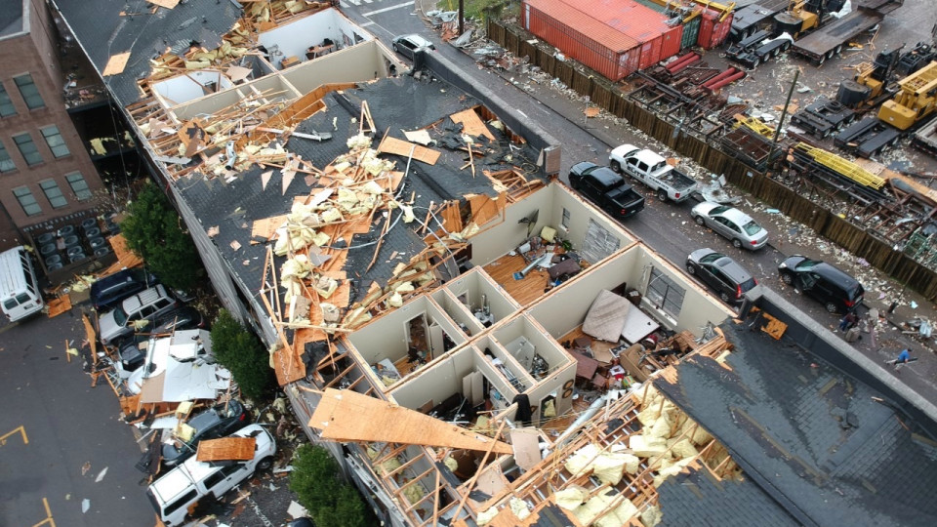

Slide 2
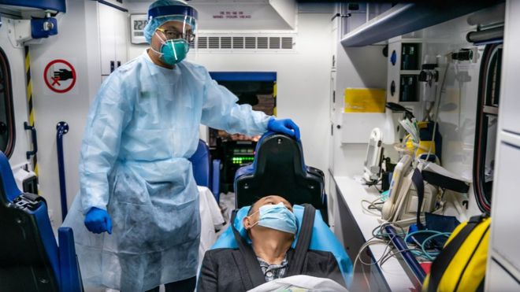

Slide 4
How Do I Trust God During Uncertain Times?

Slide 5
ISRAEL
SYRIA
Pekah
Rezin
JUDAH
Don’t be afraid.
FEAR
Ahaz
Isaiah

Slide 6
Why Should I Not Be Afraid?

Slide 7
Perspective
Wrong view of power
Wrong view of time

Slide 8
Explanation
Rezin
Damascus
Syria

Slide 9
Explanation
Pekah
Samaria
(son of Remaliah)
Israel
(Ephraim)

Slide 10
Explanation
Pekah
Samaria
(son of Remaliah)
Israel
65 Years
(Ephraim)

Slide 11
Why is it not worth worrying about?
Because they’re just people.

Slide 12
Bottom Line:
“If you are not firm in faith,
you will not be firm at all.”

Slide 13
How Jesus Explained This
Don’t be afraid of people
Why?
People are very limited
God is very powerful
God cares about you

Slide 14
Fear
Confidence
See problems as very big
See God as very big

Slide 15
Why This Matters So Much

Slide 16
How we think
How we live

Slide 17
Living Without Faith

Slide 18
ISRAEL
SYRIA
Pekah
Rezin
JUDAH
FEAR
Ahaz

Slide 19
ISRAEL
SYRIA
Pekah
Rezin
ASSYRIA
Tiglath-Pileser
JUDAH
SIN
Ahaz

Slide 20
Living By Faith

Slide 21
GOD
Enemy
Prepares
Encourages
Prays
JUDAH
Hezekiah

Slide 22
How Do I Get This Kind of Faith?

Slide 23
God wants to help us with our faith.

Slide 24
No, thanks.

Slide 25
What would be the ultimate sign?

Slide 26
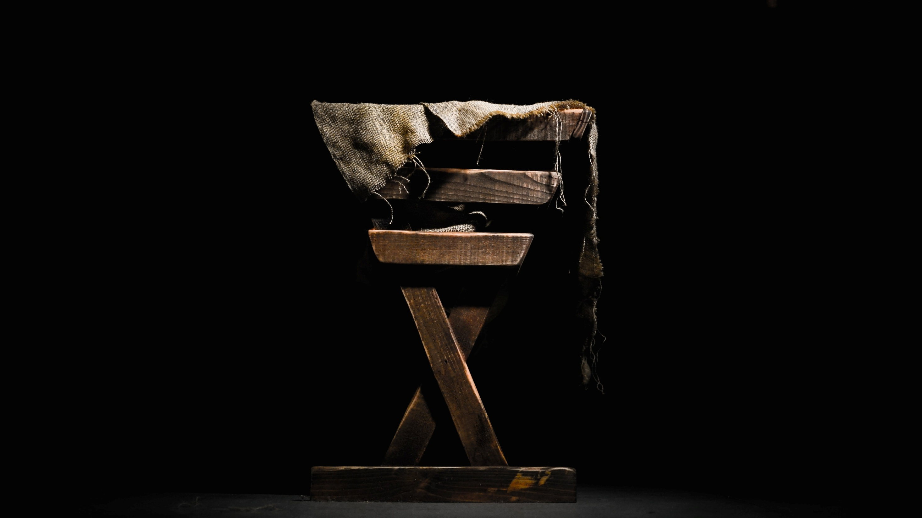
God With Us

Slide 27
ISRAEL
SYRIA
Pekah
Rezin
ASSYRIA
Tiglath-Pileser
JUDAH
Ahaz

Slide 28
How God’s Sign Changes Everything

Slide 29
This is why we can trust God.

