Slide 1
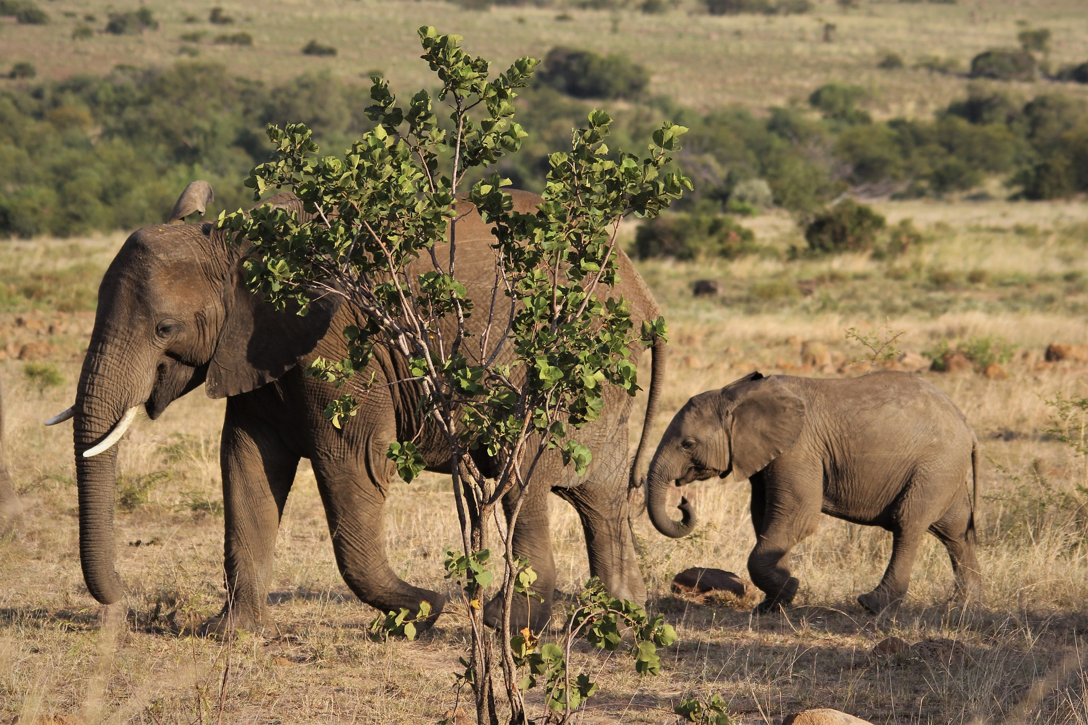
Entrusted with…
LEADERSHIP

Slide 2
…the one who exhorts, in his exhortation; the one who contributes, in generosity; the one who leads, with zeal; the one who does acts of mercy, with cheerfulness.
- Romans 12:8

Slide 3
Church
Family
Work
School
Community
Friends

Slide 4
A Nation on the Verge of Collapse

Slide 5
Ezekiel 22

Slide 6
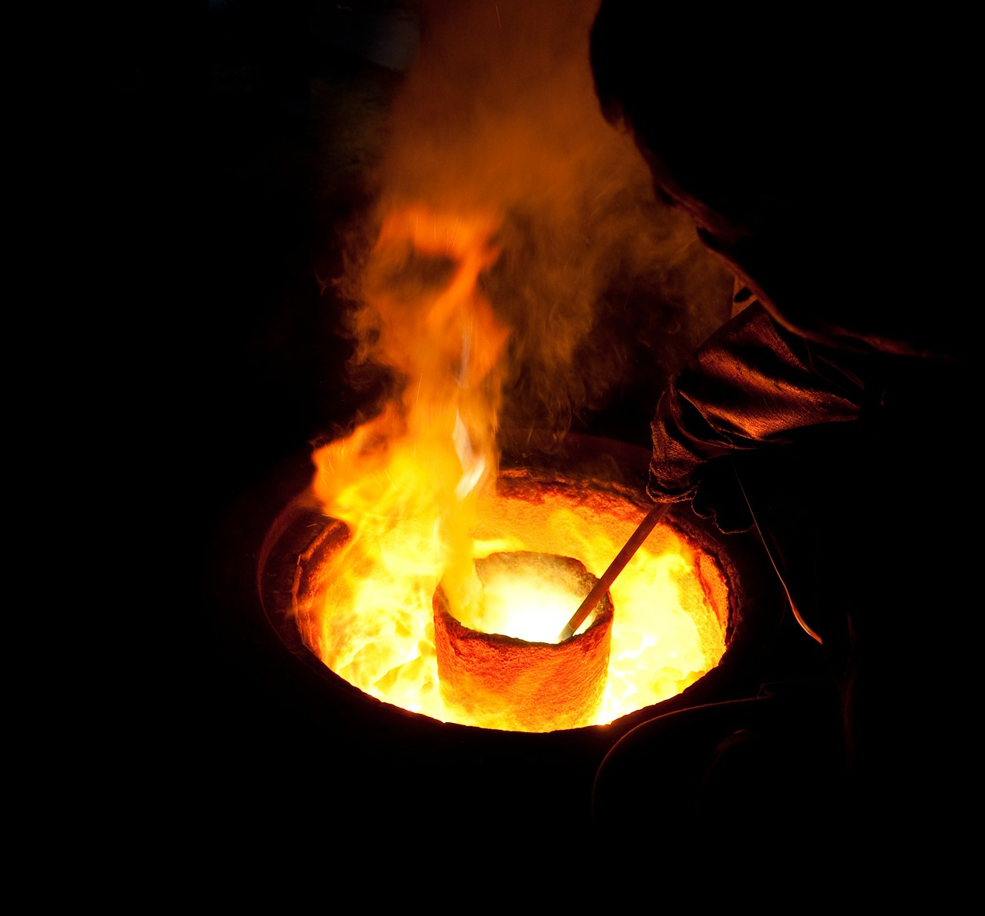
Time to smelt out the dross

Slide 7
How did they get to this point?
Poor Leadership

Slide 8
No concern for others
No concern for truth

Slide 9
What Could Save Them?

Slide 10
1 Person

Slide 11
They needed…
Awareness
Initiative
Courage

Slide 12
This parable was true both spiritually & physically.
Jeremiah 52:6-9

Slide 13
70 Years Later…

Slide 14
Nehemiah

Slide 15
Nehemiah had…
Awareness
Initiative
Courage

Slide 16
No concern for others
No concern for truth
Concern for others
Concern for truth

Slide 17
Nehemiah repaired the wall
both physically & spiritually.

Slide 18
Are you willing to stand in the gap?

