Slide 1
Blessed
The
Life

Slide 2
What does an unblessed
life look like?

Slide 3
What is my ideal life?
Power, money, success, dominance
God gets in the way
Frustrated
Blessed

Slide 4
How do I see God?
Insignificant
God gets in the way
Frustrated
Blessed

Slide 5
What does a blessed life look like?

Slide 6
God gets in the way
I long to be with God
Frustrated
Blessed

Slide 7
What is my ideal life?
A bird nesting in God’s house
I long to be with God
Frustrated
Blessed

Slide 8
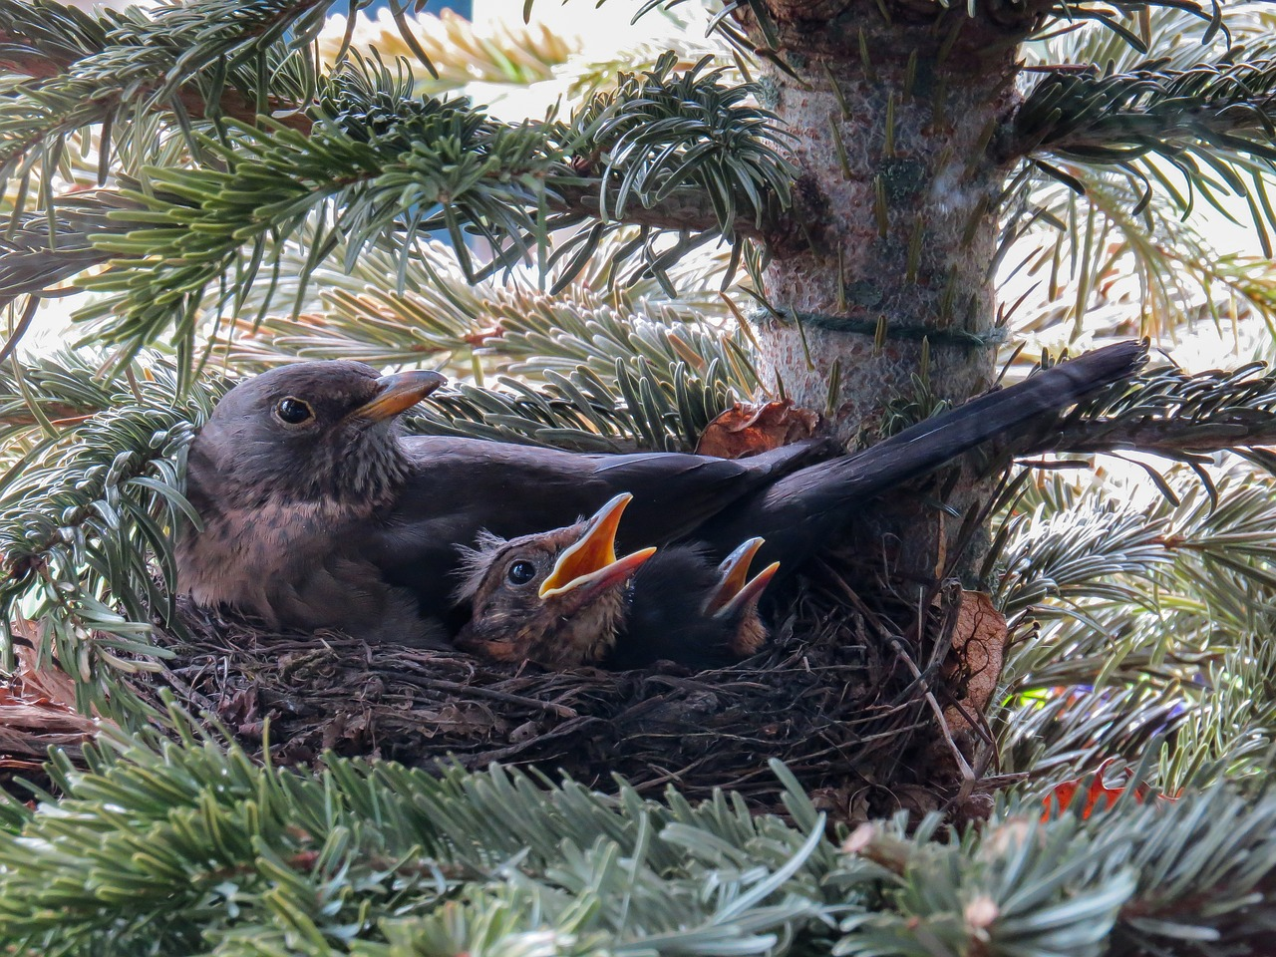

Slide 9
How do I see God?
King
Sun
Shield
I long to be with God
Frustrated
Blessed

Slide 10
How do I grow in this area?

Slide 11
Pursue God
Depend on God
Enjoy God
I long to be with God
Frustrated
Blessed

Slide 12
Where am I on this?
God gets in the way
I long to be with God
Frustrated
Blessed

