Slide 1
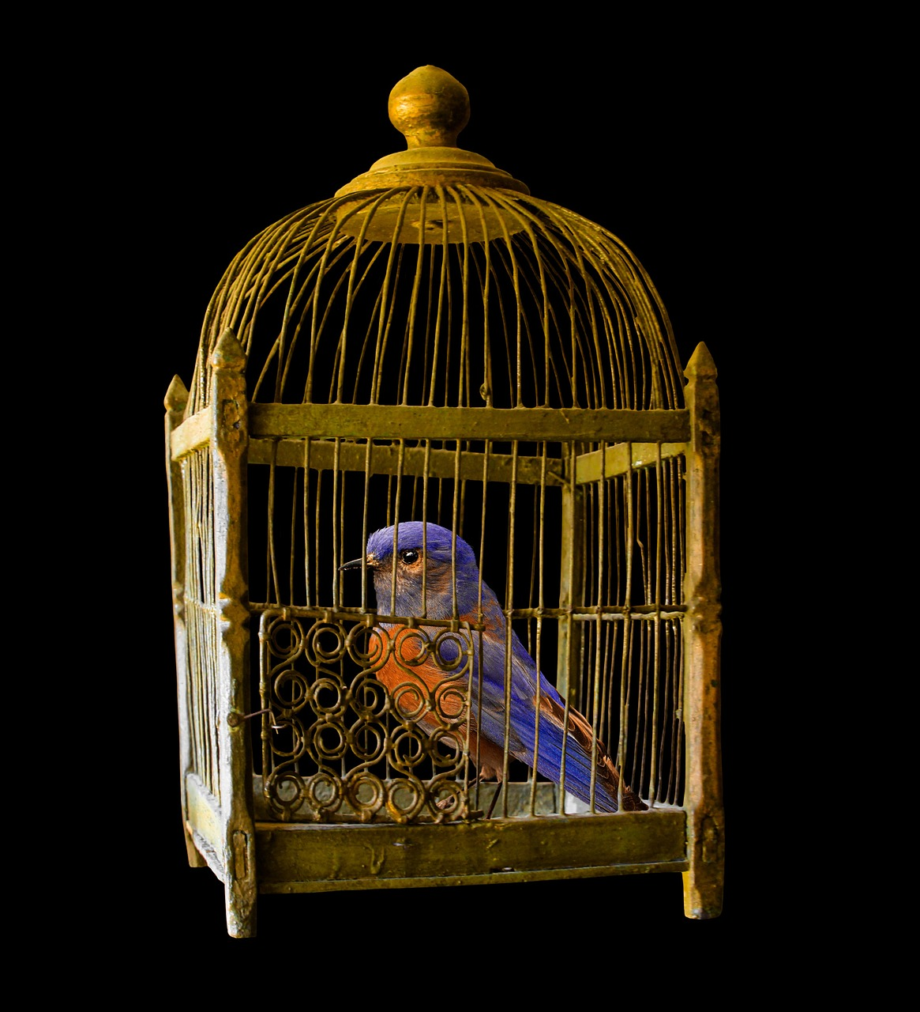

Slide 2
BREAKING FREE FROM YOUR PAST

Slide 3
Past Sins & Failures

Slide 4
Peter the ROCK
Peter the FISHER- MAN
Peter the COWARD
Wrong Turn

Slide 5
Peter the ROCK
Peter the FISHER- MAN
????
Peter the COWARD

Slide 6
Peter the ROCK
Peter the FISHER- MAN
Peter the COWARD

Slide 7
Peter the SHEPHERD
Peter the ROCK
Peter the FISHER- MAN
Peter who REALLY LOVES JESUS
Peter the COWARD

Slide 8
Paul the PROCLAIMER OF GRACE
Paul the PERFECT PHARISEE
Paul the MOST FORGIVEN
Paul the WORST SINNER

Slide 9
Others’ Past Sins & Failures

Slide 10
Sees God’s hand in this path
Joseph the BLESSED BY GOD
Joseph the LOVED SON
Joseph the SERVANT OF GOD
Joseph the MIS-TREATED

Slide 11
Things That Were Lost

Slide 12
Paul the PRISON EVANGELIST
Paul the WORLD EVANGELIST
Paul the PRISONER

Slide 13
The Key:
Everyone Reached Outside of Themselves

Slide 14
Peter the SHEPHERD
Peter the ROCK
Peter the FISHER- MAN
Peter who REALLY LOVES JESUS
Peter the COWARD

Slide 15
Paul the PROCLAIMER OF GRACE
Paul the PERFECT PHARISEE
Paul the MOST FORGIVEN
Paul the WORST SINNER

Slide 16
Joseph the BLESSED BY GOD
Joseph the LOVED SON
Joseph the SERVANT OF GOD
Joseph the MIS-TREATED

Slide 17
Paul the PRISON EVANGELIST
Paul the WORLD EVANGELIST
Paul the PRISONER

Slide 18
The Ultimate Overcomer

Slide 19
Jesus the FOUNDER OF SALVATION
Jesus the CREATOR
Jesus the SUFFERER

