Slide 1
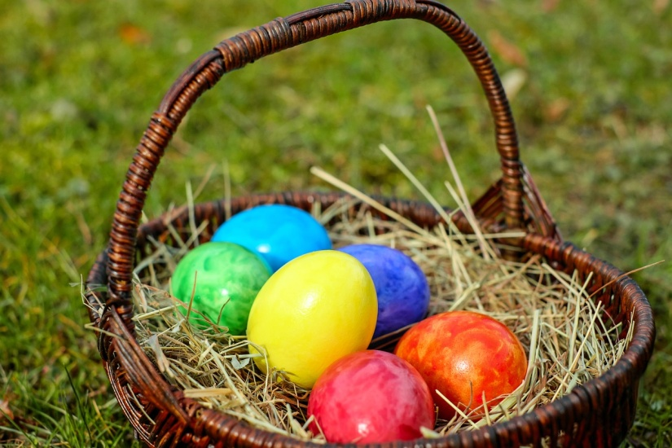
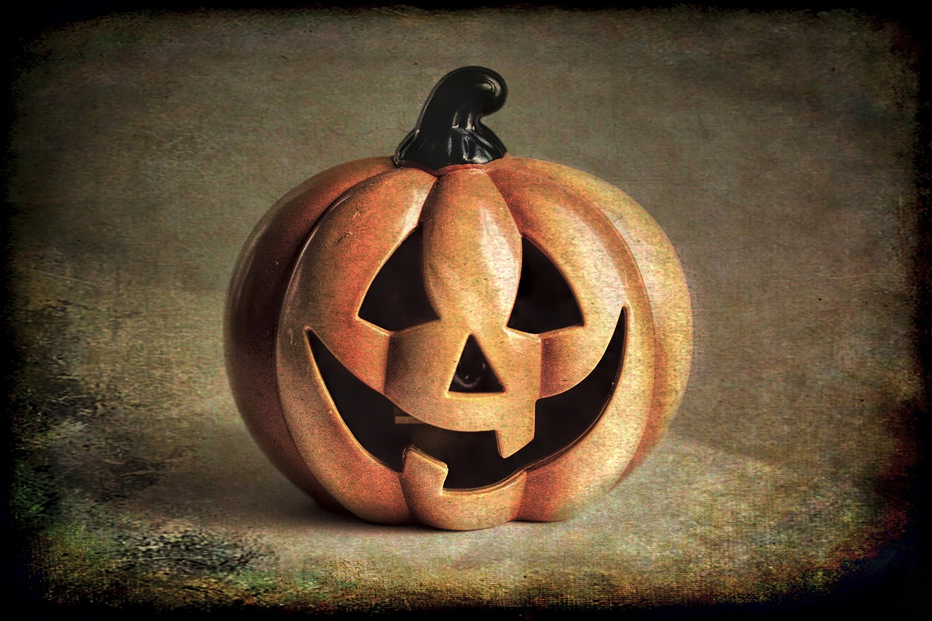
Should Christians Celebrate
Easter,
Christmas,
or Halloween?

Slide 2
Bible doesn’t directly address it
Therefore Wrong?
Therefore fine?

Slide 3
How to Study These Kinds of Topics

Slide 4
Me
BIBLE

Slide 5
Jeremiah 10:2-4
² Thus says the Lord:
“Learn not the way of the nations, nor be dismayed at the signs of the heavens because the nations are dismayed at them, ³ for the customs of the peoples are vanity. A tree from the forest is cut down and worked with an axe by the hands of a craftsman. ⁴ They decorate it with silver and gold; they fasten it with hammer and nails so that it cannot move.

Slide 6
Me
Original Audience
BIBLE
Principles

Slide 7
History

Slide 8
Jesus?
Christian?
Pagan?

Slide 9
Jesus?
Christian?
Pagan?

Slide 10
Jesus?
Christian?
Pagan?

Slide 11
In the Worship Service

Slide 12
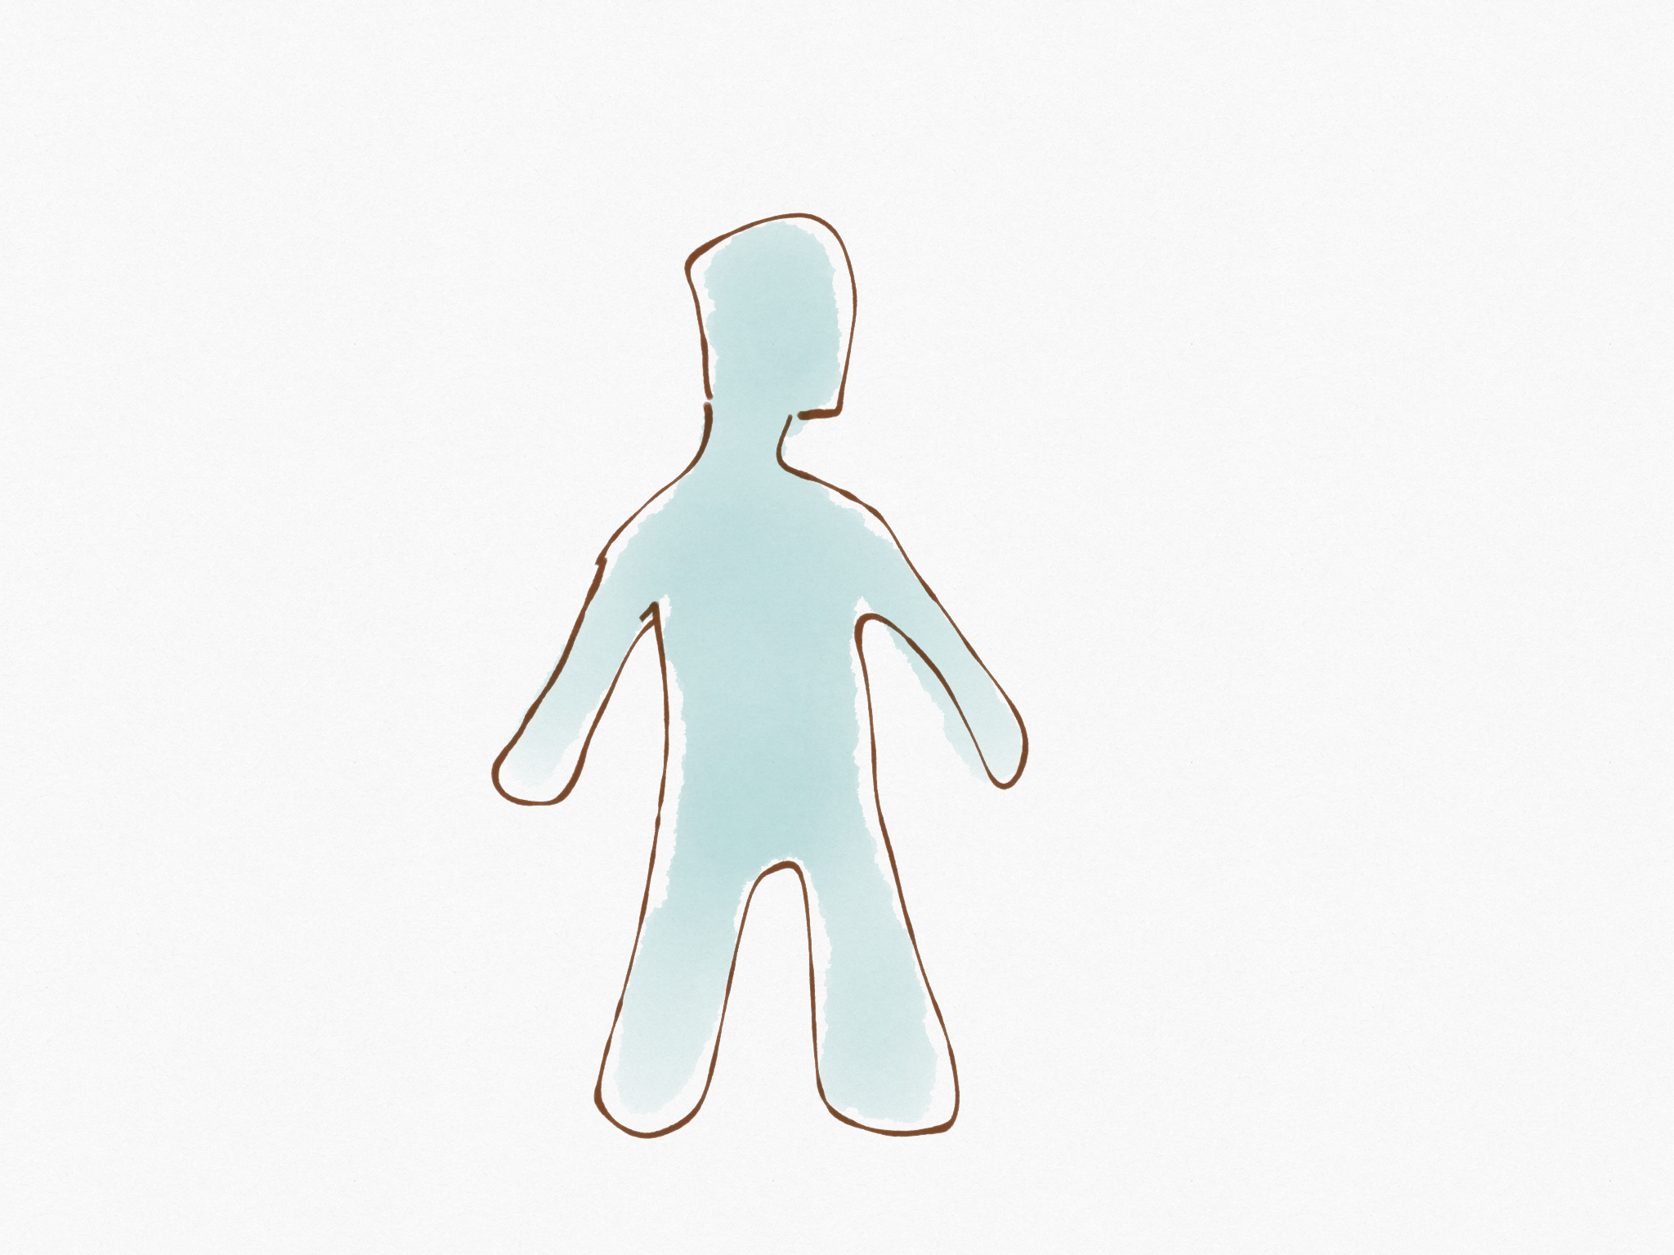
Christ’s wisdom
Human Tradition
Human Precepts
Self-made religion

Slide 13
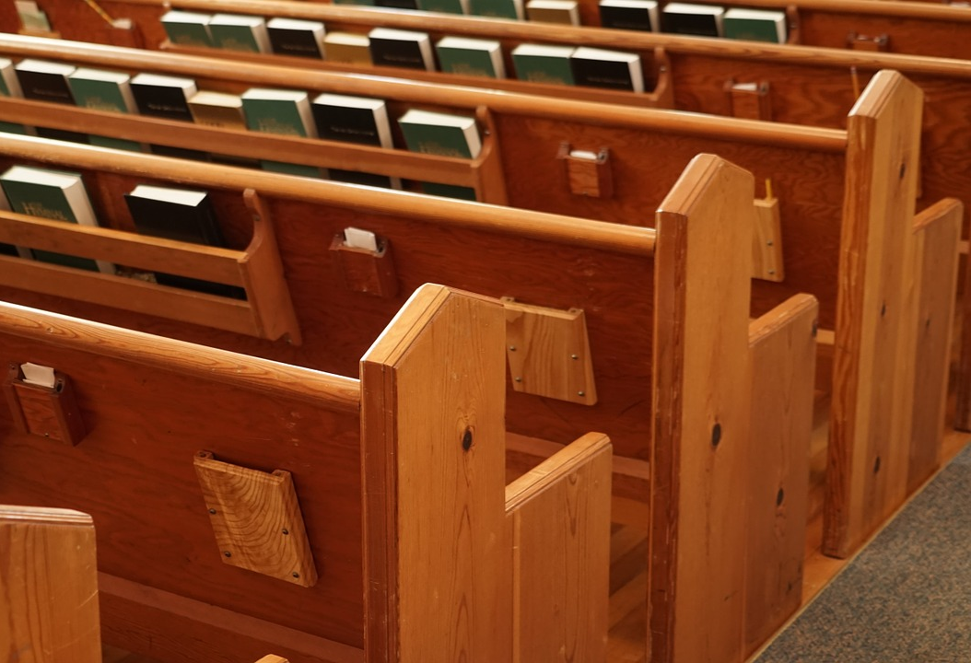
Worship
Home
Jesus’ Instructions
Eating a feast

Slide 14
At Home

Slide 15
Considerations:
Pagan roots?
Angels worshiped at birth?
Self-made religion?
Over exalting Mary?
Misrepresenting the Bible?
Opportunity to teach world?
Fun family time?
Religious
Time?
Wrong for Christians?

Slide 16
Fun family time?
Religious
Time?
Considerations:
Pagan roots?
Jesus told us how to remember Him.
Wrong for Christians?

Slide 17
Fun family time?
Wrong for Christians?
Considerations:
Witchcraft?

Slide 18
Think About Others

Slide 19
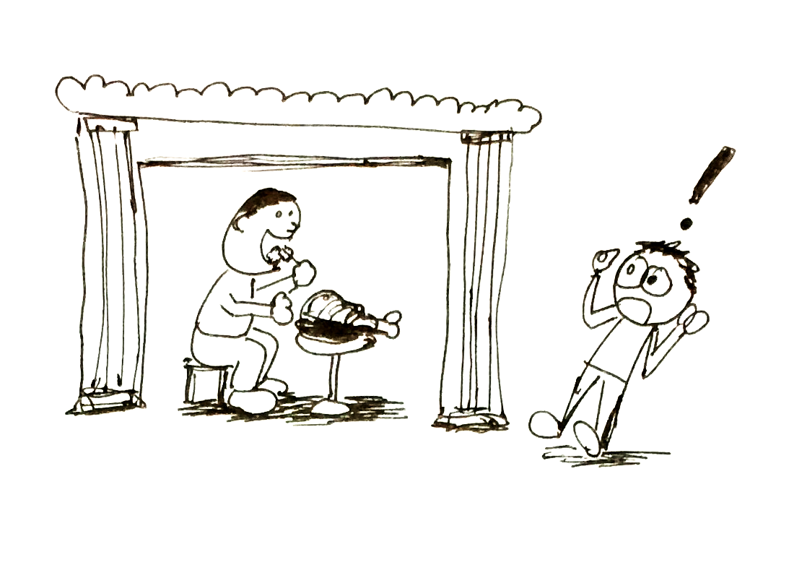
Aspects that are wrong?
Am I participating in wrong?
What am I communicating to others?

Slide 20
Do it for God’s glory.
Think About Others.

