Slide 1
How Churches Grow

Slide 2
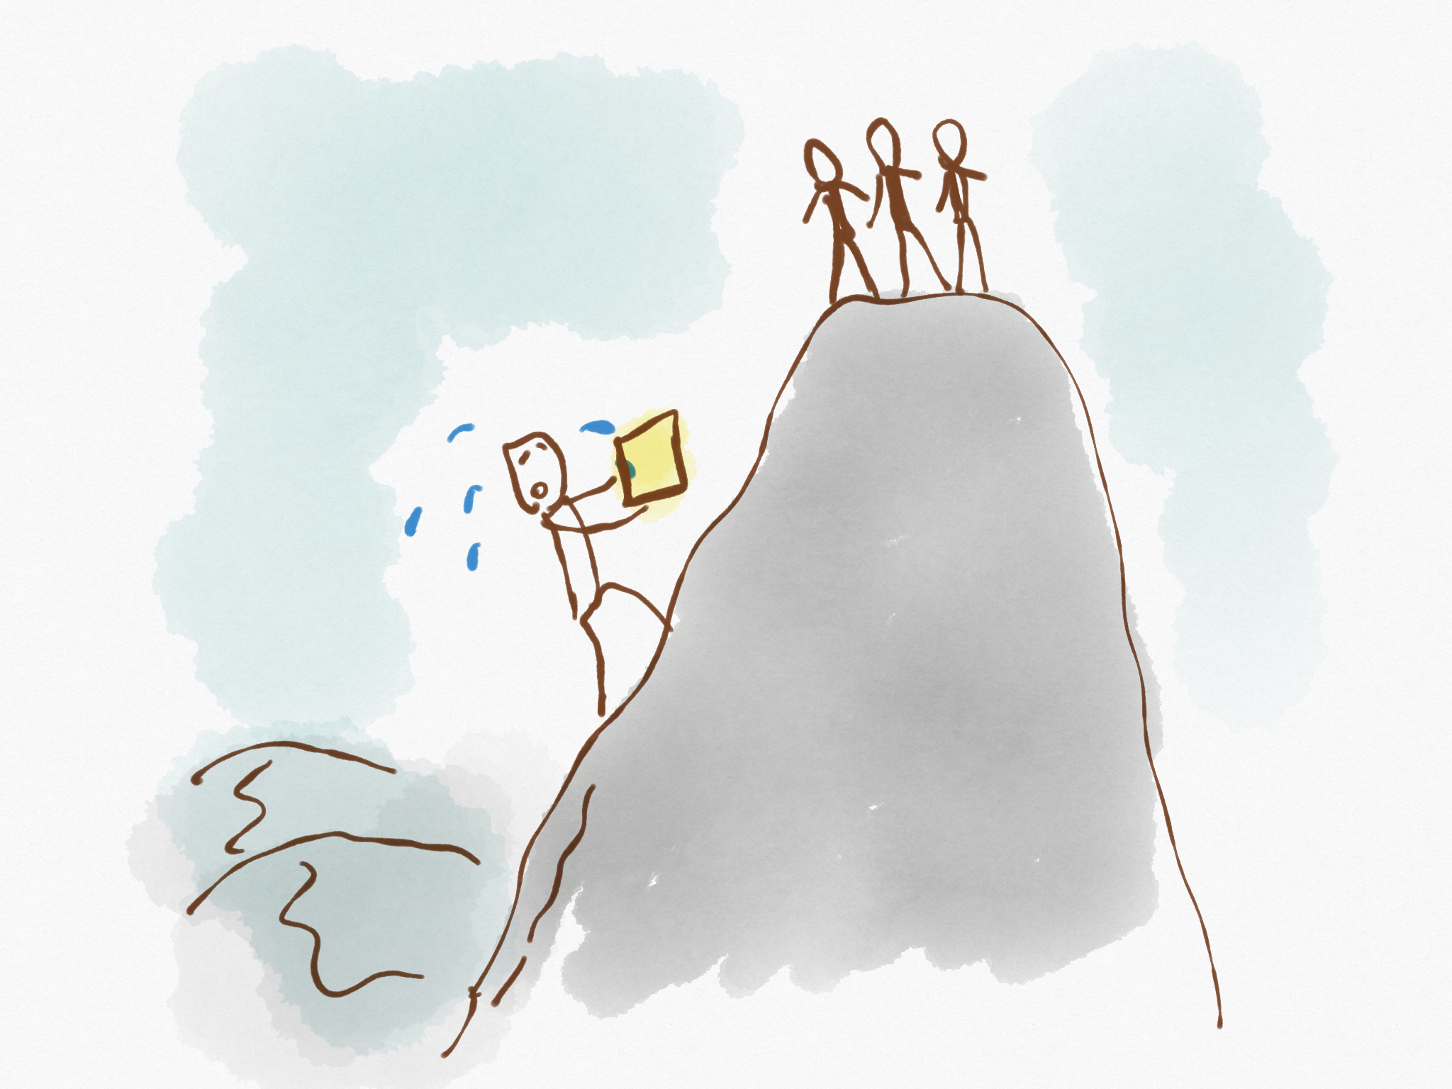
Paul’s hard work

Slide 3
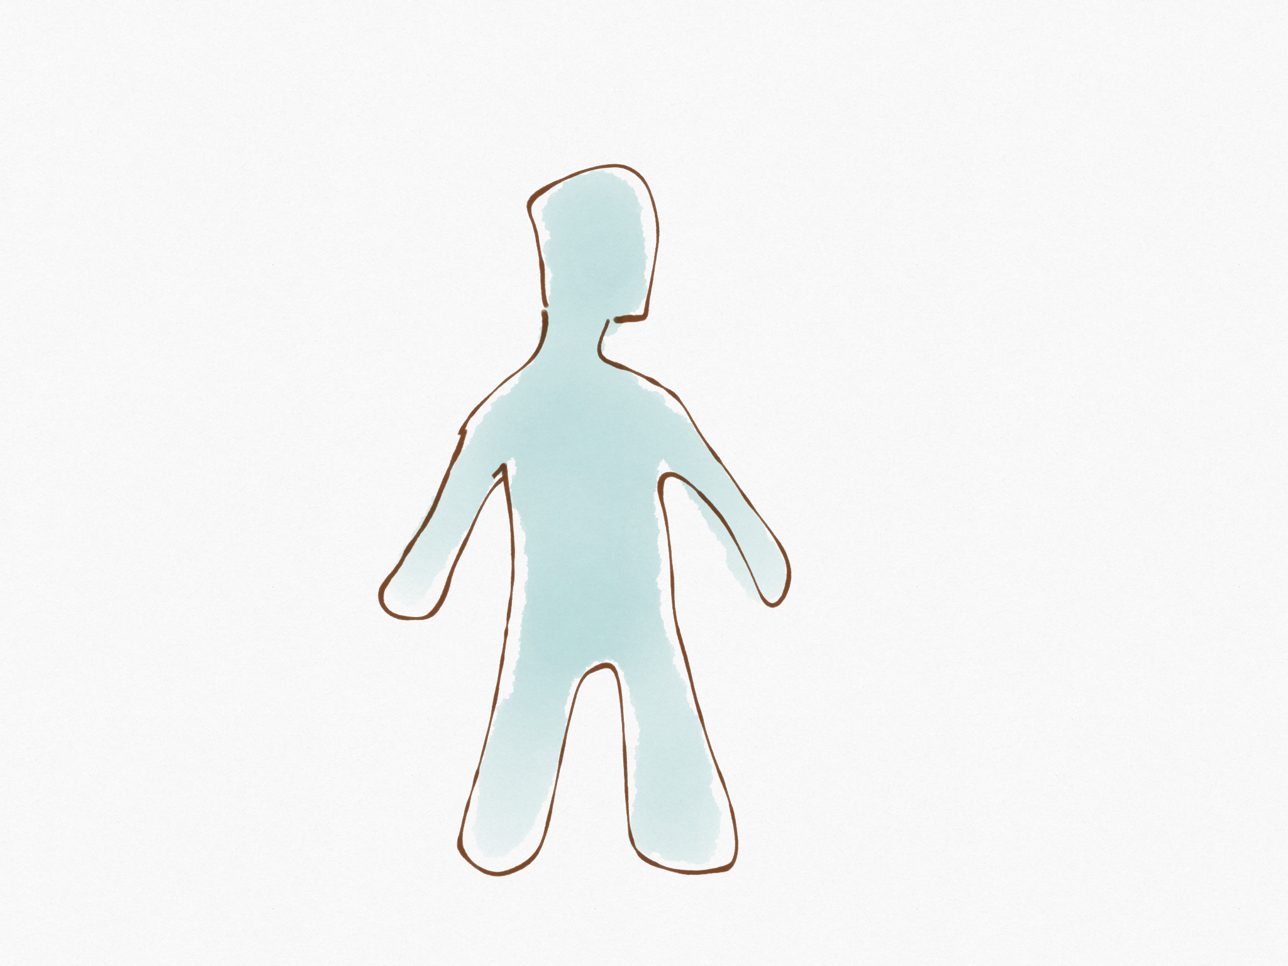
The Goal
CHRIST

Slide 4
How do we get there?

Slide 5
1. Filling our minds
The gospel

Slide 6
2. Passionate Diligence

Slide 7
3. Seeing it as a team effort
CHRIST
CHRIST
CHRIST
CHRIST
CHRIST

Slide 8
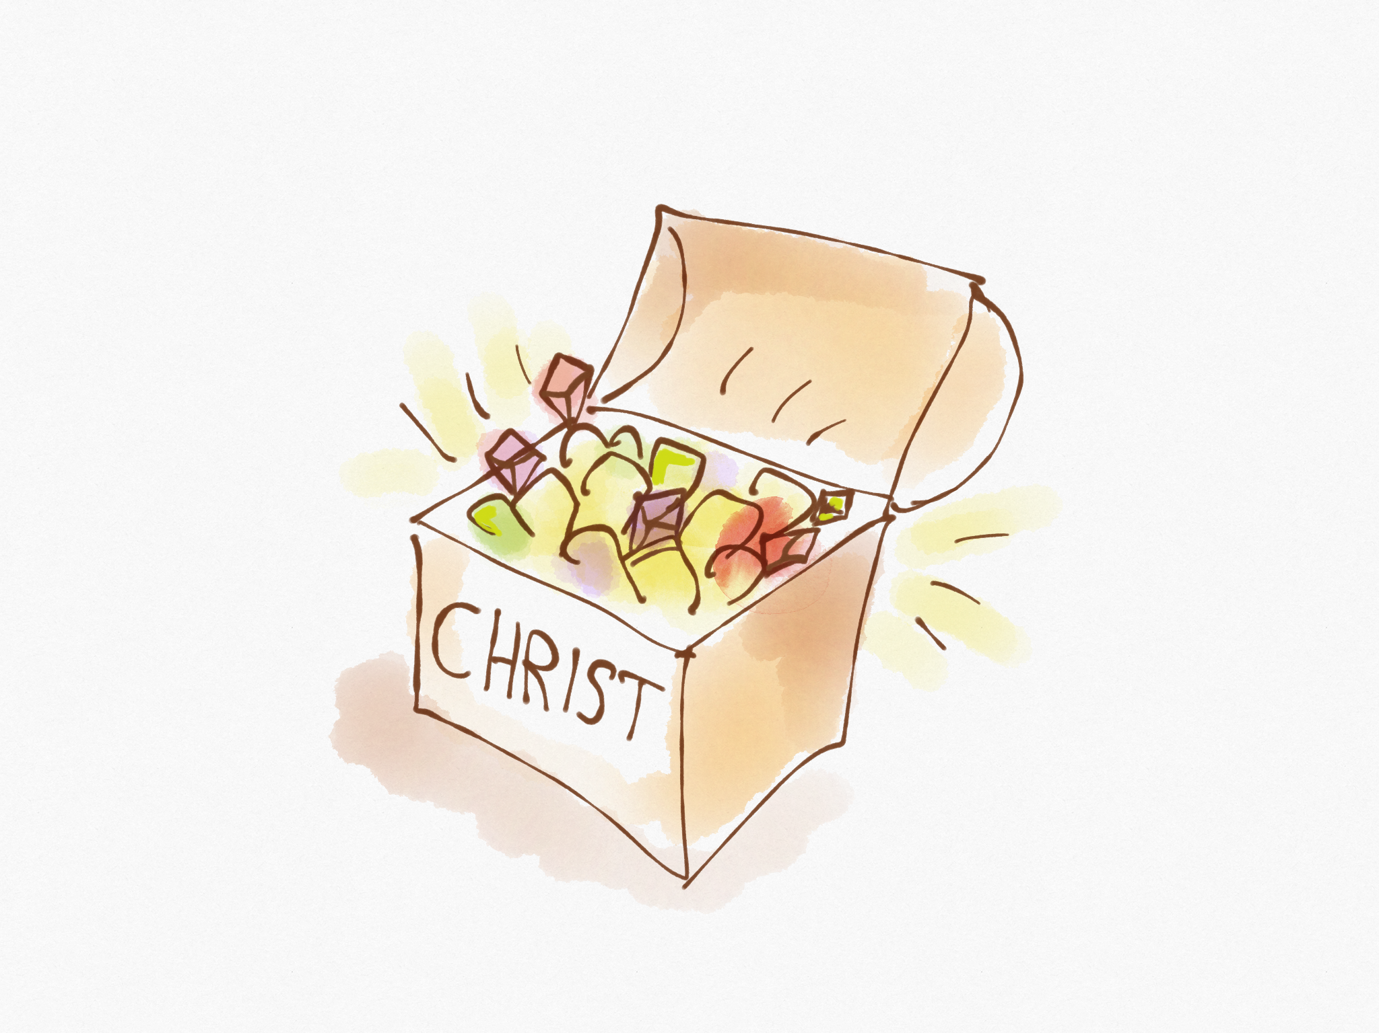
4. Perceiving the Value

Slide 9
The Fear

Slide 11
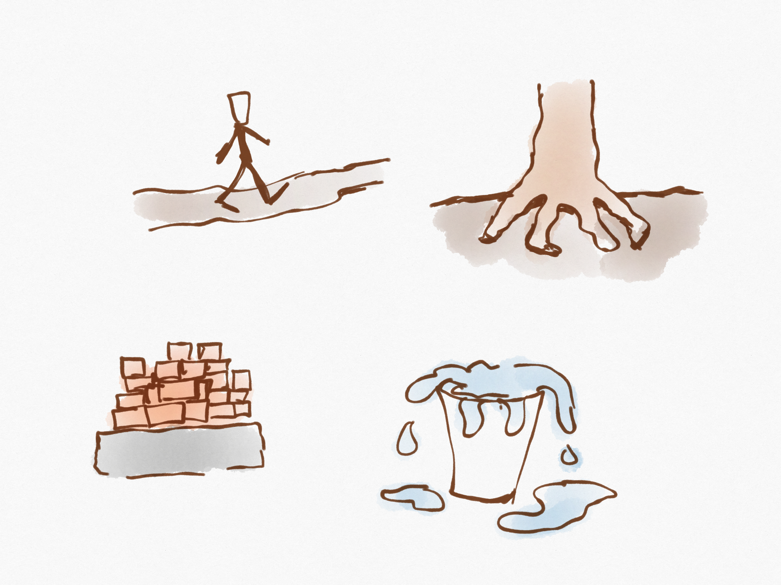
5. Making the relationship active

Slide 12
The Captive Church

Slide 13
Philosophy & Human Tradition
I think…

Slide 14
Philosophy & Human Tradition
CHRIST
Let Christ be in charge.
I think…

Slide 15
Old Law
Old Law
Reality

Slide 16
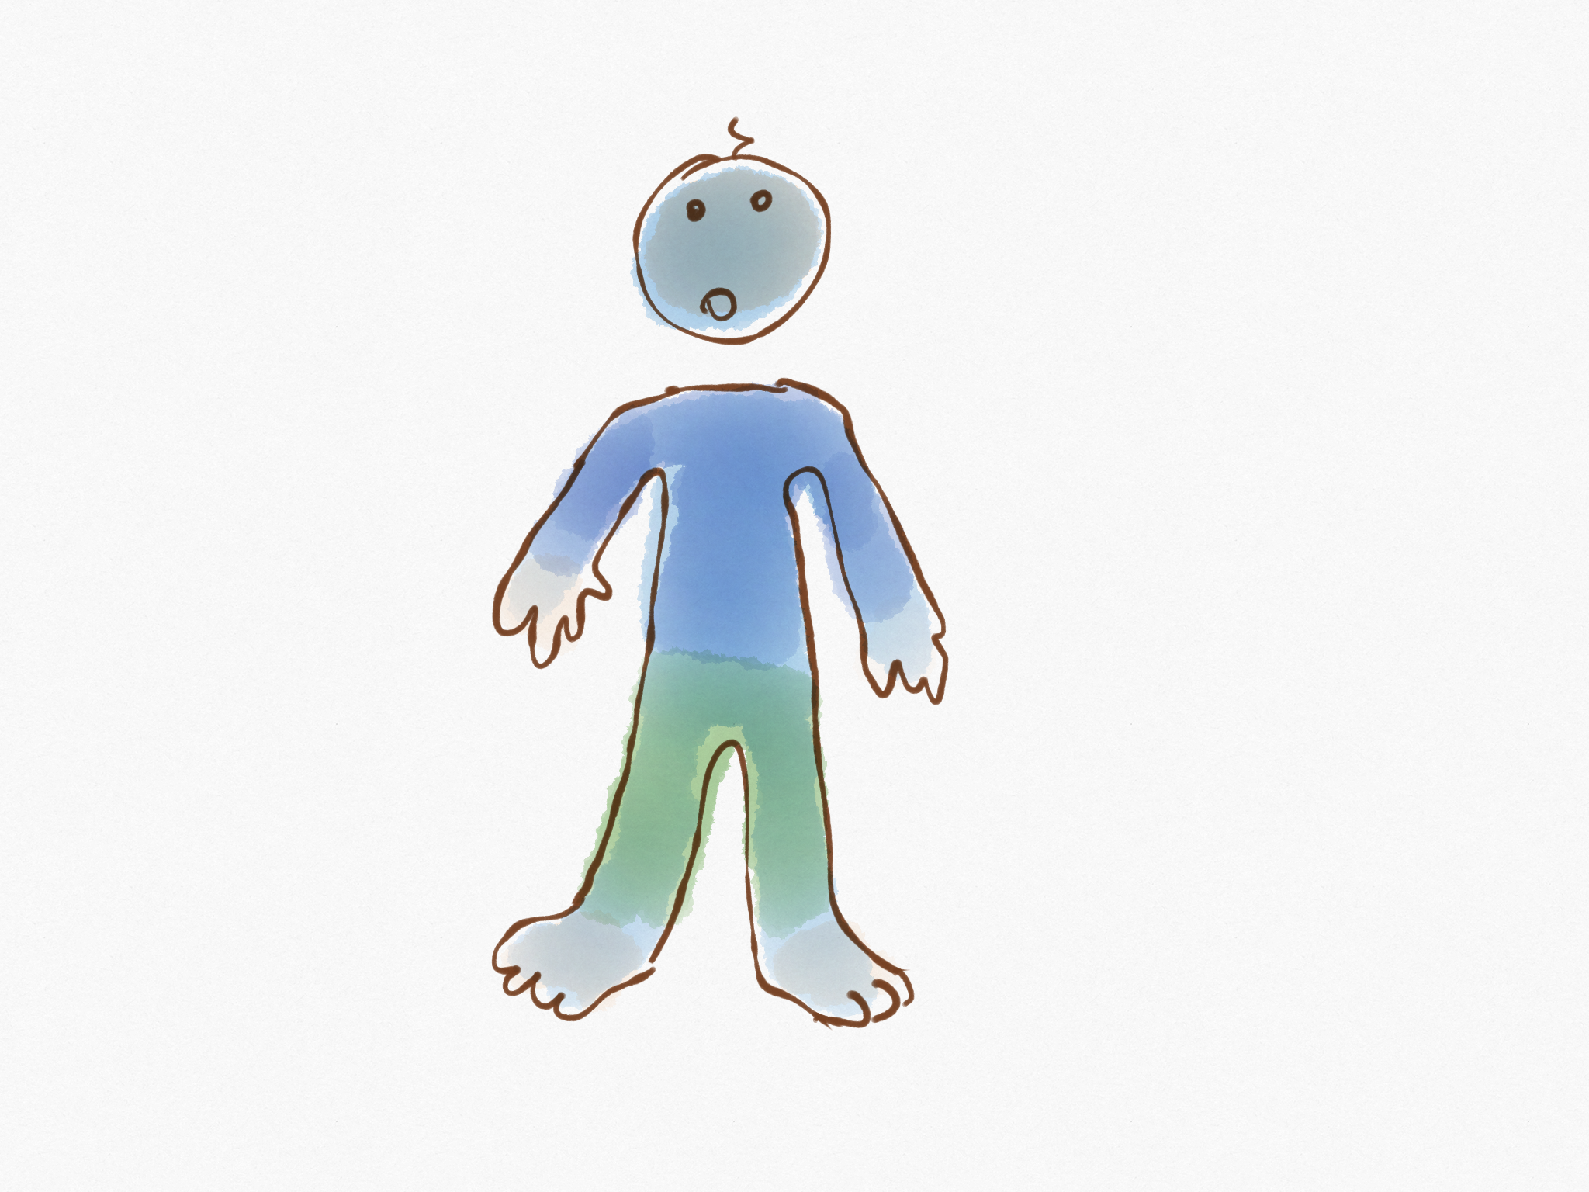
Crazy Religious Practices
Hold fast to the head.

Slide 17
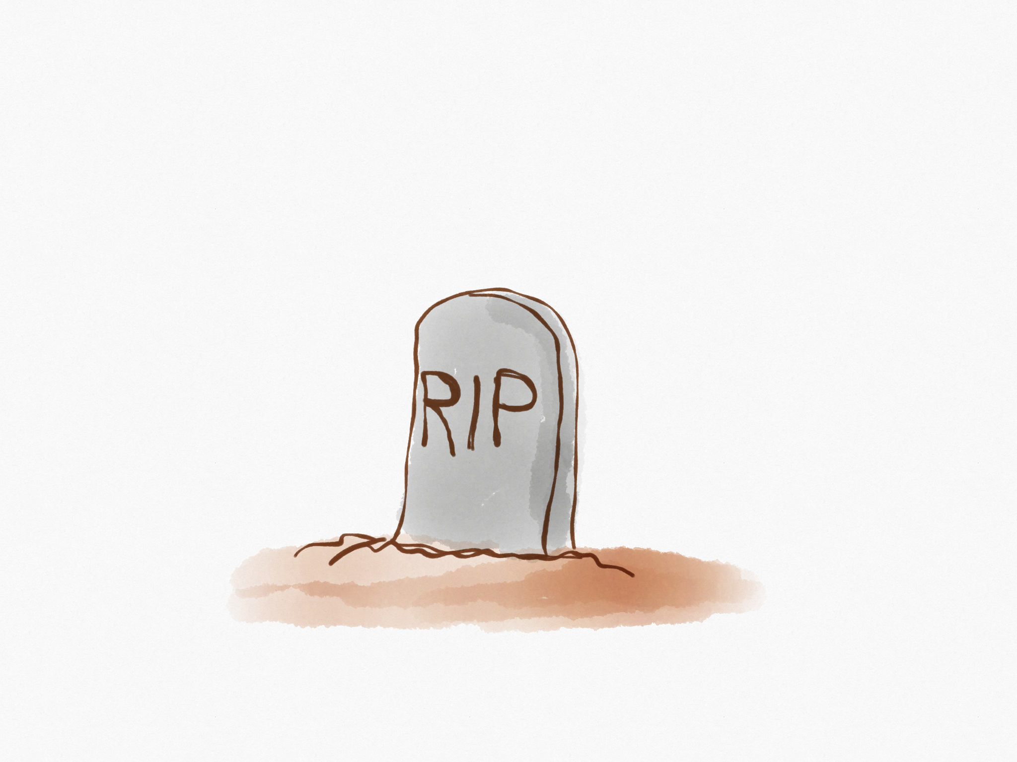
Human Precepts
We died to those things.

Slide 18
Human Precepts
Self made religion
We died to those things.

Slide 19
The Individual Responsibility

Slide 20
Seek things up here.
Not down here.

