Slide 1
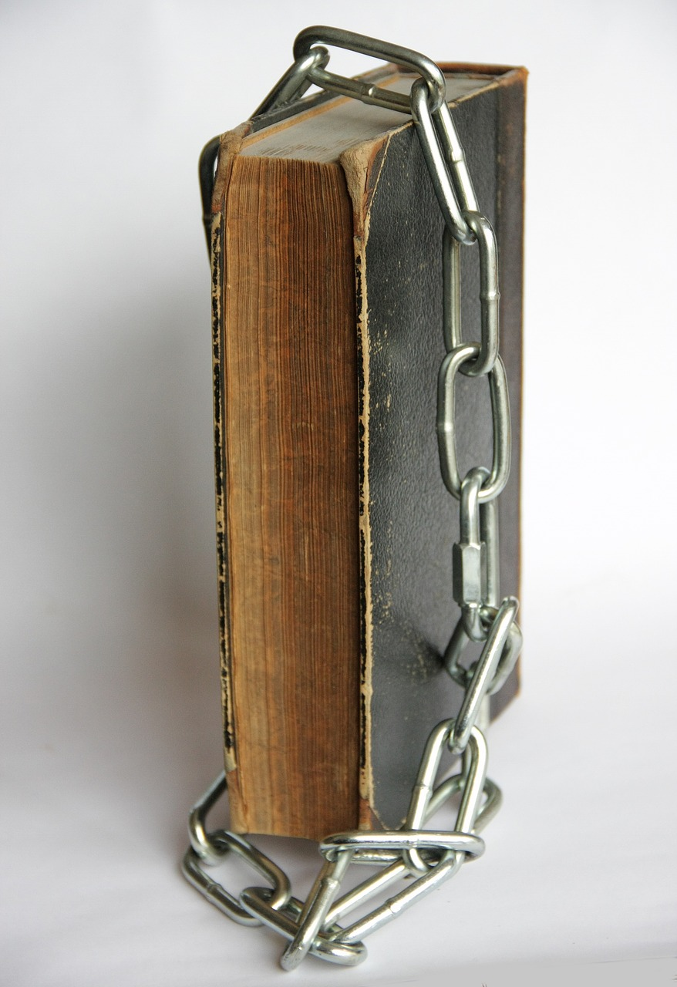
Is the Bible a Closed Book?

Slide 2
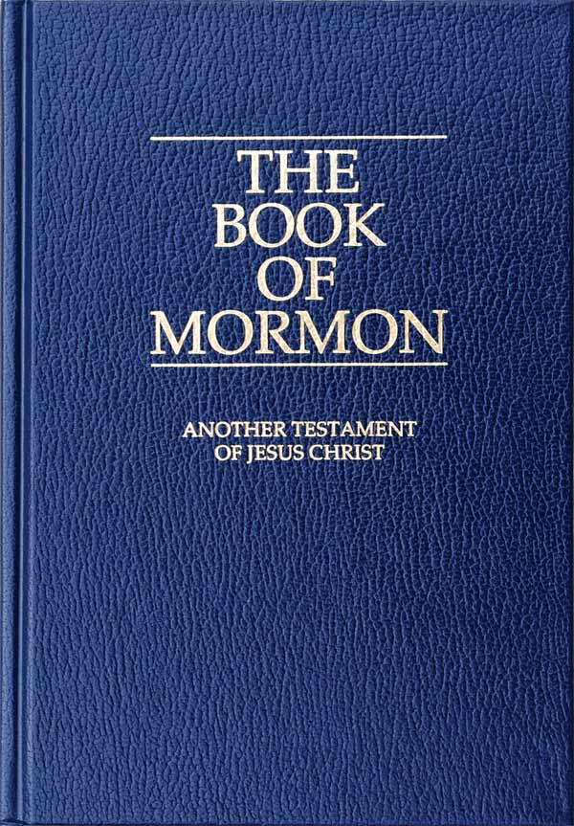
Further books?

Slide 3
Further books?
Church history?
Personal revelation?

Slide 4
Further books?
Church history?
Personal revelation?

Slide 5
Rest of history?
Prophets
Apostles
Jesus
OT
Creation
Present

Slide 6
Is the Bible…
A
one-time message?
An ever evolving story?
or

Slide 7
Fulfillment
Gospel
OT
Creation
Present

Slide 8
Teach & remember all things
Apostles
Gospel
OT
Creation
Present

Slide 9
Last days
Past
Gospel
OT
Creation
Present

Slide 10
Spiritual gifts
Witness
Apostles
Gospel
OT
Creation
Present

Slide 11
Spiritual gifts
Foundation
Apostles
Gospel
OT
Creation
Present

Slide 12
Did the apostles ever think others would be able to add to or improve on the gospel?

Slide 13
Entrusted with.
Creation
Present

Slide 14
The beginning
Different?
Creation
Present

Slide 15
The Point

Slide 16
Once for all delivered.
Creation
Present

