Slide 1
6 Secrets

Slide 3
What are your most important “life goals?”

Slide 4
What are your most important “life goals?”

Slide 5
What are your most important “life goals?”

Slide 6
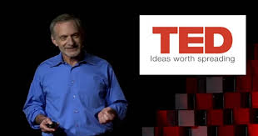
What Makes a Good Life?
Lessons from the Longest Study on Happiness

Slide 7
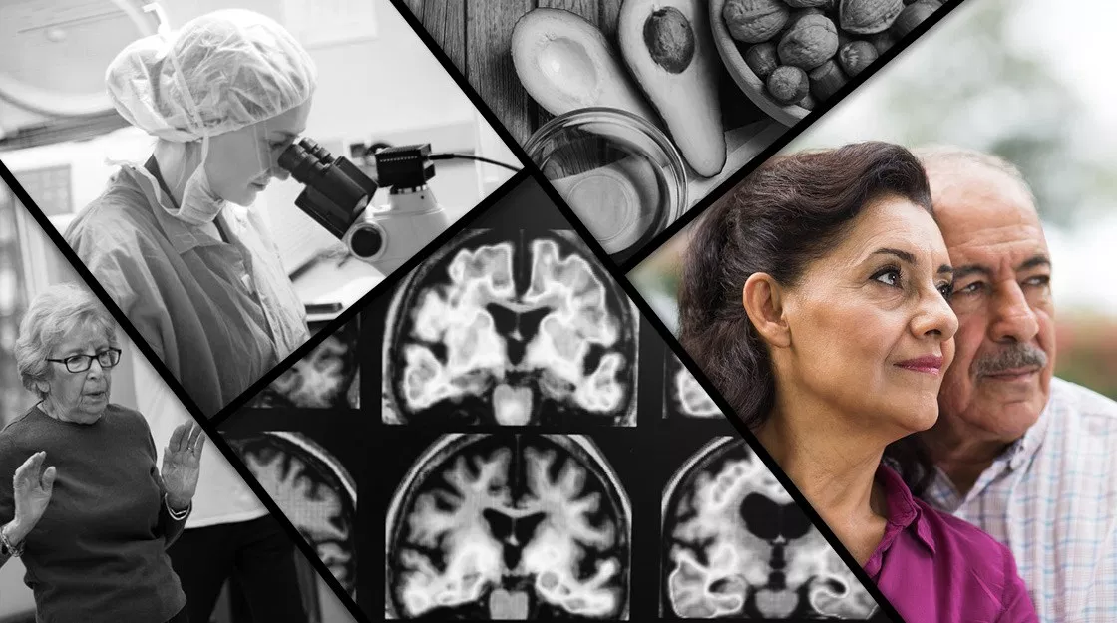
800 Humans
250 Harvard male graduates
450 low/middle class men
100 women

Slide 8
Acts 17
²⁴ The God who made the world and everything in it, being Lord of heaven and earth, does not live in temples made by man,²⁵ nor is he served by human hands, as though he needed anything, since he himself gives to all mankind life and breath and everything.
²⁸ for “‘In him we live and move and have our being’; as even some of your own poets have said, “‘For we are indeed his offspring.’

Slide 9
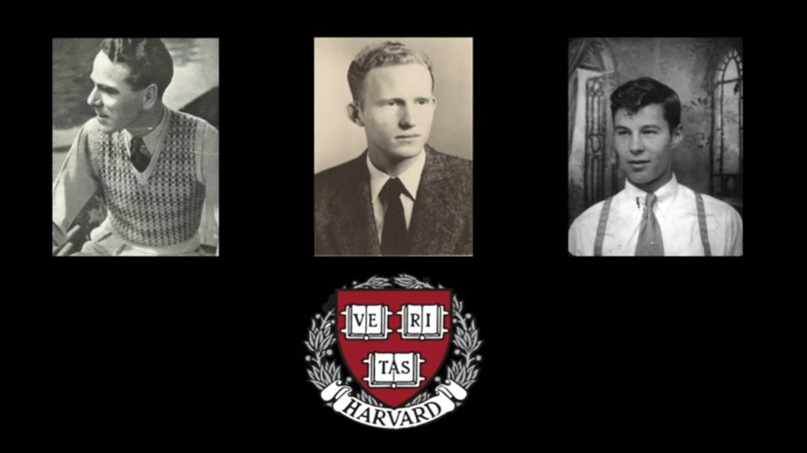

Slide 10
6 Secrets to Happy Life
Avoid Smoking and Alcohol
Pursue Higher Education
Have a Happy Childhood
Prioritize Relationships
Develop Coping Skills
Have a Generative Spirit
Altruism: Constructive service to others which brings pleasure and personal satisfaction.
Anticipation: Realistic planning for future discomfort.
Humor: Expression of ideas and feelings that gives pleasure to others.
Sublimation: Transformation of unhelpful emotions or instincts into healthy actions, behaviors, or emotions
Suppression: The conscious decision to delay paying attention to a thought, emotion, or need in order to cope with the present reality

Slide 11
6 Secrets to a Spiritual Life
⁸ Finally, all of you, have unity of mind, sympathy, brotherly love, a tender heart, and a humble mind. ⁹ Do not repay evil for evil or reviling for reviling, but on the contrary, bless, for to this you were called, that you may obtain a blessing.
So if there is any encouragement in Christ, any comfort from love, any participation in the Spirit, any affection and sympathy, ² complete my joy by being of the same mind, having the same love, being in full accord and of one mind. ³ Do nothing from selfish ambition or conceit, but in humility count others more significant than yourselves. ⁴ Let each of you look not only to his own interests, but also to the interests of others. ⁵ Have this mind among yourselves, which is yours in Christ Jesus
²⁹ Jesus said, “Truly, I say to you, there is no one who has left house or brothers or sisters or mother or father or children or lands, for my sake and for the gospel, ³⁰ who will not receive a hundredfold now in this time, houses and brothers and sisters and mothers and children and lands, with persecutions, and in the age to come eternal life. ³¹ But many who are first will be last, and the last first.”
Avoid Compromising Mind or Body
Continue your Spiritual Education
Be a Blessing to Your Children
Cultivate and Expand your “people”
Resolve Issues Wisely
Give of yourself to Help Others

Slide 12
Acts 17
²⁸ for “‘In him we live and move and have our being’; as even some of your own poets have said, “‘For we are indeed his offspring.’

