Slide 1
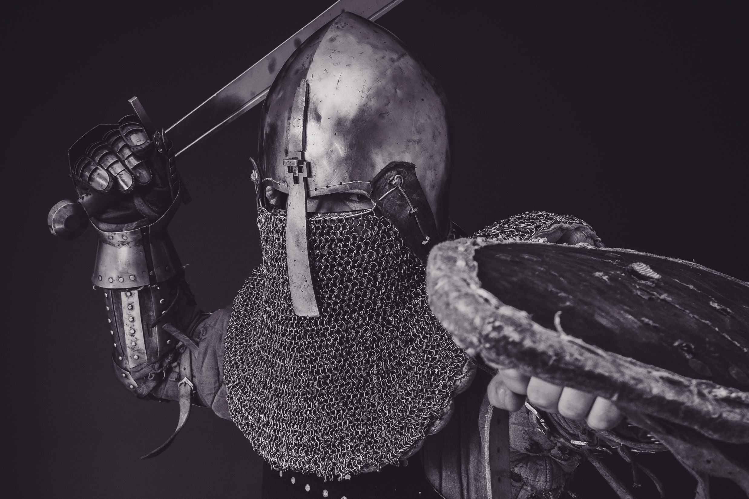
Conquering with
Truth

Slide 2
Stand therefore, having fastened on the belt of truth…
– Ephesians 6:14

Slide 3
Truth
that overcomes
Lies

Slide 4
Failing Temptation

Slide 5
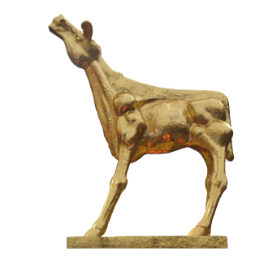
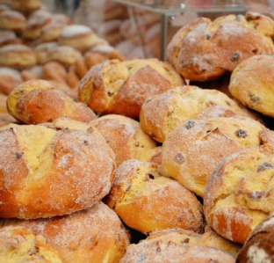
Israel in the Wilderness
FAILED
FAILED
FAILED

Slide 6
Overcoming Temptation

Slide 7
Jesus in the Wilderness

Slide 8
It is written.
Physical needs are most important.
Spiritual needs are most important.

Slide 9
It is written.
Spiritual needs are always most important.

Slide 10
Jesus in the Wilderness
Passed

Slide 11
It is written.
God isn’t with you.
God is trustworthy.

Slide 12
It is written.
God is always trustworthy.

Slide 13
Jesus in the Wilderness
Passed
Passed

Slide 14
It is written.
You need something more.
God is enough.

Slide 15
It is written.
God is always enough.

Slide 16
Jesus in the Wilderness
Passed
Passed
Passed

Slide 17
How about us?

Slide 18
Us in the Wilderness

Slide 19
Why did the Israelites fail?

Slide 20
It is written.
They had God’s word too!

Slide 21
It is written.
Faith +
They were missing this part.

Slide 22
Faith +
truth
That’s how truth becomes a lifestyle.

