Slide 1
2007
16% - Nones
2014
23% - Nones

Slide 2
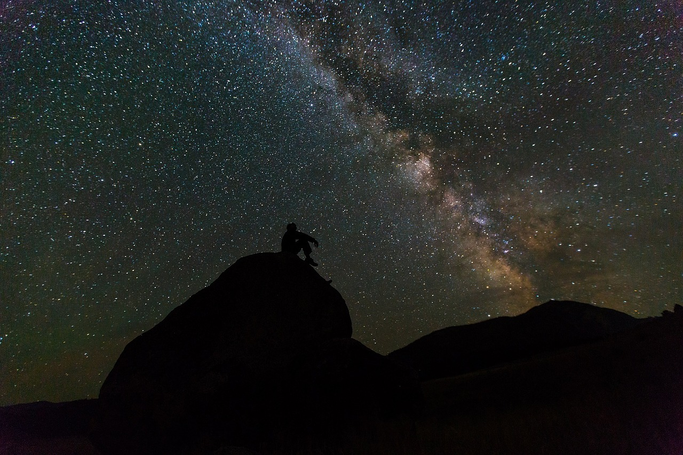
is there a
GOD?

Slide 3
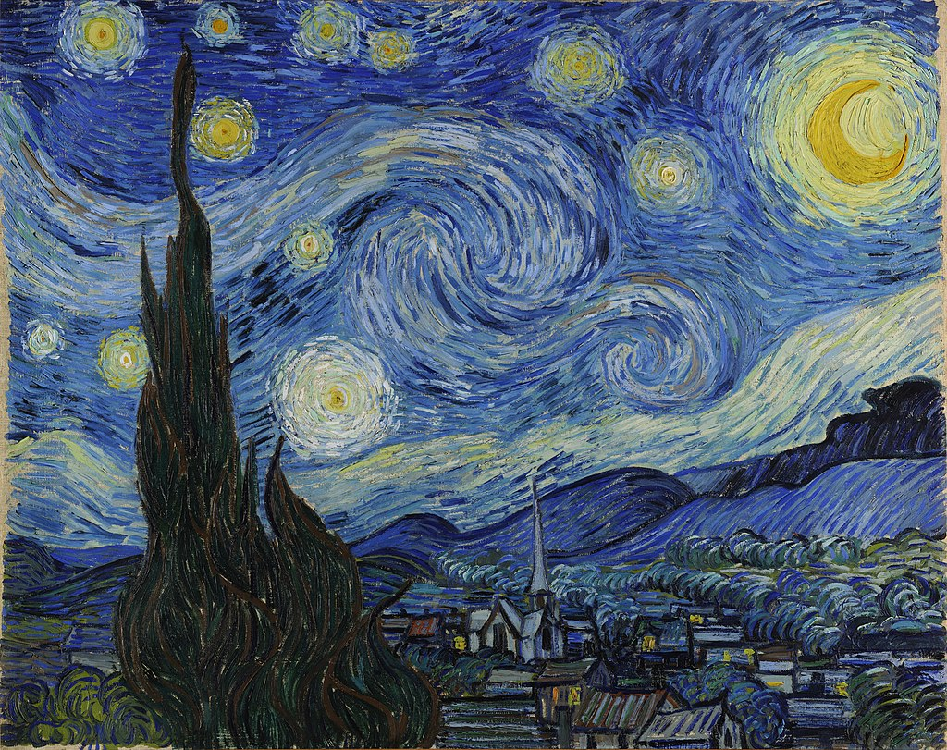

Slide 4
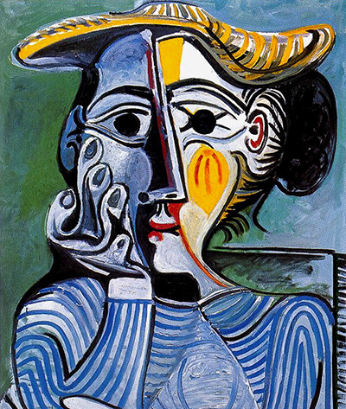

Slide 5
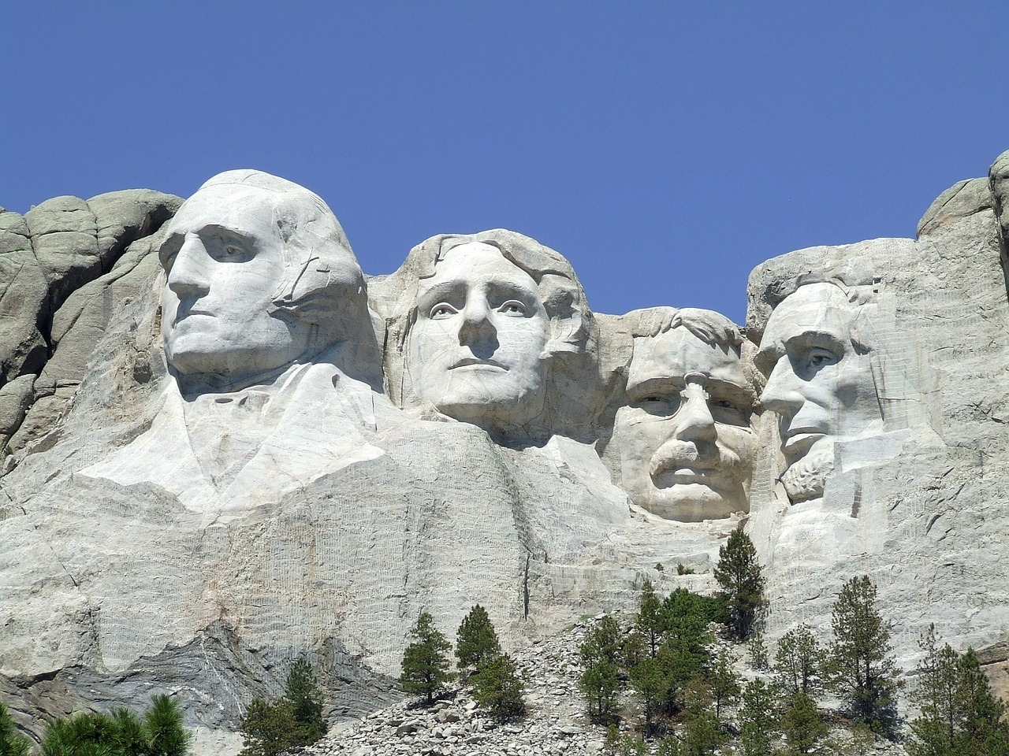

Slide 8
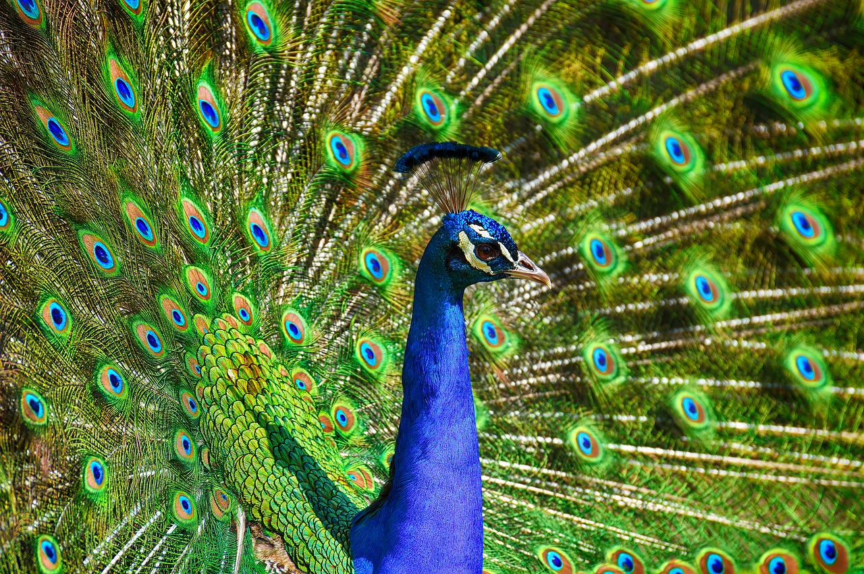

Slide 9
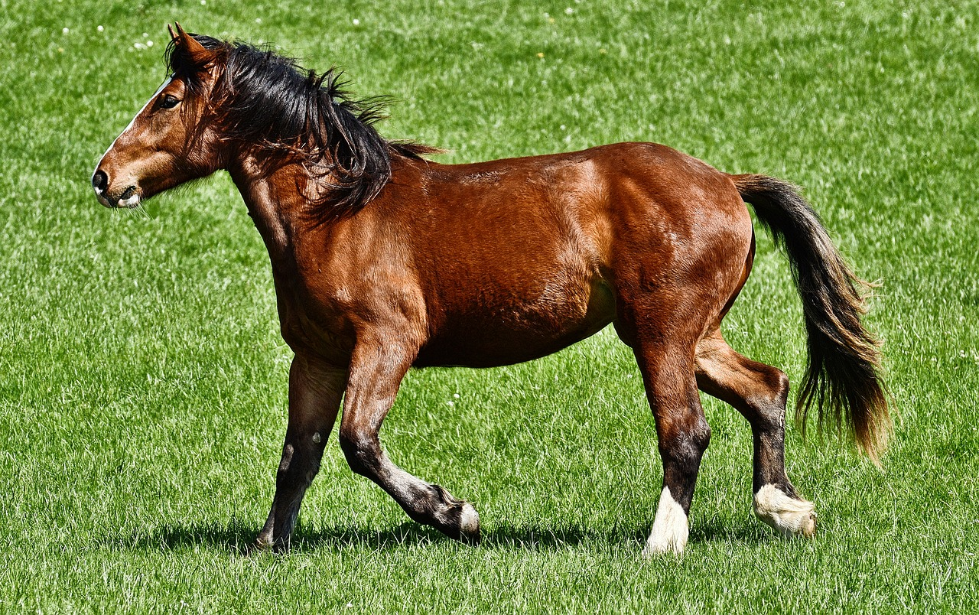

Slide 11
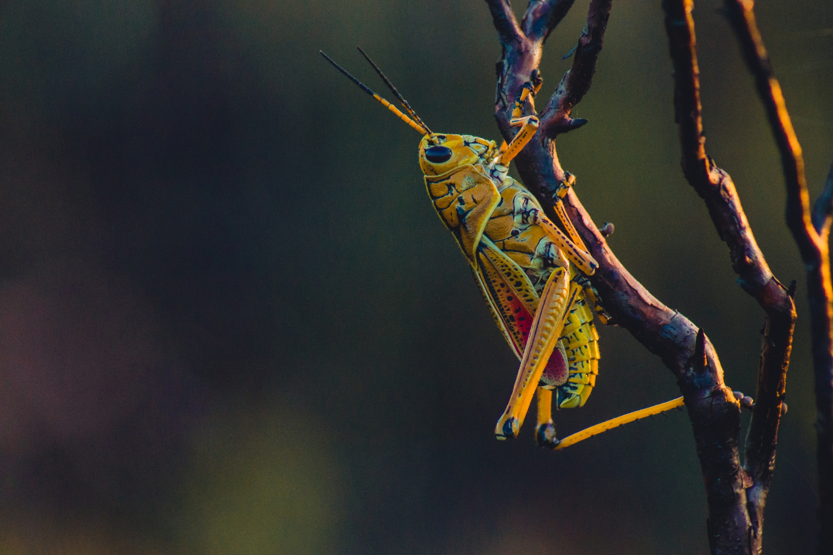

Slide 12
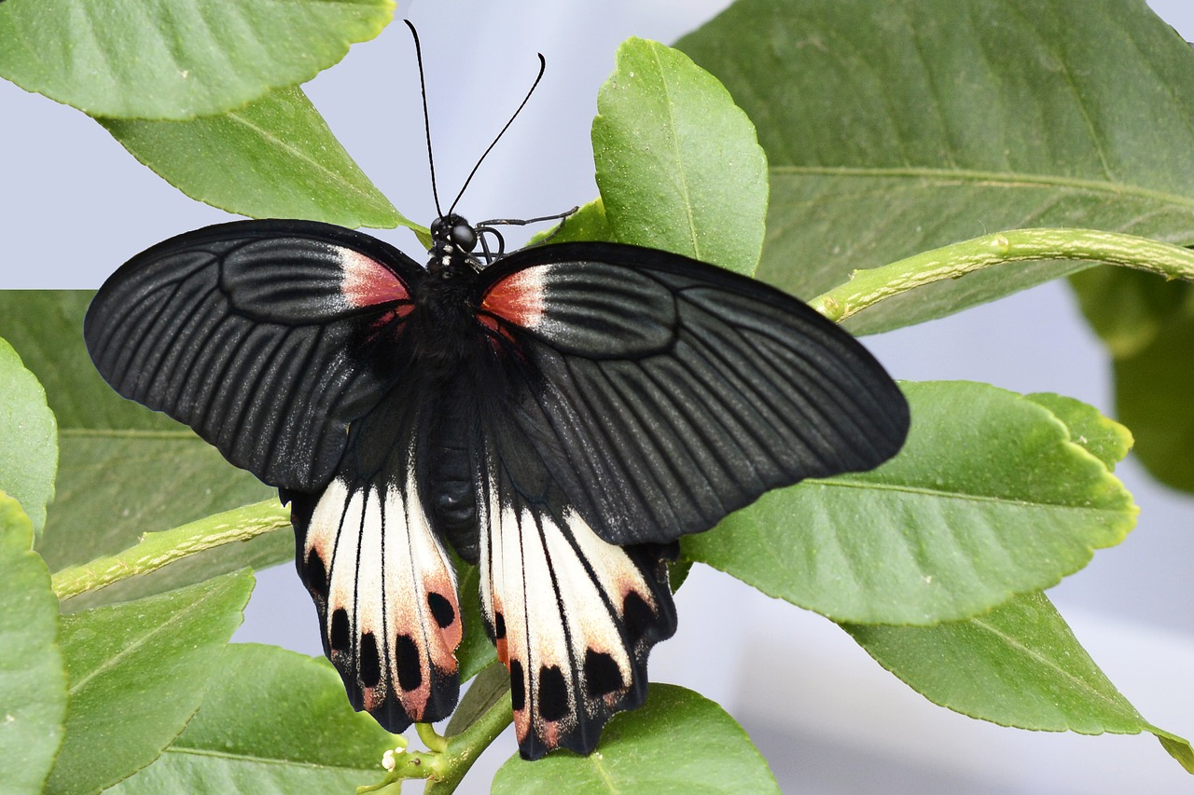

Slide 13
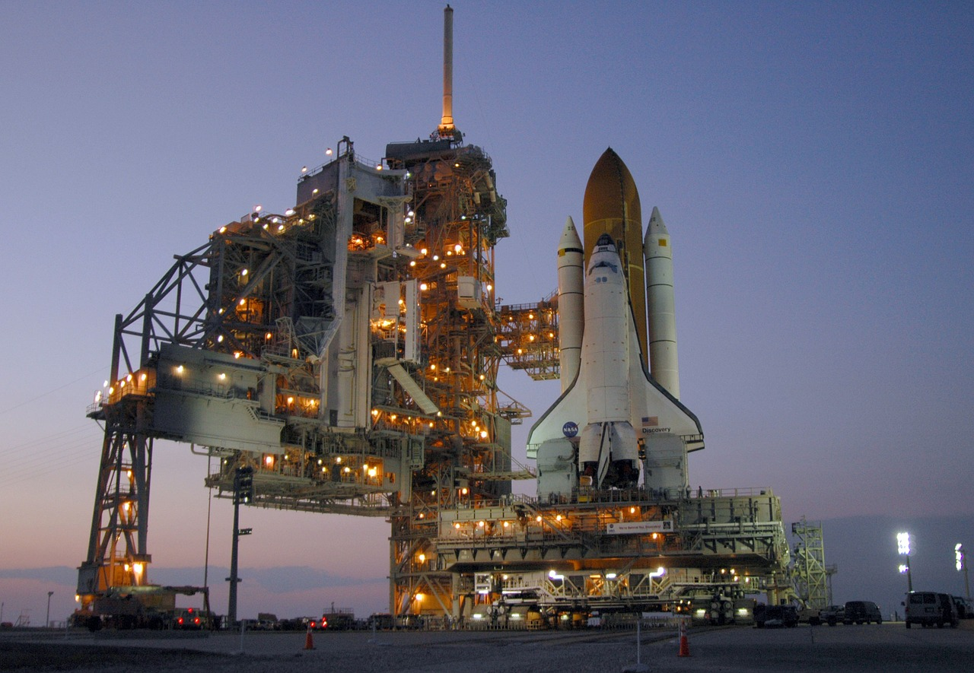

Slide 14
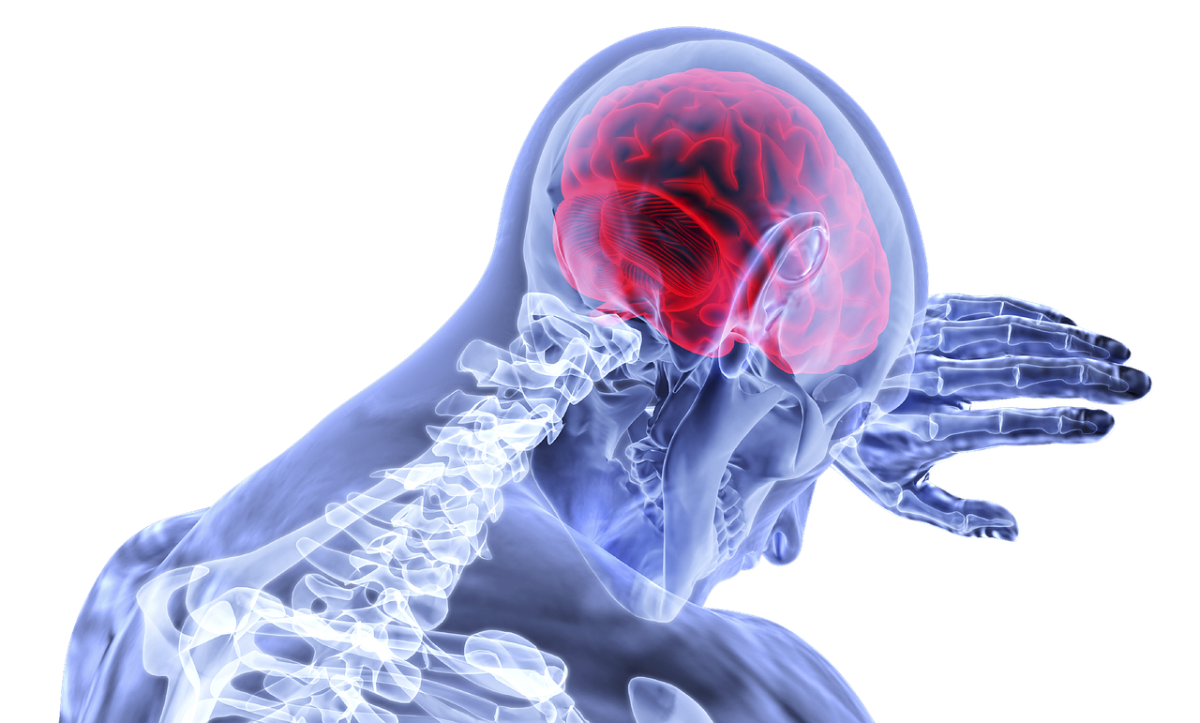

Slide 15
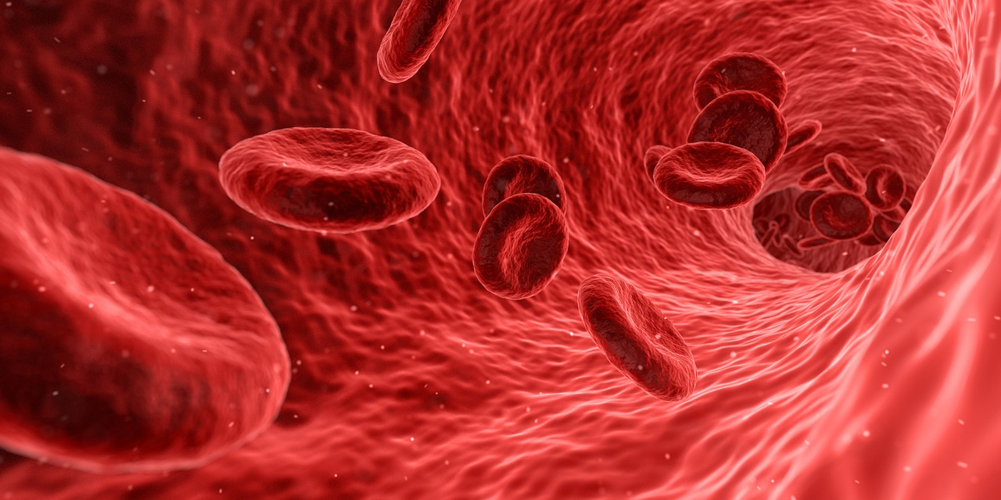

Slide 16
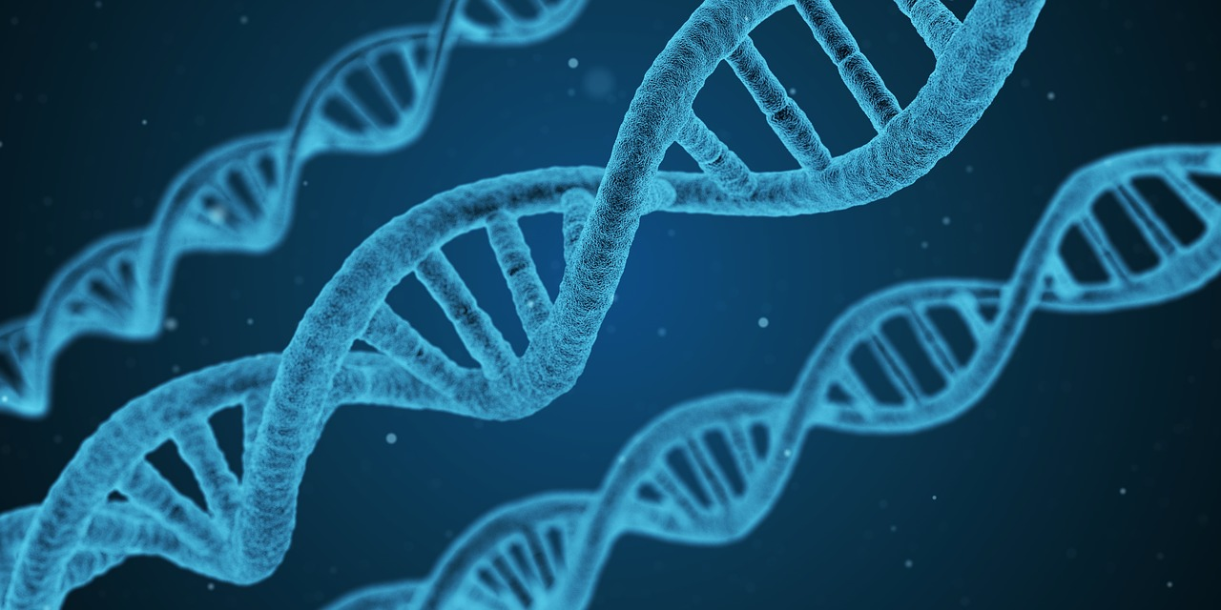

Slide 17
The Design of the Universe

Slide 18
Designer
Design
Natural Processes
Design

Slide 19
“Evolution is a fact as much as the "theory of gravity." You can prove it just as easily. You just need to look at your bellybutton that you share with other placental mammals, or your backbone that you share with other vertebrates, or your DNA that you share with all other life on earth. Those traits didn't pop up in humans. They were passed down from different ancestors to all their descendants, not just us.”
- Dr. Prosanta Chakrabarty

Slide 20
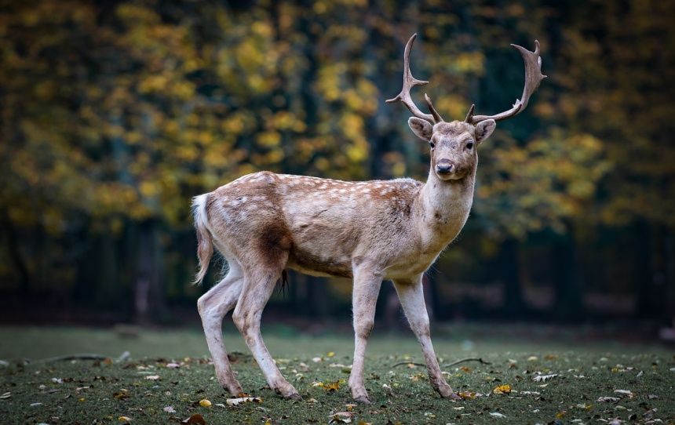
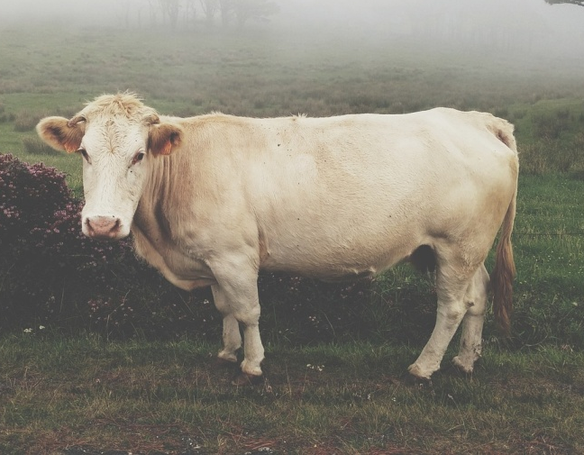
Why are these so similar?

Slide 21
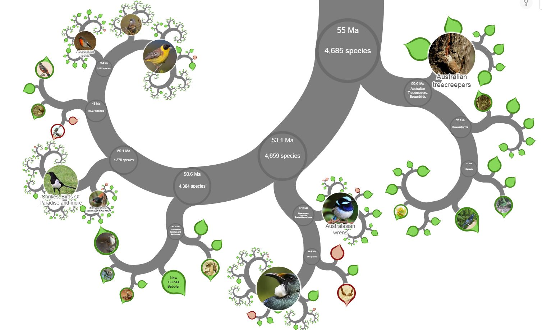

Slide 22
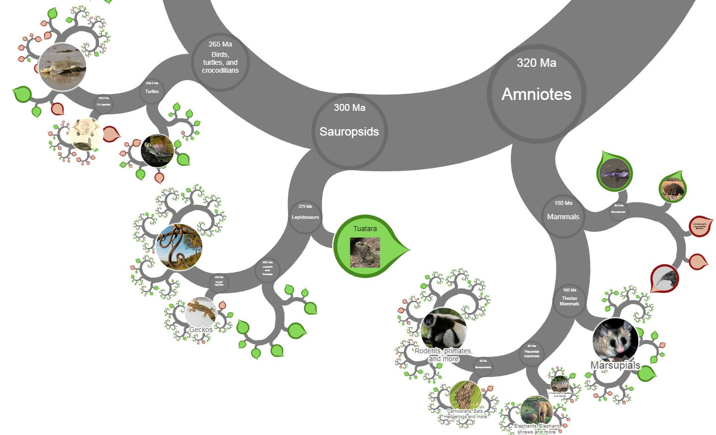
Flying birds
Flying bats

Slide 23
Flying and gliding animals (volant animals) have evolved separately many times, without any single ancestor. Flight has evolved at least four times, in the insects, pterosaurs, birds, and bats. Gliding has evolved on many more occasions.
- Wikipedia

Slide 24
Problem #1:
Parallel and Convergent Evolution

Slide 25
“Venomous animals are not all closely related to each other. The platypus is much more closely related to us, for example, than it is to a centipede. And that means that venom has independently evolved many times over in the history of life.”
- On the Origin of Venom by Carl Zimmer.

Slide 26
“While horses are the world’s only living monodactyl, they were not the only animals to evolve only one toe per limb. A now-extinct group of South American animals called Prototheriidae evolved an even smaller single toe per limb than horses today have. These animals were horse-like in their build and foot structure, but were not closely related to horses. The similarities between them and horses were just a remarkable example of convergent evolution,”
- Brianna McHorse (Harvard Doctoral Student)

Slide 27
Why are these so similar?

Slide 28
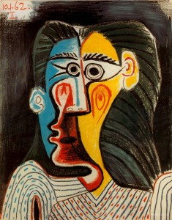
Why are these so similar?

Slide 29
Problem #2:
Unlikelihood

Slide 30
“Think about it, on one planet, and possibly only one planet in the entire universe, molecules that would normally make nothing more complicated than a chunk of rock, gather themselves together into chunks of rock-sized matter of such staggering complexity that they are capable of running, jumping, swimming, flying, seeing, hearing, capturing and eating other such animated chunks of complexity;

Slide 31
capable in some cases of thinking and feeling, and falling in love with yet other chunks of complex matter.
– The God Delusion by Richard Dawkins

Slide 32
capable in some cases of thinking and feeling, and falling in love with yet other chunks of complex matter. We now understand essentially how the trick is done, but only since 1859.”
– The God Delusion by Richard Dawkins

Slide 33
“If you took all the carbon in the universe and put it on the face of the earth, allowed it to chemically react at the most rapid rate possible, and left it for a billion years, the odds of creating just one functional protein molecule would be
- Dr Walter Bradley author of the book The Mystery of Life’s Origin

Slide 34
“If you took all the carbon in the universe and put it on the face of the earth, allowed it to chemically react at the most rapid rate possible, and left it for a billion years, the odds of creating just one functional protein molecule would be 1 chance in 1,000,000,000,000,000,000,000,000,000,000,000,000,000,000,000,000,000,000,000,000 (10 followed by 60 zeroes).”
- Dr Walter Bradley author of the book The Mystery of Life’s Origin

Slide 35
Problem #3:
Design is Evident

Slide 36
“So why don't we put some of this embodied intelligence into our robotic machines, to release them from relying on excessive work on computation and sensing?

Slide 37
Well, to do that, we can follow the strategy of nature, because with evolution, she's done a pretty good job in designing machines for environment interaction. And it's easy to notice that nature uses soft material frequently and stiff material sparingly.”
- Giada Gerboni at TED2018

Slide 38
Our Sense of Justice

Slide 39
Where do morals come from?
Me?

Slide 40
Where do morals come from?
Us?
Them?

Slide 41
“We hold these truths to be self-evident, that all men are created equal, that they are endowed by their Creator with certain unalienable Rights, that among these are Life, Liberty and the pursuit of Happiness.”

Slide 42
Where do morals come from?
Nature?

Slide 43
Something Higher

Slide 44
The Purpose of Life

Slide 45
“The very purpose of life is to be happy.”
- The Dalai Lama

Slide 46
Purpose?
Me?

Slide 47
Purpose?
Them?

Slide 48
Something Higher

Slide 49
What does the Bible say?
Design declares God’s glory.
God defines right & wrong.
God gives us purpose.

