Slide 1
Dealing with
BARRIERS

Slide 2
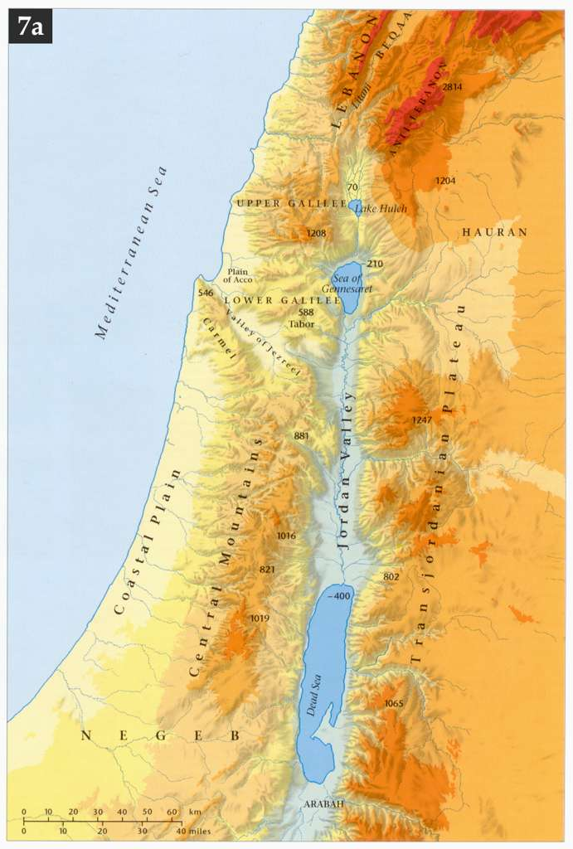
Asher
Naphtali
Zebulun
Issachar
Manasseh
Manasseh
Ephraim
Dan
Gad
Benjamin
Reuben
Judah
Simeon

Slide 3
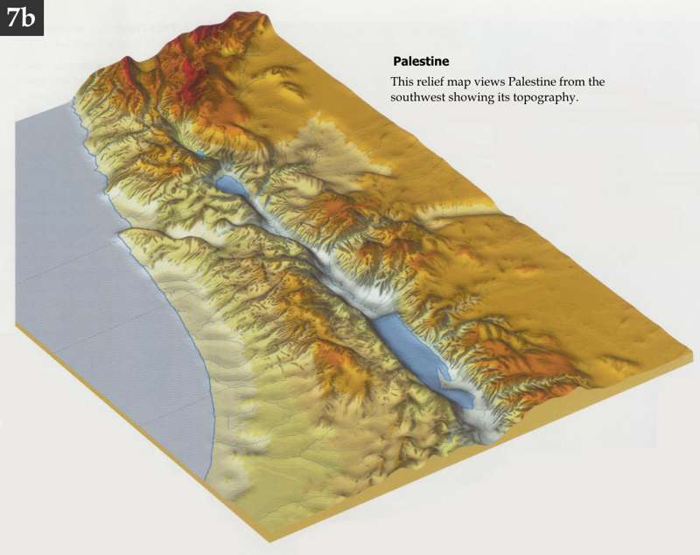

Slide 4
Bonus
Promised Land

Slide 5
We’ll just stop here.

Slide 6
Lesson #1
Don’t get too engrossed in life on your side of the barrier.

Slide 7
Just thinking about this.

Slide 8
Solution:
Just thinking about this.
Help others FIRST.
Notice how my actions might discourage others.

Slide 9
Lesson #2
Learn to have spiritual concern for those on the other side of the barrier.

Slide 10
Keep up the great work!

Slide 11
!

Slide 12
Hear
Talk
Hear
War

Slide 13
Hear
Talk
Hear
War

Slide 14
What have you done???
It’s not that at all.
Hear
Talk
Hear
War

Slide 15
Lesson #3
Don’t let physical barriers create communication barriers.

Slide 16
Hear
Talk
Hear
War

Slide 17
?

Slide 18
Lesson #4
Let our spiritual union overcome our physical barriers.

Slide 19
We want to follow God.
We want to follow God.

