Slide 1
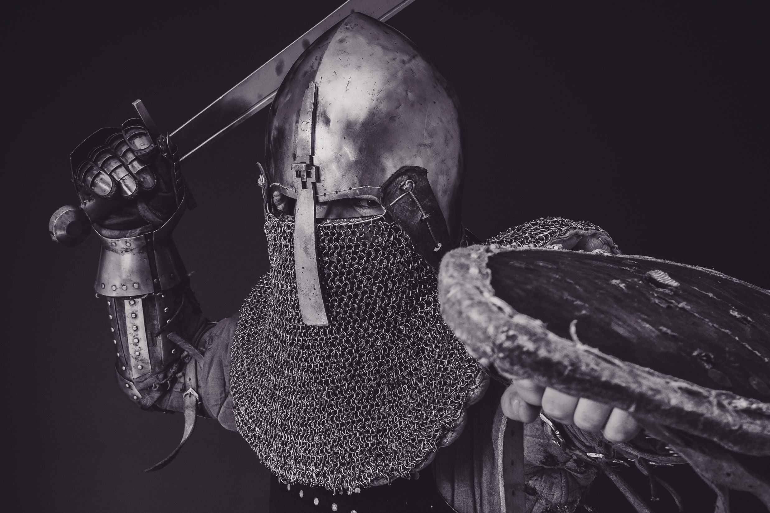
Conquering with
Purity

Slide 2
Secret Sins

Slide 3
How did this sin happen?

Slide 4
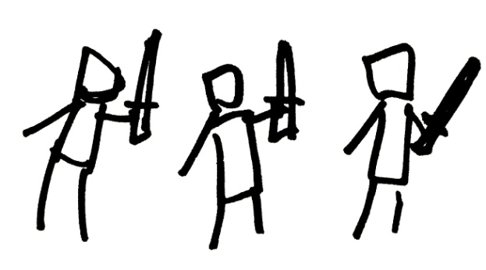
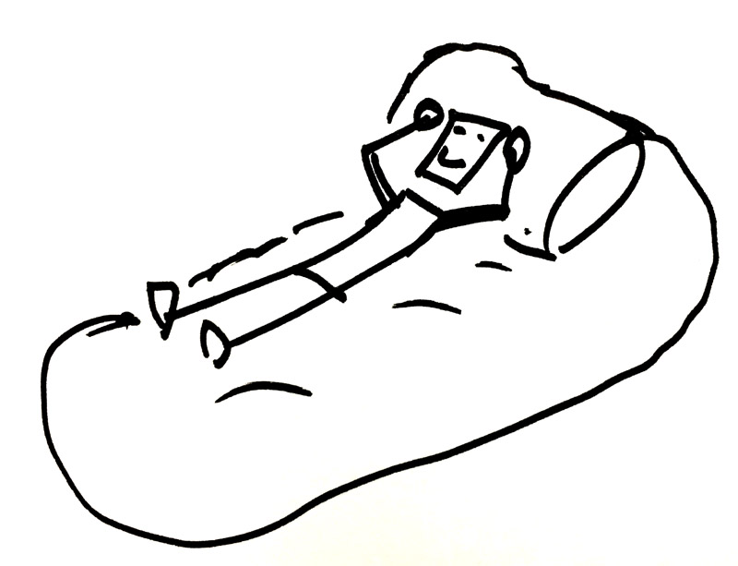
David’s Army
SIN
David
1. His life wasn’t filled with God’s work.

Slide 5
What should he do?
SIN

Slide 6
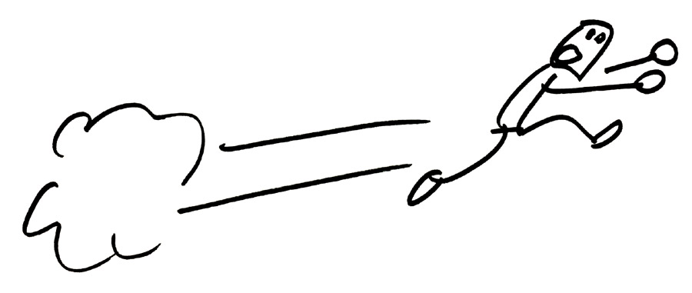
SIN

Slide 7
SIN
But he…

Slide 8
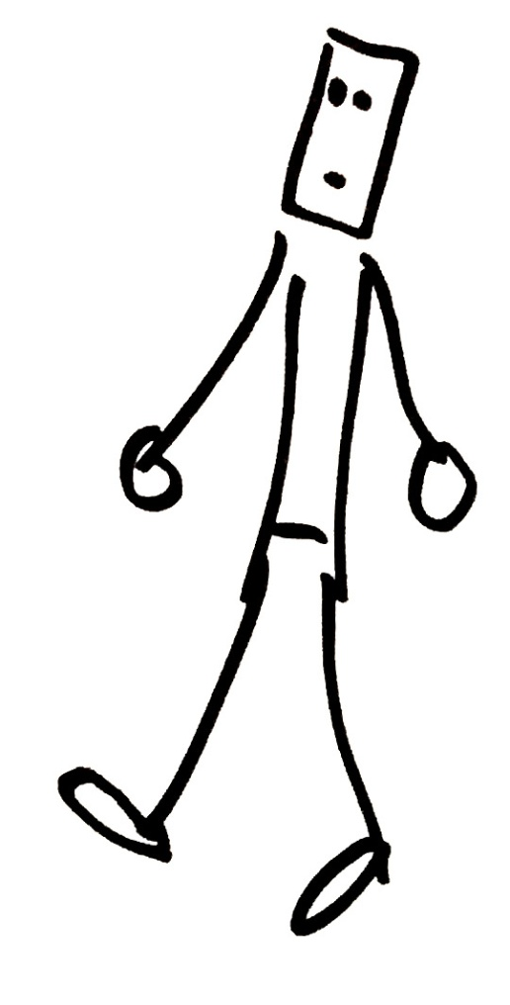
SIN
2. Went closer.

Slide 9
The Embarrassment of Sin

Slide 10
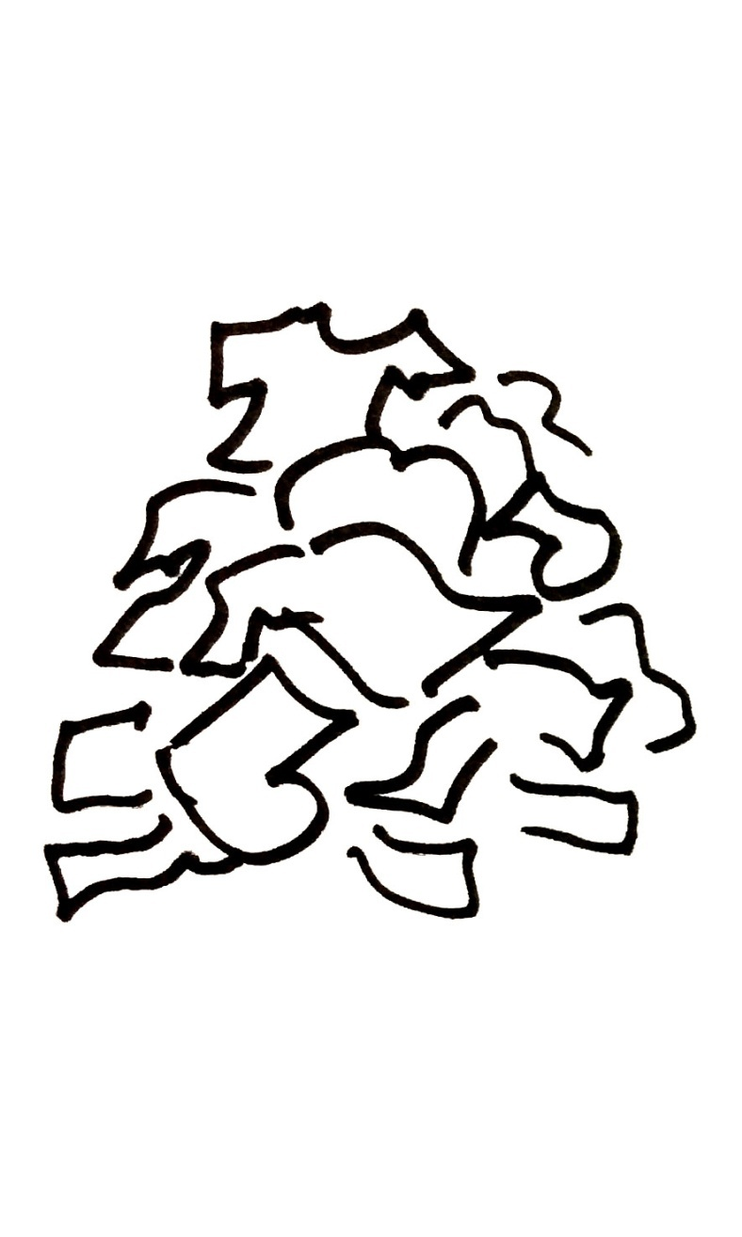

Slide 11
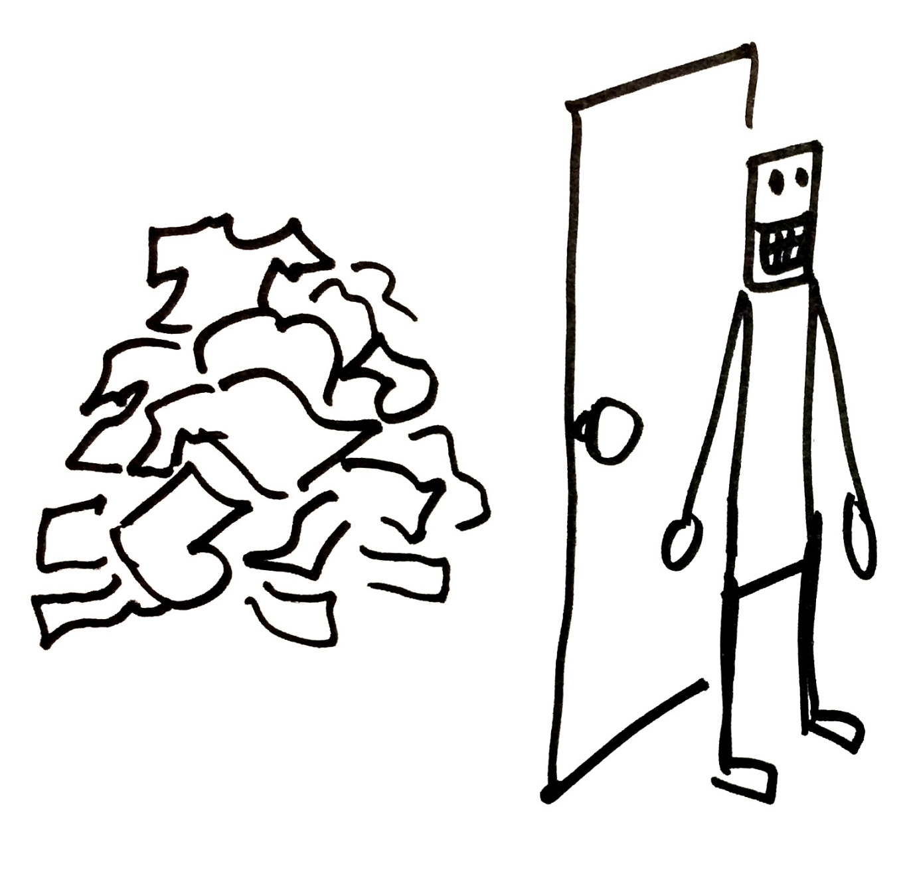

Slide 12
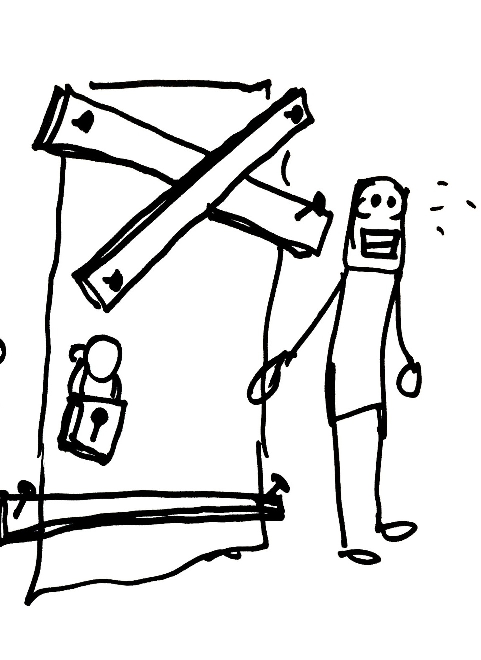

Slide 13
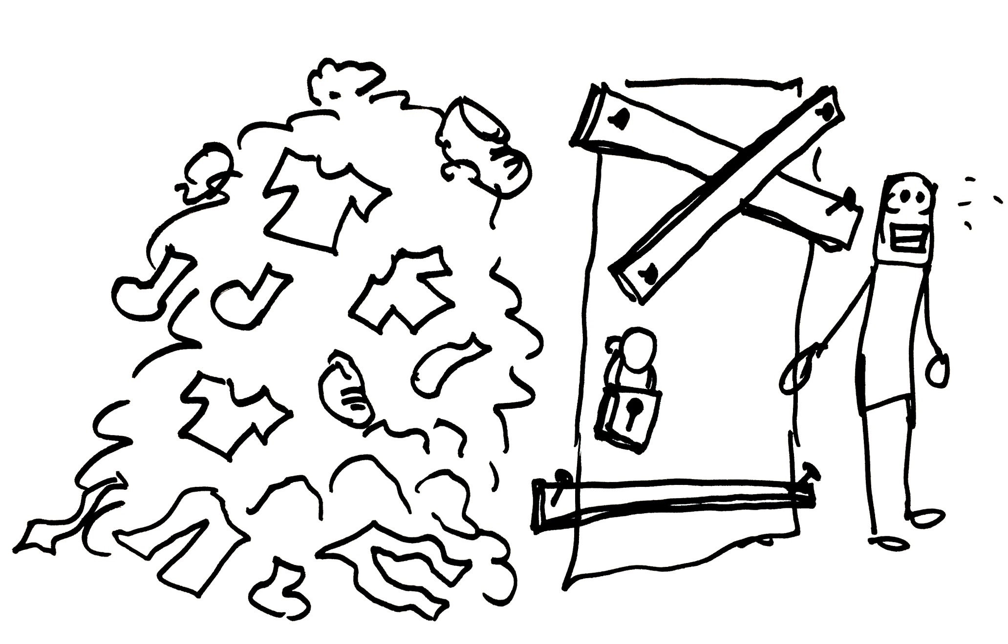
1. Hiding sin never helps you get rid of sin.
2. Hiding sin changes you.

Slide 14
What can save us from this prison?

Slide 15
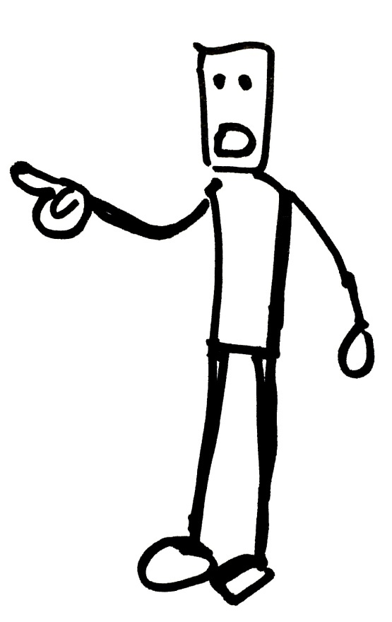
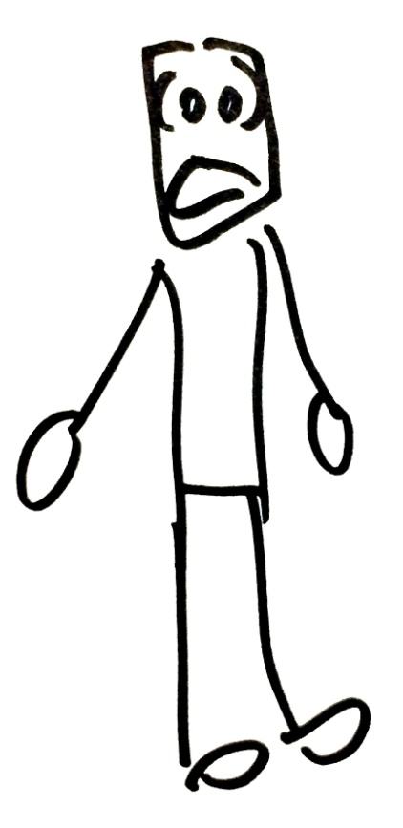
Everyone needs a “Nathan”

Slide 16
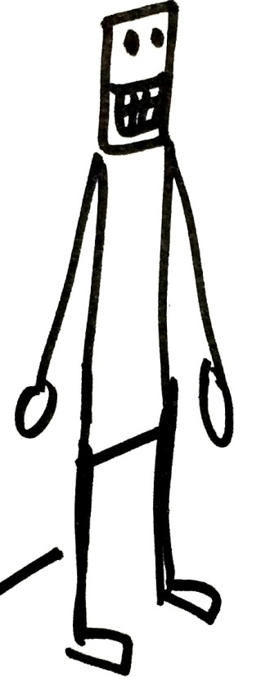
But we often have the opposite kind of friends.

Slide 17
What makes a good “Nathan”?
Someone who…
…is close to you.
…you look up to spiritually.
…loves you enough to come.
…can show you that sin is bad.
…can hold up the mirror.

Slide 19
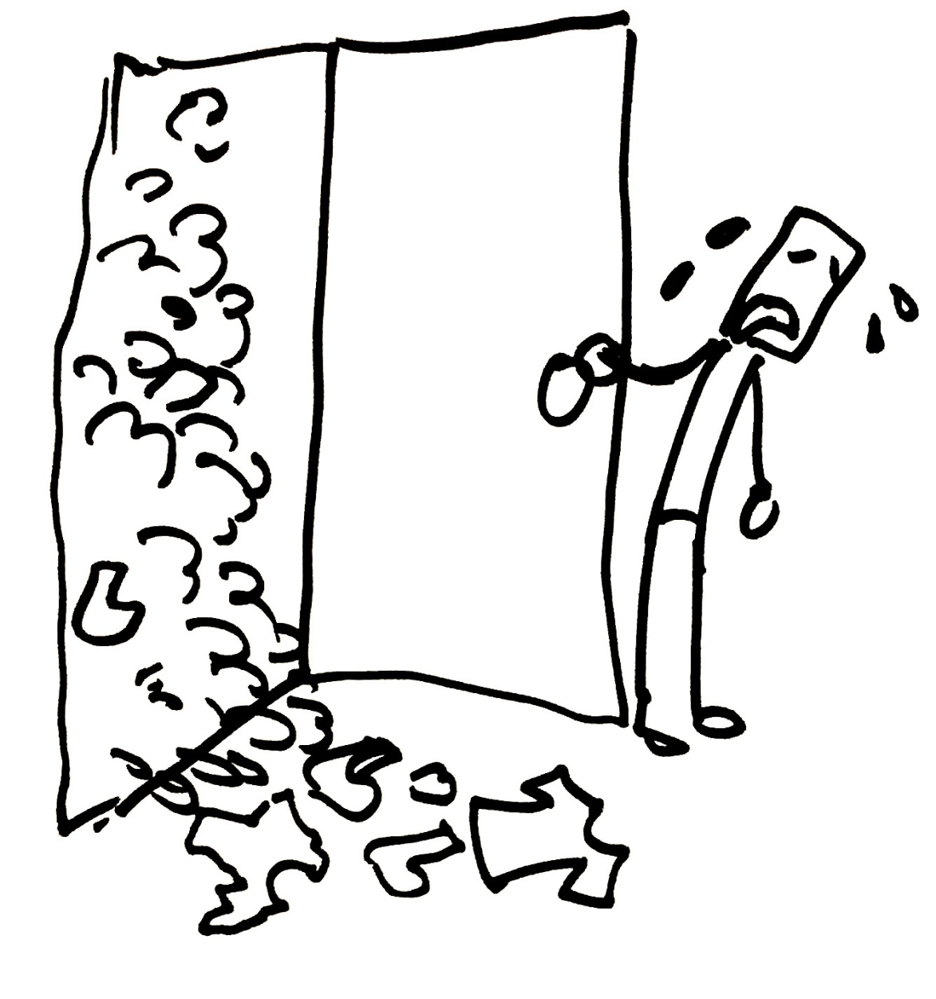
David takes complete responsibility.

Slide 20
And God forgives him.

