Slide 1
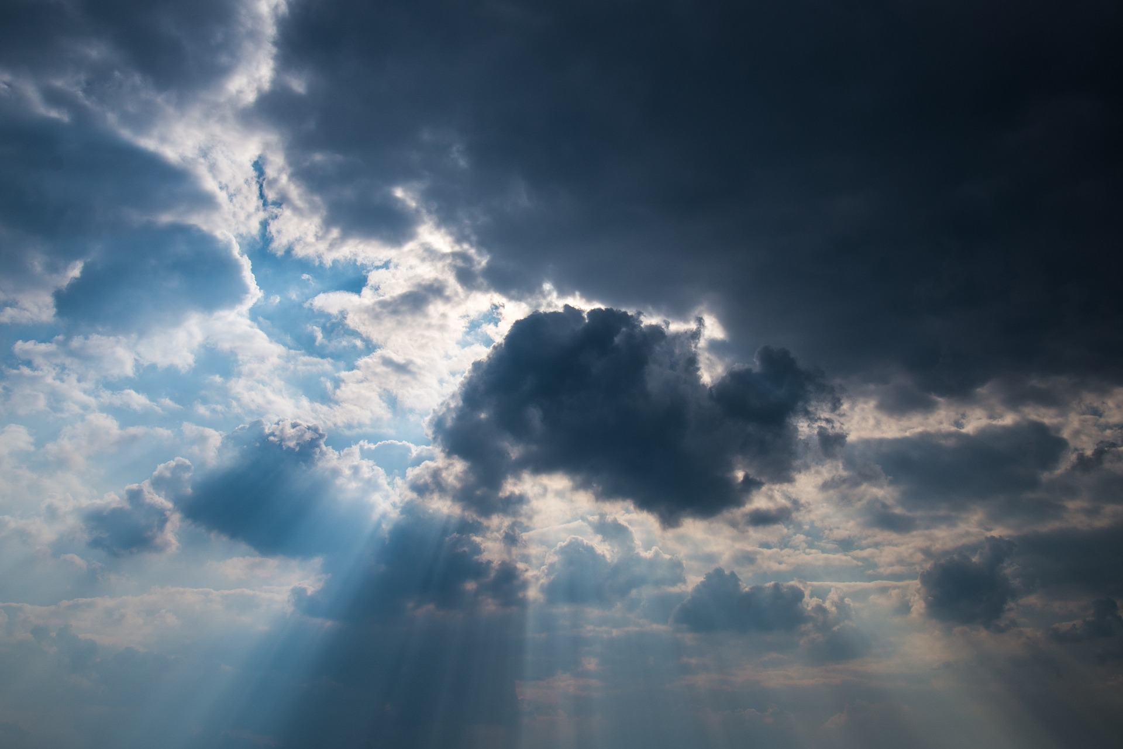
Renewing Our Perspective on
God

Slide 2
Plenty of Evidence
Humans picked a smaller God
That lead to sin
The result is death

Slide 3
Welcome to the Throne Room.

Slide 4
God Created

Slide 5
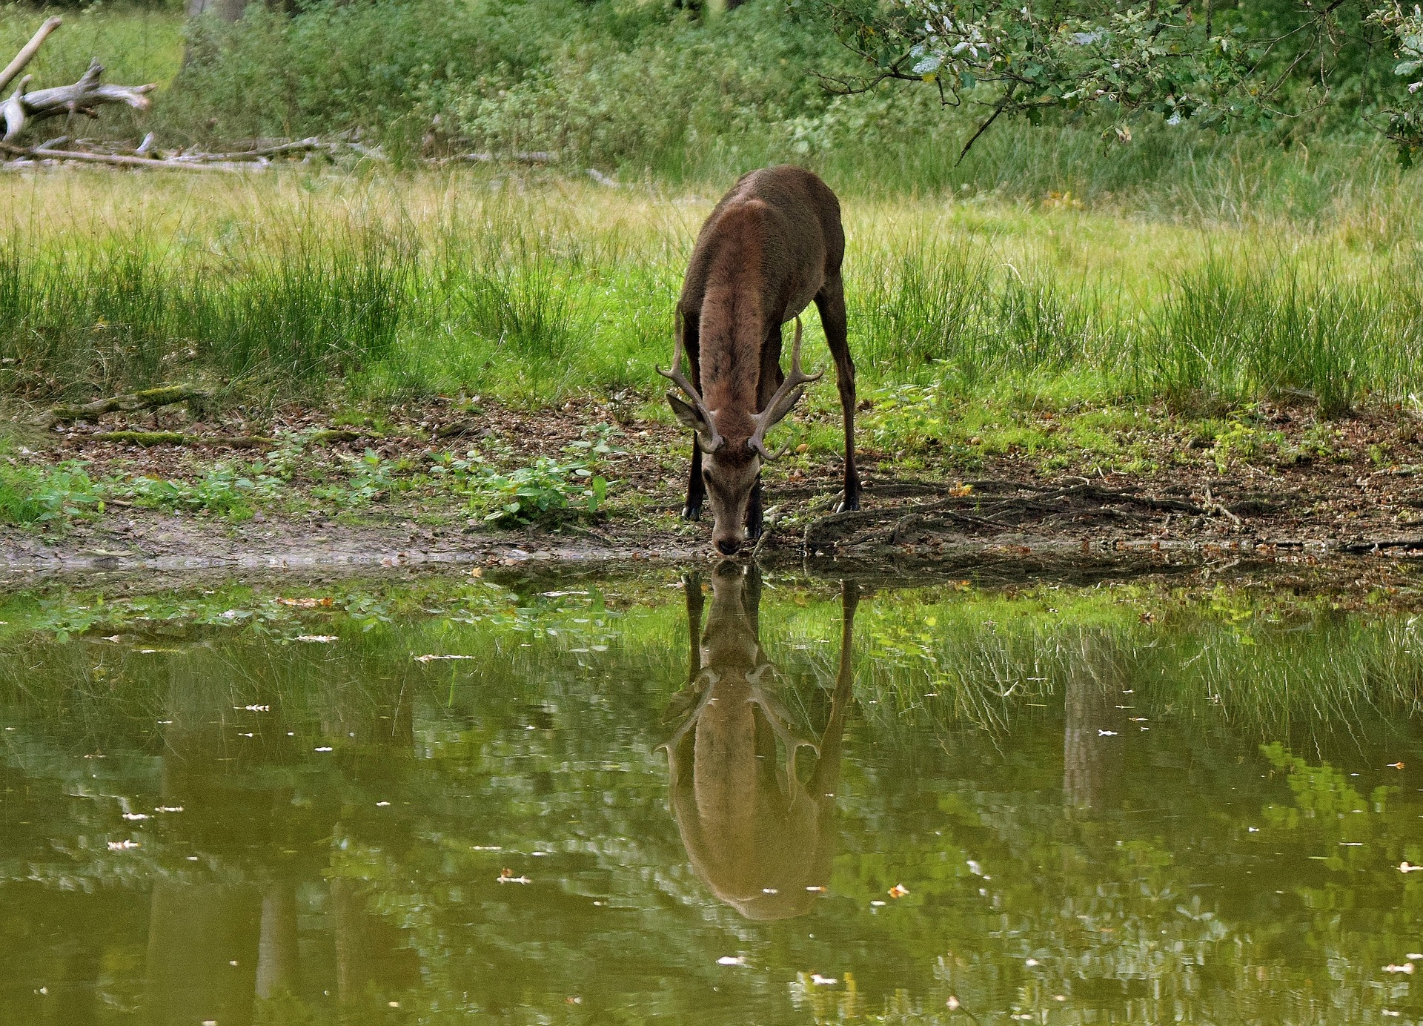
God Sustains It

Slide 6
God Provides

Slide 7
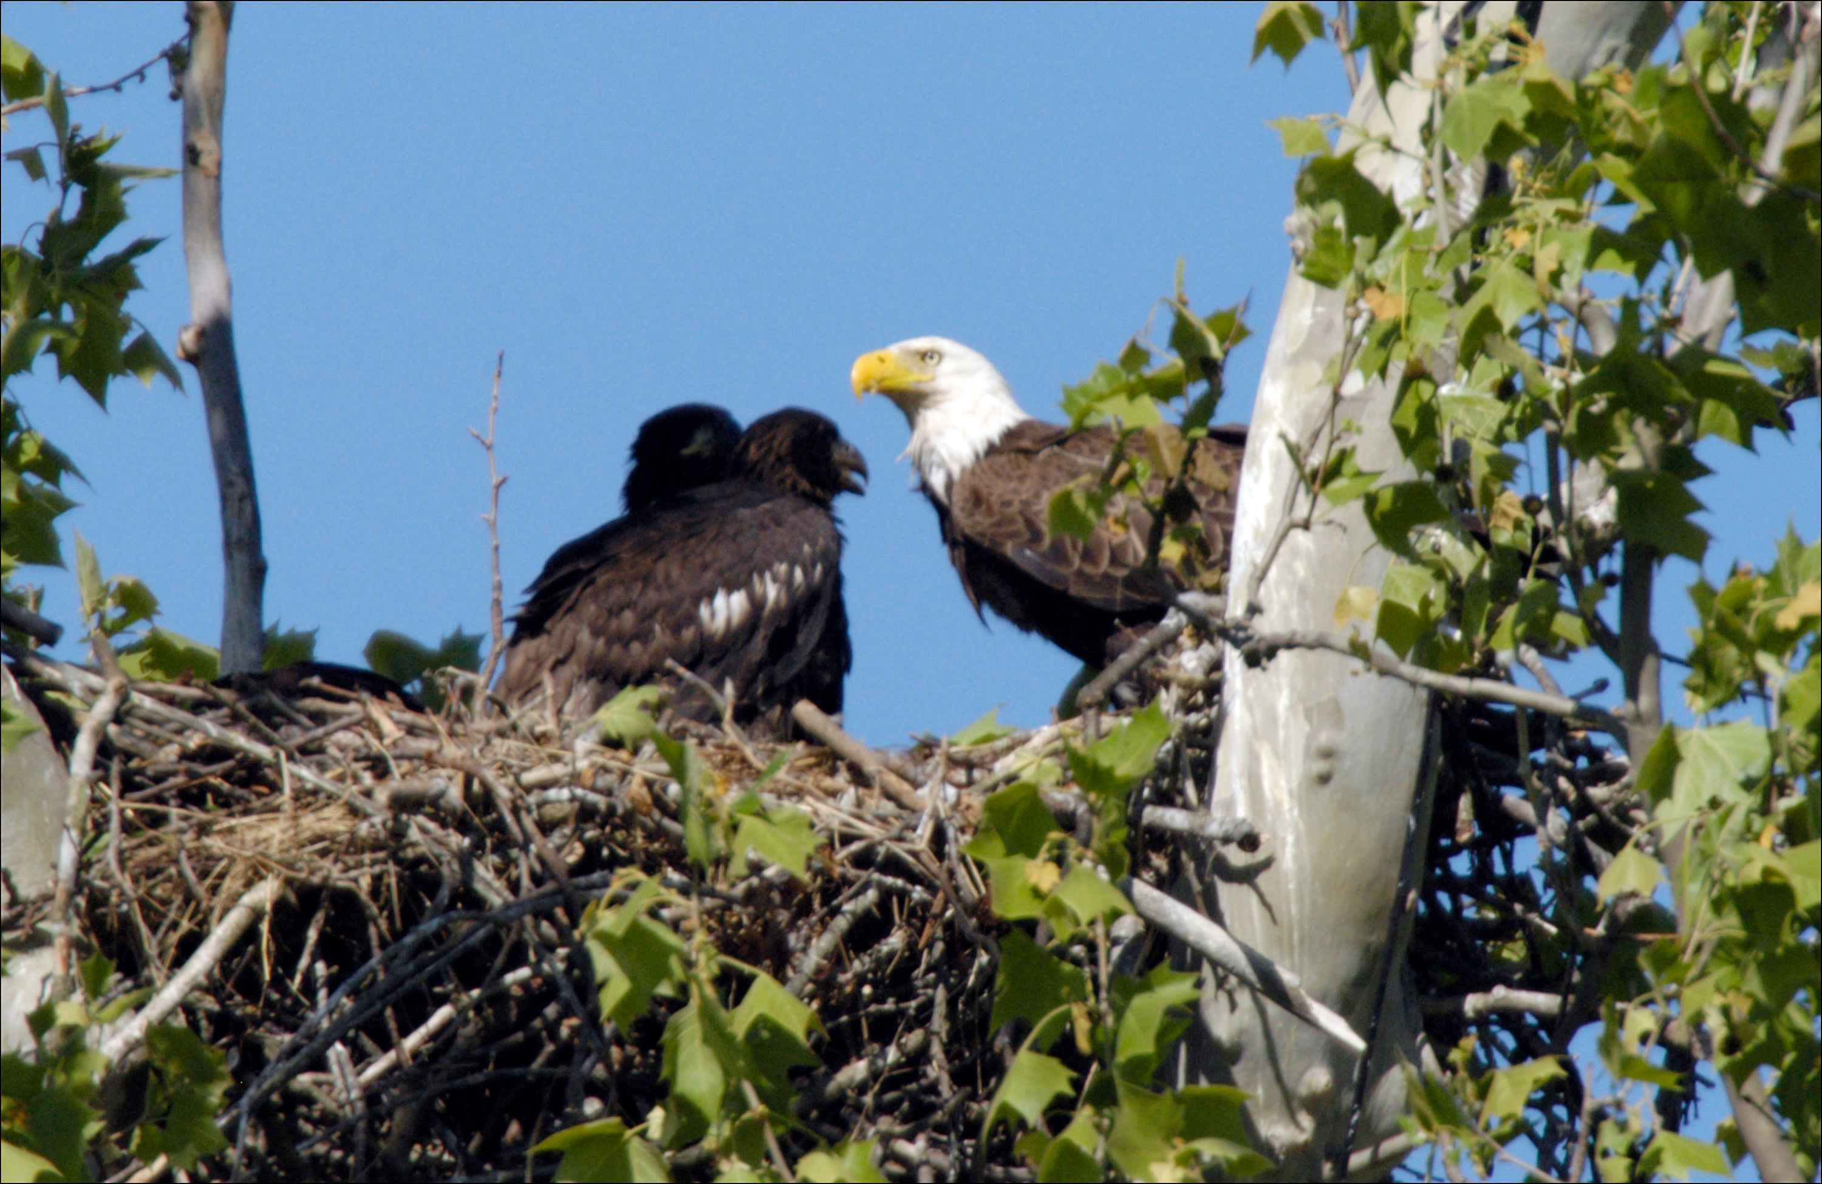
God Gives Homes

Slide 8
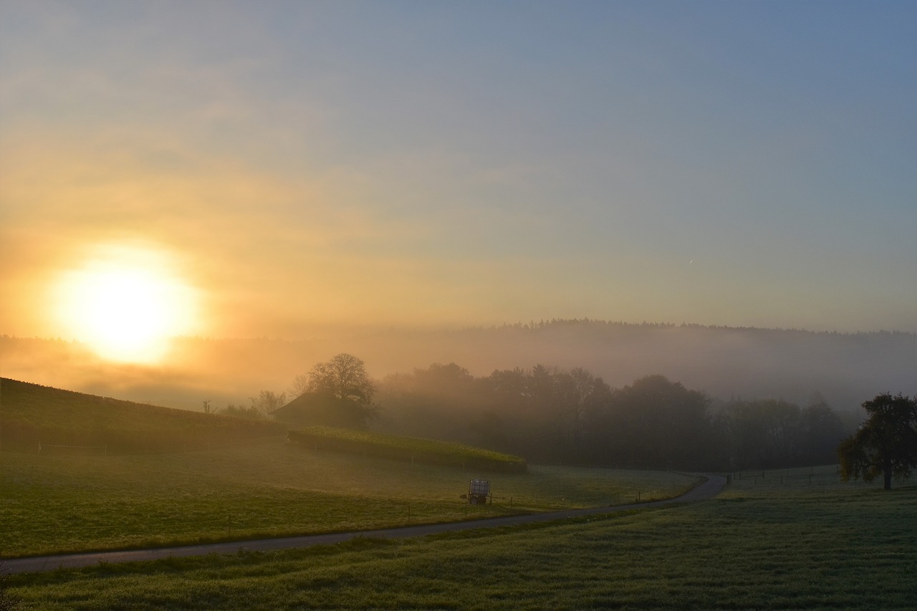
God Keeps It All Going

Slide 9
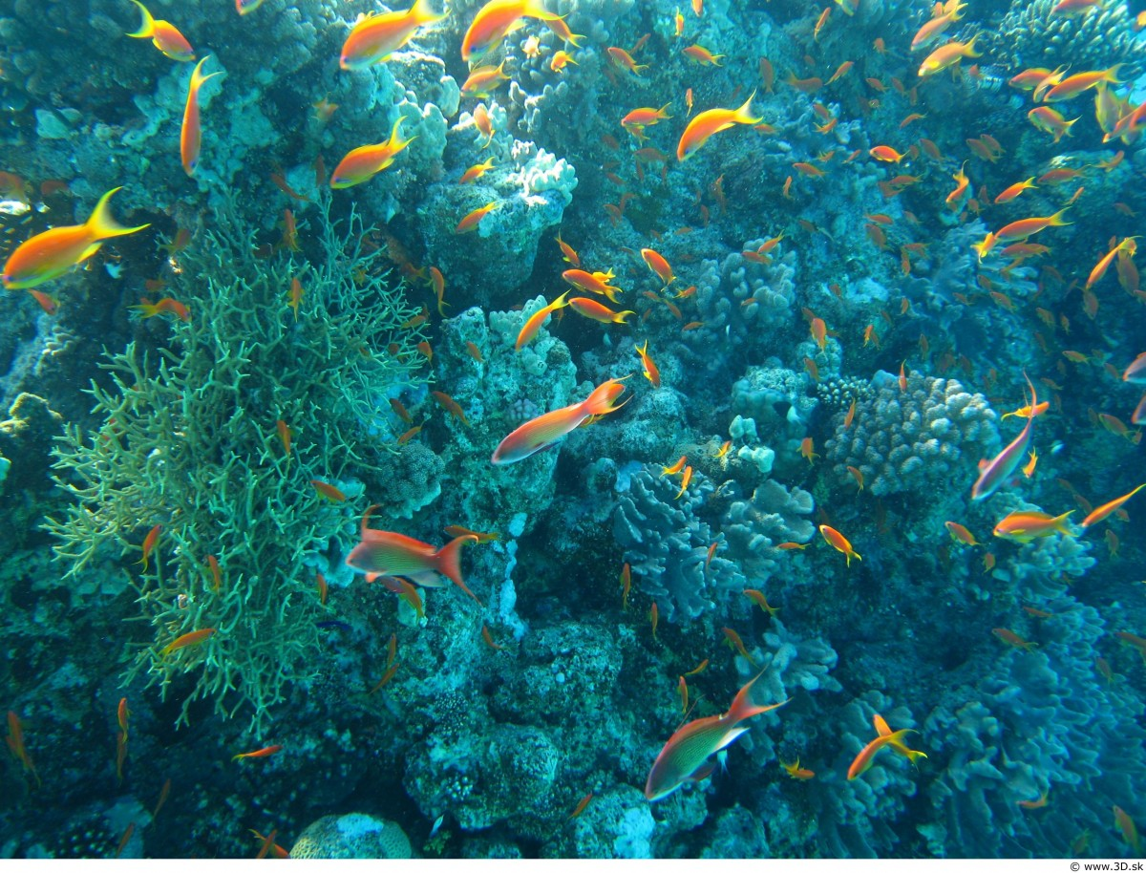
It Seems So Perfect!

Slide 10
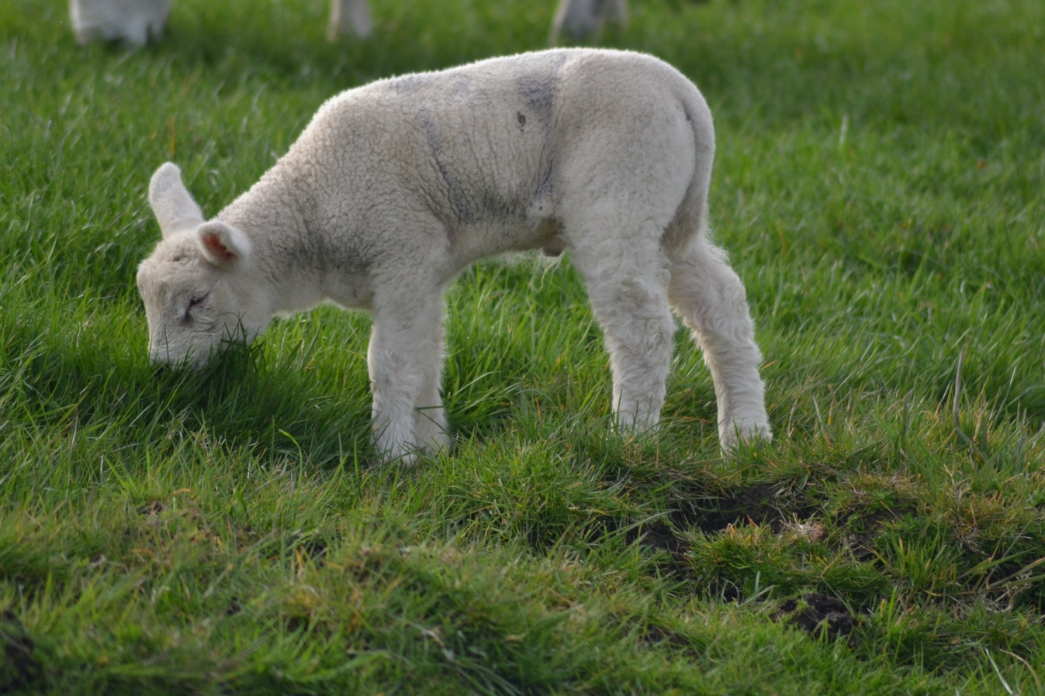
Everything is Dependant on God

Slide 11
Prayer to God:
Glory endure forever
Rejoice in what You made
Because you’re powerful!

Slide 12
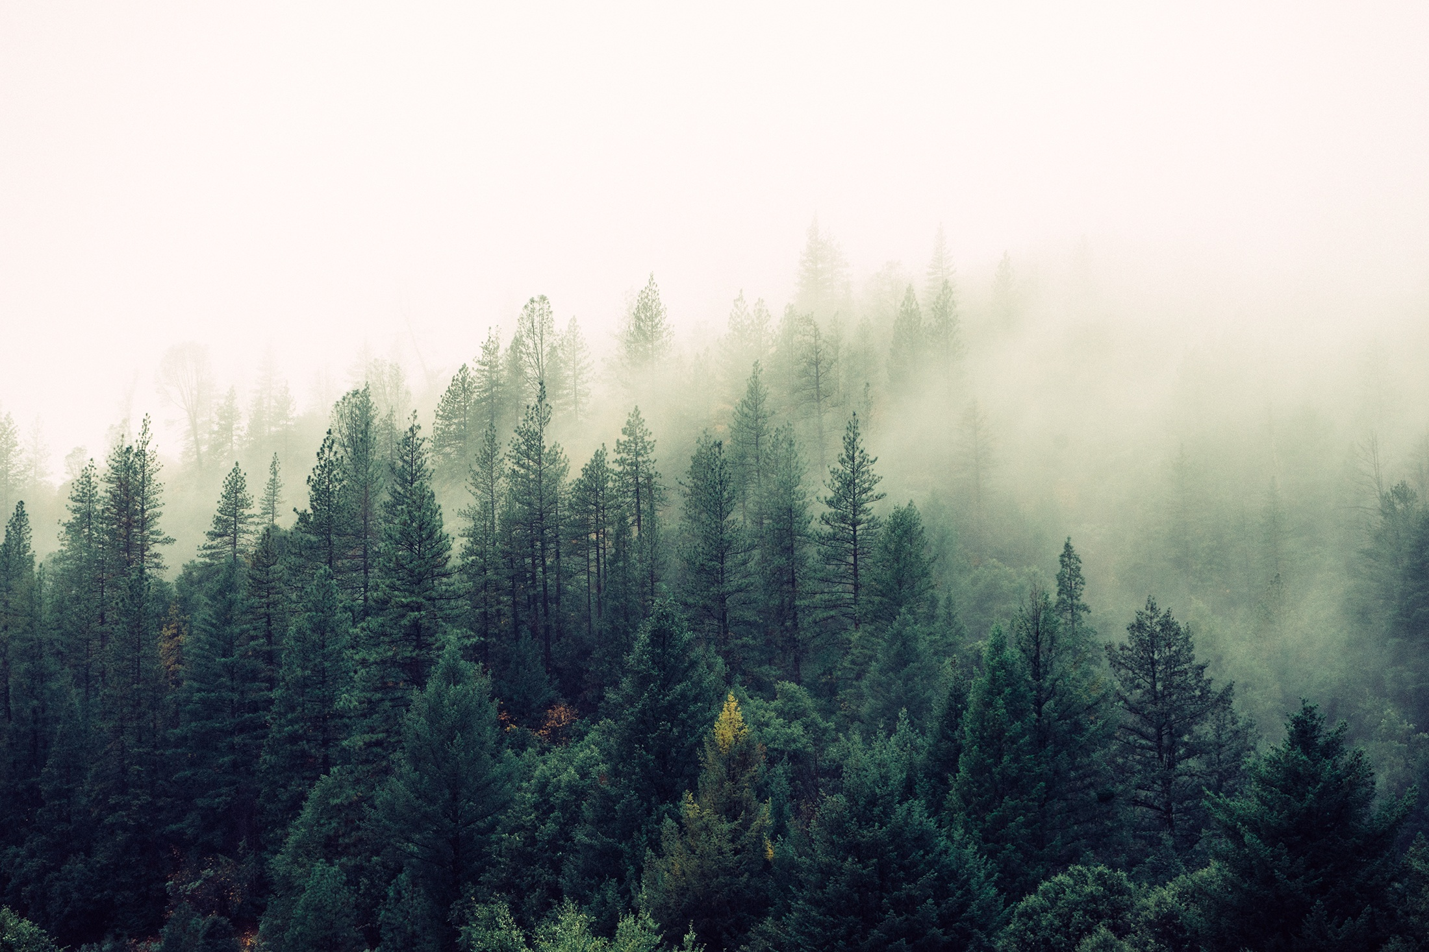
Prayer for Me:
Praise God
Please God
Because I rejoice in GOD

Slide 13
And…
…Destroy the Wicked

Slide 14
Plenty of Evidence
Humans picked a smaller God
That lead to sin
The result is death

Slide 15
Is that the God you serve?

