Slide 1
Conquering with
Zeal
Laodicea

Slide 2
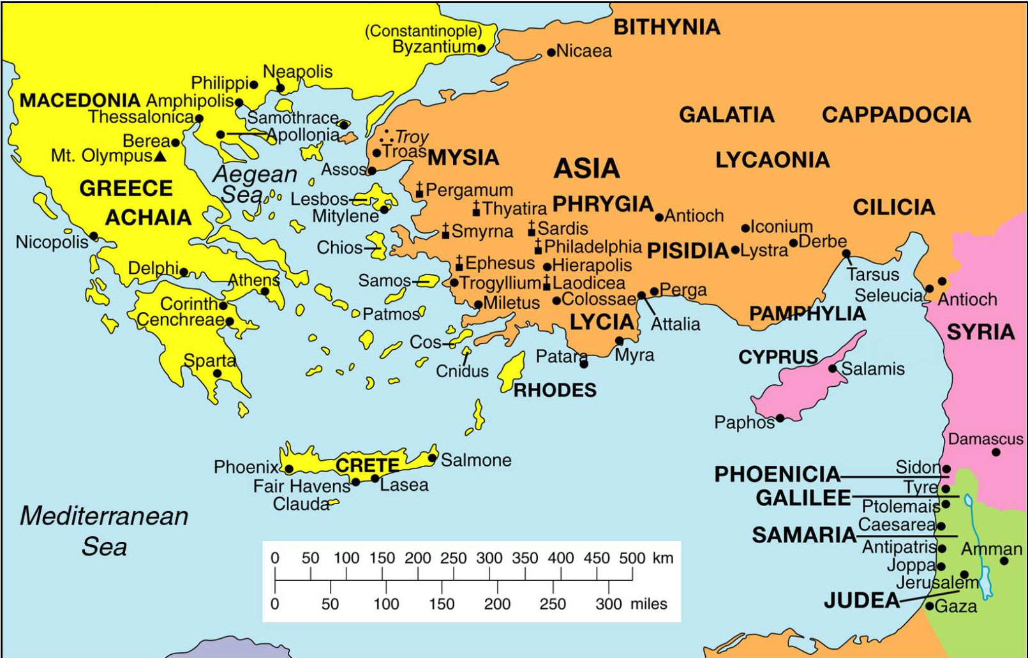

Slide 3
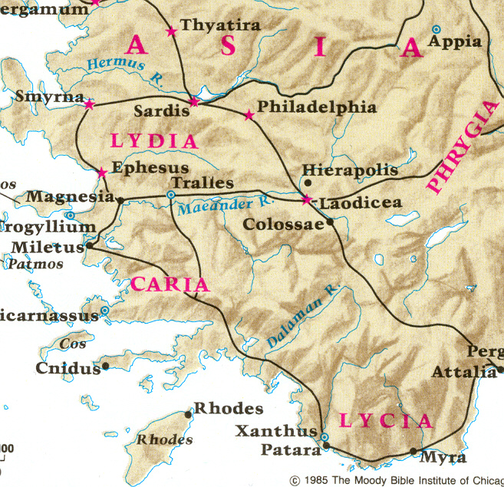

Slide 4
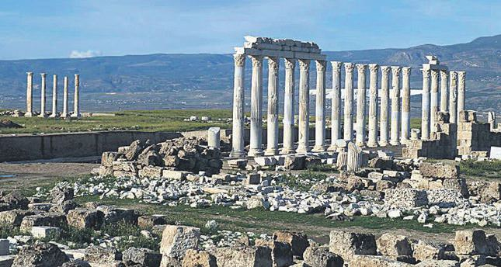

Slide 5
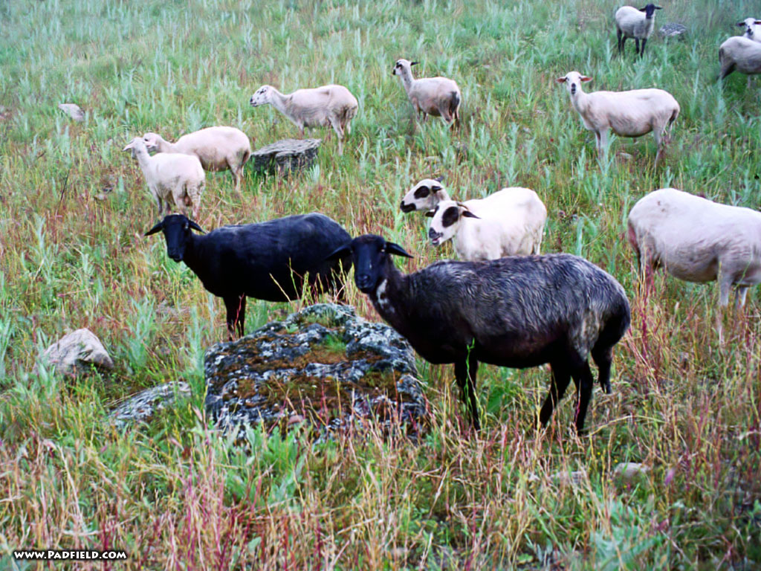

Slide 7
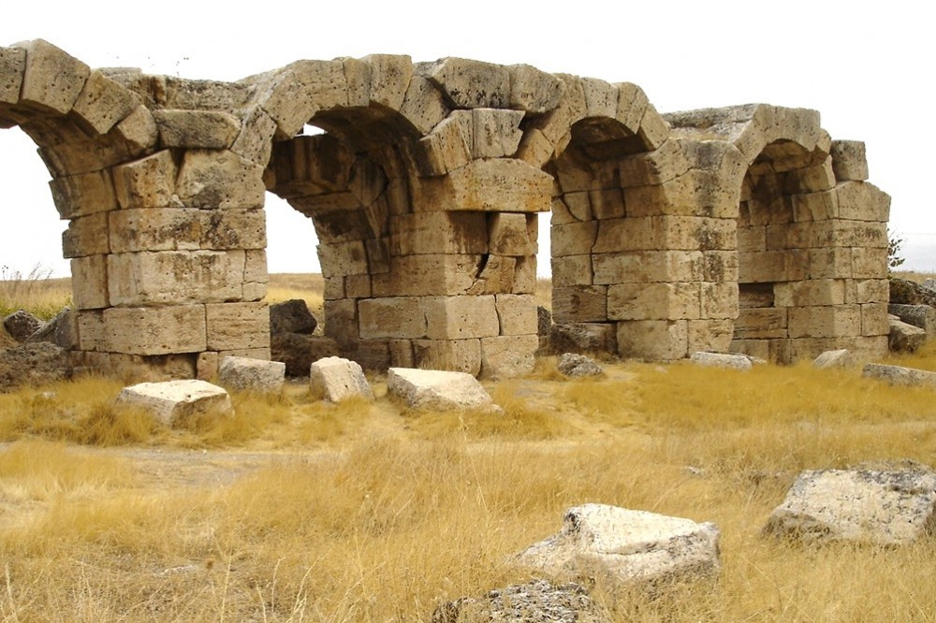

Slide 8
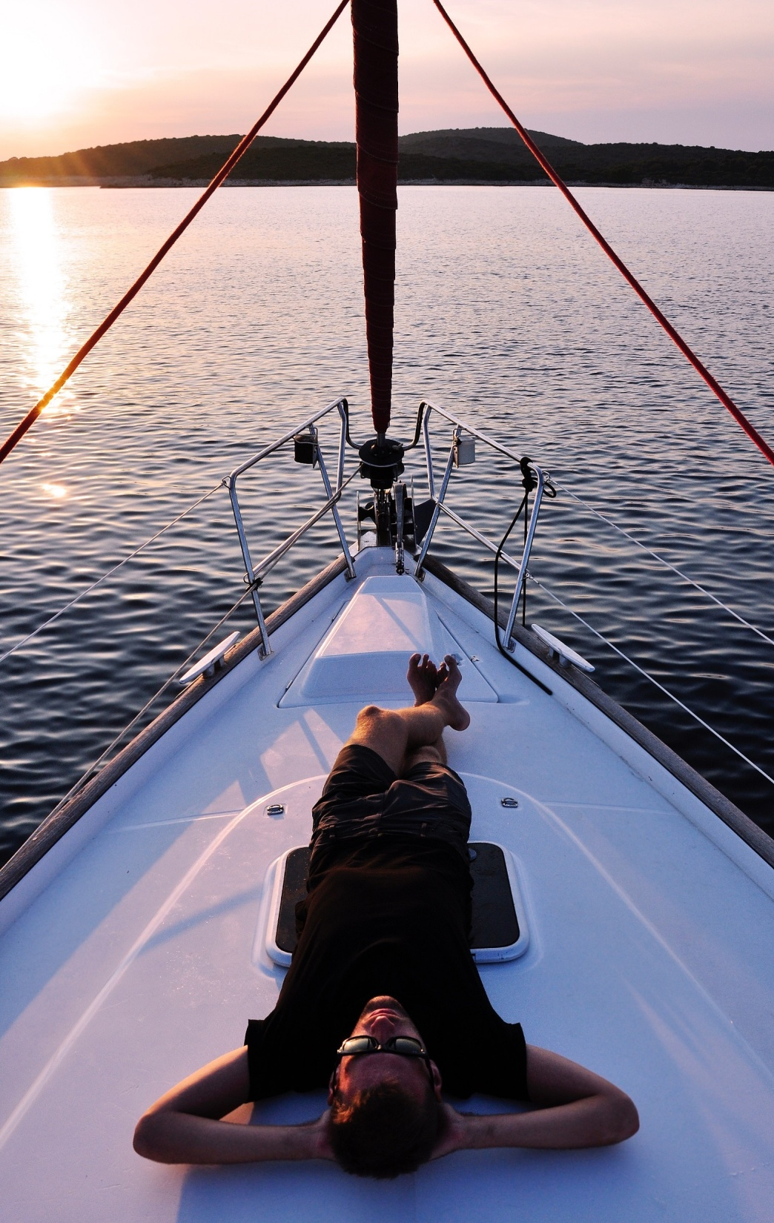
They thought they were:

Slide 9
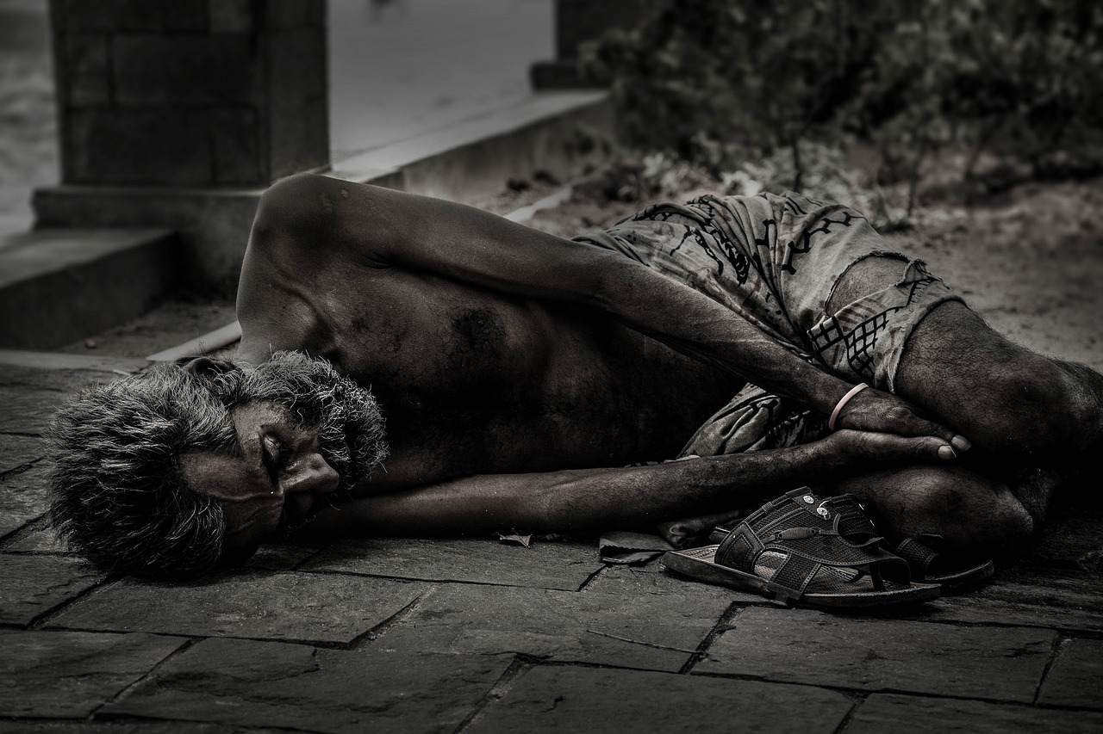
But they were:

Slide 10
What were they doing wrong?

Slide 11
COLD
LUKEWARM
HOT
(Not following God)
(Zealous for God)

Slide 12
Bad place
Better place
Even Better!
Much better!
Best!
COLD
LUKEWARM
HOT
(Not following God)
(Zealous for God)

Slide 13
WORST PLACE TO BE.

Slide 14
How do we fix it?

Slide 15
I need…
I need NOTHING.

Slide 16
I need…
Gold
Clothes
Sight

Slide 17
This is a hard letter to read.

Slide 18
You have to want it.

