Slide 1
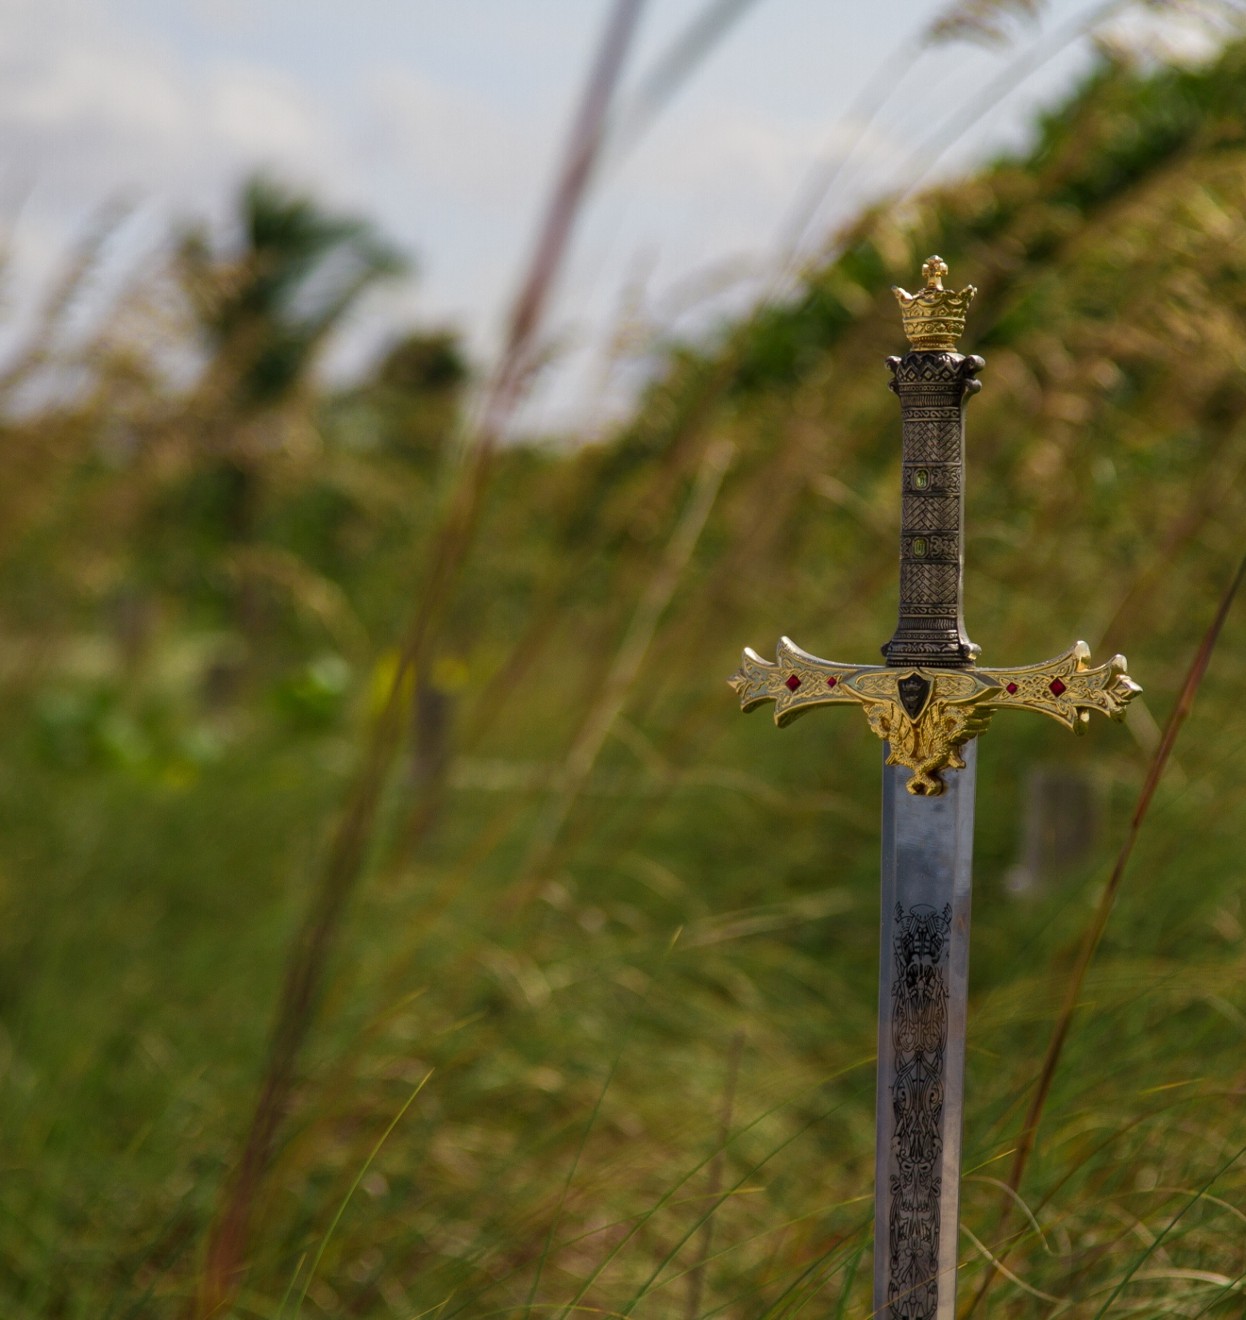
The First Battle in the Bible

Slide 2
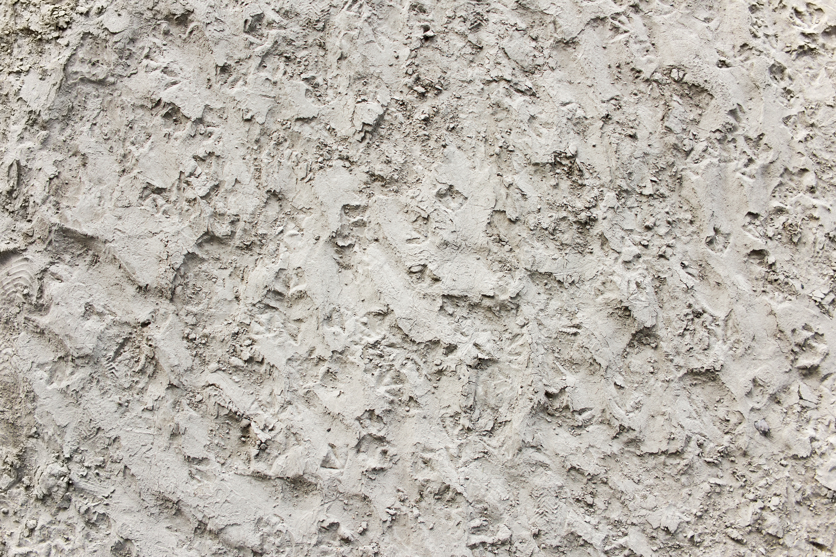
The Promise

Slide 3
The Choice

Slide 4
The Blessing

Slide 5
The Consequence

Slide 6
What’s Abraham Going to Do About It?

Slide 7
The Victory

Slide 8
The Praise

Slide 9
The Story Sounds a Lot Like…
Jesus
Me?

