Slide 2
John’s Vision
Jesus is POWERFUL

Slide 3
We are in a battle

Slide 6
Identifying the Dangers
Lack of Love

Slide 7
Trials

Slide 8
False Teaching

Slide 9
Tolerate Sin

Slide 10
Spiritually Dead

Slide 11
Seize Your Crown

Slide 12
Lukewarm

Slide 13
How do we do that?

Slide 15
Jesus will win!

Slide 18
It’s About Drawing Close to Christ

Slide 19
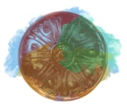
Conquering with zeal
Conquering with purity
Conquering with love
Conquering with truth
Conquering with patience

