Slide 1
How do you handle
Difficulties?

Slide 2
The Song of Hannah

Slide 3
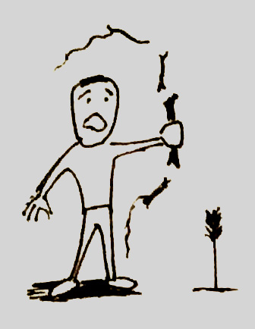
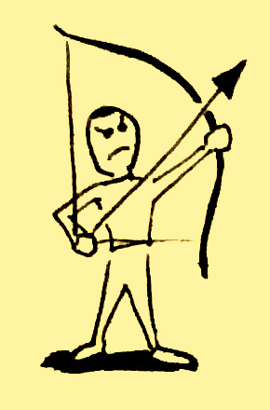

Slide 4
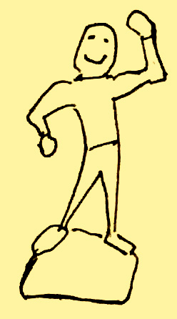
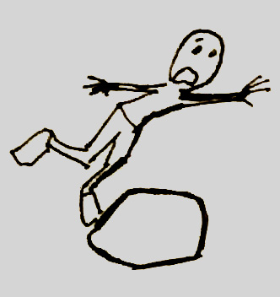

Slide 5
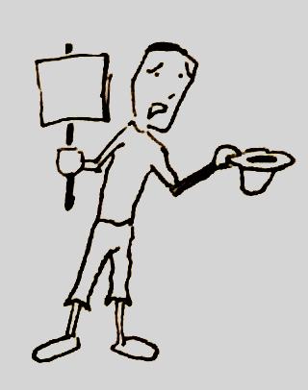
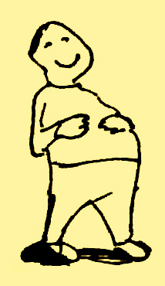

Slide 7
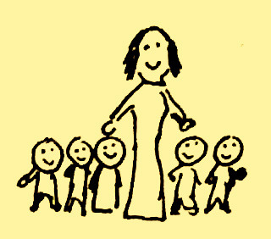
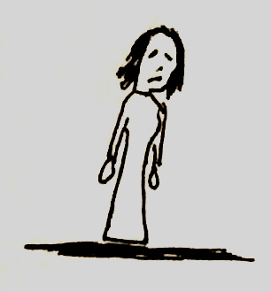

Slide 9
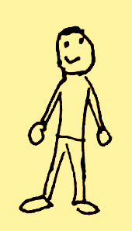
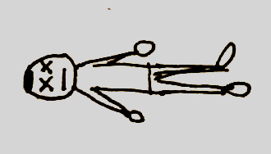

Slide 10
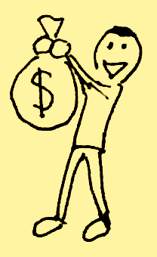

Slide 11
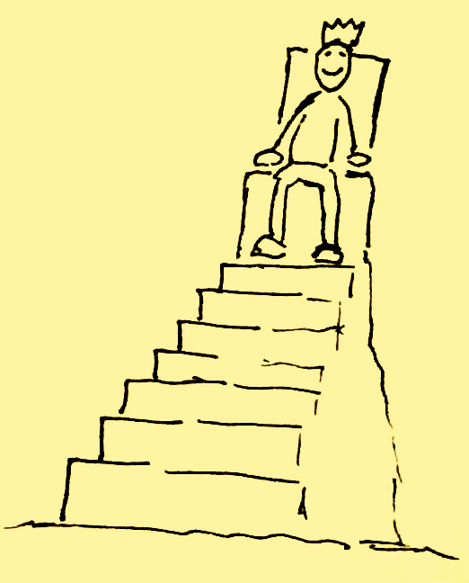
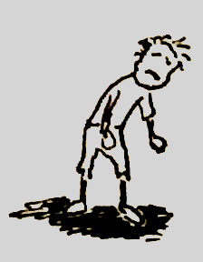

Slide 12
GOD IS POWERFUL

Slide 13
The Way of Fear
The Way of Faith
1 Samuel 13-14

Slide 14
The Way of Fear
Feel overwhelmed
Run from problems
Make poor decisions

Slide 15
The Way of Faith
See God’s power
Find out what God wants
Go and do it
God gives the victory

Slide 16
And what more shall I say? For time will fail me if I tell of Gideon, Barak, Samson, Jephthah, of David and Samuel and the prophets, who by faith conquered kingdoms, performed acts of righteousness, obtained promises, shut the mouths of lions, quenched the power of fire, escaped the edge of the sword, from weakness were made strong.
- Hebrews 11:32-34

