Slide 2
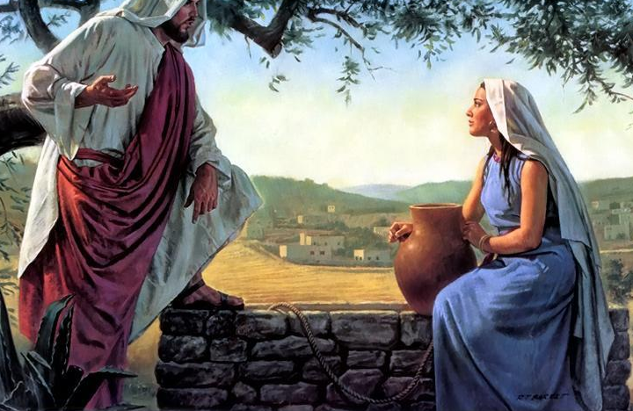
I. The Setting (vs. 1-6)
A) Jesus’ rising popularity
B) Jesus & disciples go to Galilee.
C) En route, He passes through Samaria
D) Exhausted by the long trip, He comes to rest at a well

Slide 3
II. The Conversation
A) The discussion (vs. 7-25)
B) The declaration (v. 26)

Slide 4
III. The Reaction (vs. 27-42)
A) …of the Samaritan woman (vs. 28-29)
B) …of the Samaritan men (vs. 30, 39-42)
C) …of the disciples (vs. 31-38)

Slide 6
John 4:7-14
“There came a woman of Samaria to draw water. Jesus said to her, ‘Give Me a drink.’
(8) For His disciples had gone away into the city to buy food.
(9) Therefore the Samaritan woman said to Him, ‘How is it that You, being a Jew, ask me for a drink since I am a Samaritan woman?’ (For Jews have no dealings with Samaritans.)

Slide 7
John 4:7-14
(10) Jesus answered and said to her, ‘If you knew the gift of God, and who it is who says to you, 'Give Me a drink,' you would have asked Him, and He would have given you living water.’
(11) She said to Him, ‘Sir, You have nothing to draw with and the well is deep; where then do You get that living water?

Slide 8
John 4:7-14
(12) You are not greater than our father Jacob, are You, who gave us the well, and drank of it himself and his sons and his cattle?’
(13) Jesus answered and said to her, ‘Everyone who drinks of this water will thirst again;
(14) but whoever drinks of the water that I will give him shall never thirst; but the water that I will give him will become in him a well of water springing up to eternal life.’”

