Slide 2
I. YOU Are Worth a Son of God

Slide 3
II. YOU Are Worth a Son of God
Despite Your Sins

Slide 4
III. Your NEIGHBOR is Worth a Son of God

Slide 5
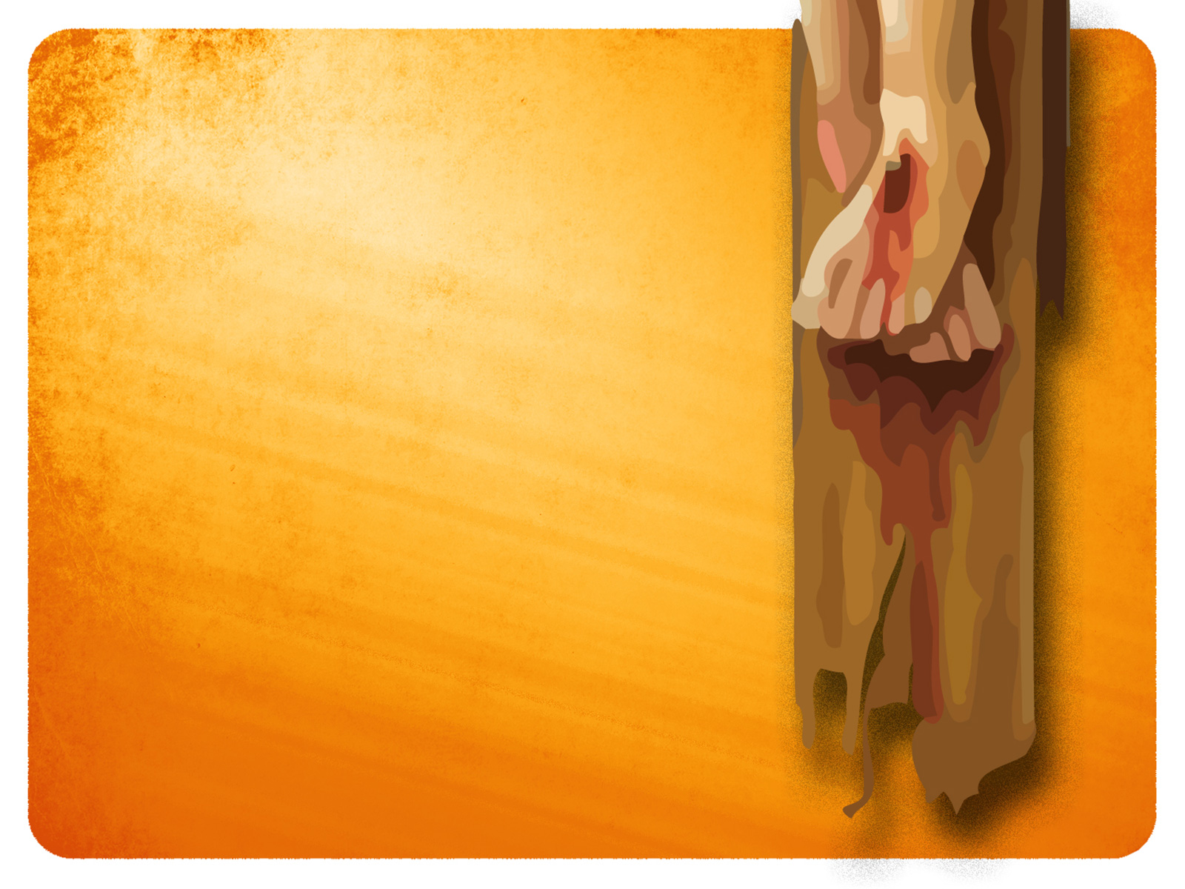
IV. What Are YOU WORTH to YOU?

Slide 6
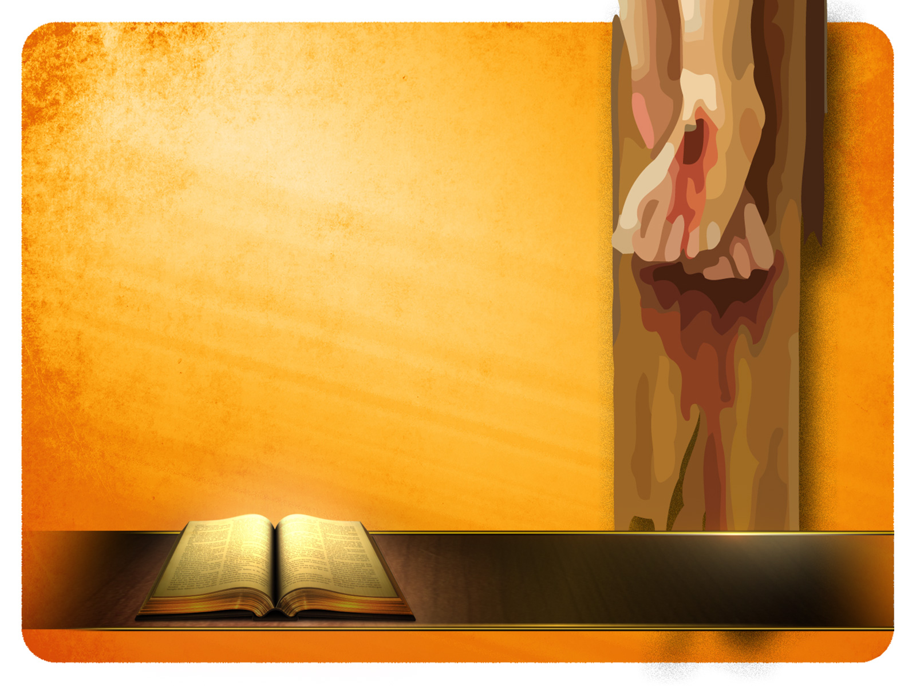
“I have been crucified with Christ; and it is no longer I who live, but Christ lives in me; and the life which I now live in the flesh I live by faith in the Son of God, who loved me and gave Himself up for me.” (Galatians 2:20)

