Slide 2
1 KINGS 17

Slide 4
I. A Fresh Path
(vs. 8-11)

Slide 5
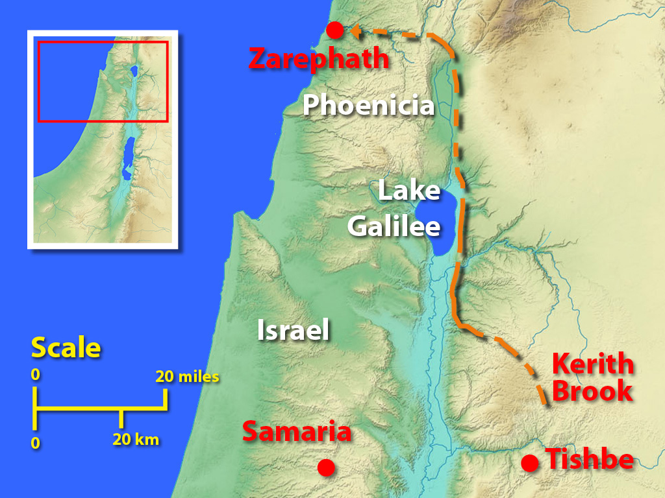
A) The Call

Slide 6
B) The Command
“Arise, go to Zarephath, which belongs to Sidon, and dwell there…”

Slide 7
C) The Challenge
“Behold, I have commanded a widow there to feed you.”

Slide 8
D) The Comfort
“So he arose and went to Zarephath. And when he came to the gate of the city, behold, a widow was there gathering sticks…”

Slide 9
II. A Fantastic Plan
(vs. 12-15a)

Slide 10
A) A Doubt
“And she said, ‘As the LORD your God lives, I have nothing baked, only a handful of flour in a jar and a little oil in a jug. And now I am gathering a couple of sticks that I may go in and prepare it for myself and my son, that we may eat it and die.’”

Slide 11
B) A Demand
“And Elijah said to her, ‘Do not fear; go and do as you have said. But first make me a little cake of it and bring it to me, and afterward make something for yourself and your son.’”

Slide 12
C) A Decision
“And she went and did as Elijah said.”

Slide 13
III. A Fabulous Provision
(vs. 15-16)

