Slide 1
Ten Fingers
of
Salvation

Slide 2
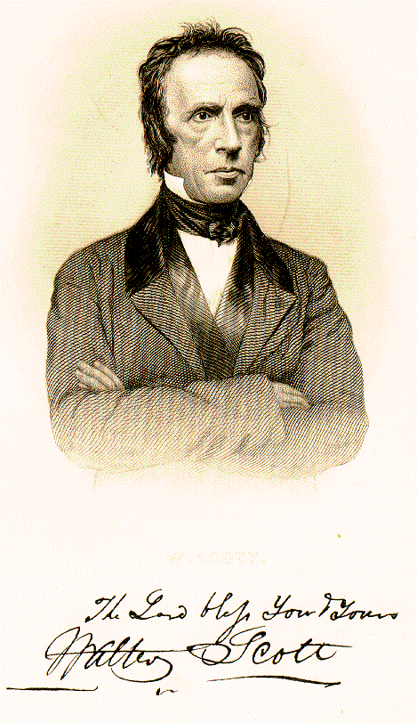
Walter Scott
1796-1861
5-Finger Exercise:
Faith
Repentance
Baptism
Remission of Sins
Holy Spirit & Eternal Life

Slide 3
5-Finger Exercise:
Hear
Believe
Repent
Confess
Be Baptized

Slide 4
Unanticipated Problems...
No mention of God’s grace.
Salvation by human initiative alone.
Sounds like justification by works.
Over time, easy-to-remember slogans can take the place of God’s word!

Slide 5
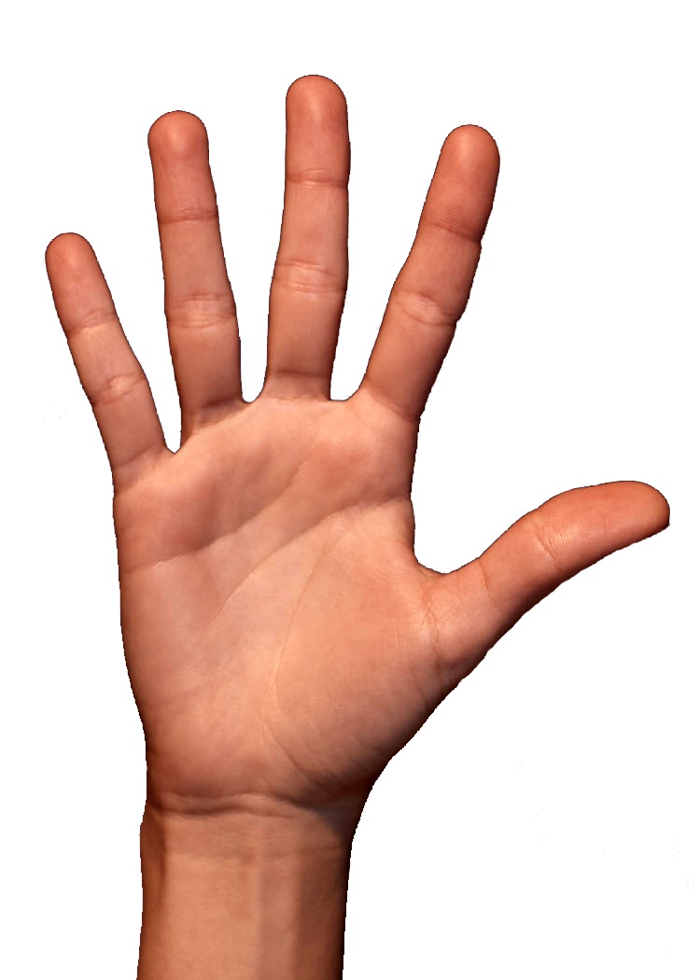
A More Complete Memory Exercise:
Use All Ten Fingers!

Slide 6
A More Complete Memory Exercise:
Grace - Ephesians 2:8
Love - John 3:16
Mercy - Ephesians 2:4
Blood - Eph. 1:7; 1 Pet. 1:18-19
Revelation - Eph. 1:9; 2 Tim. 3:16-17

Slide 7
A More Complete Memory Exercise:
Hear - Romans 10:17
Believe - John 8:24
Repent - Acts 17:30
Confess - Romans 10:8-9
Baptism - Mark 16:16; Acts 2:38; Rom. 6:1-4; Galatians 3:27; 1 Peter 3:21

Slide 8
A More Complete Memory Exercise:
Grace
Hear
Love
Believe
Mercy
Repent
Blood
Confess
Revelation
Be Baptized

Slide 9
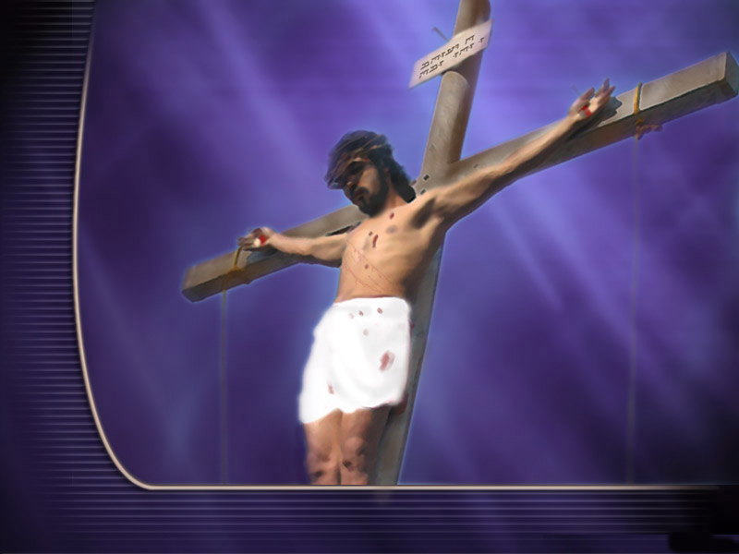
“The whole counsel of God” Acts 20:27
Man’s
Response
God’s
Provision

Slide 10
Hear the WORD of God
Confess Your FAITH in Christ
Be Baptized INTO Christ
Believe in JESUS as Christ
Repent of YOUR Sins
Abide Faithfully IN Christ

Slide 11
Ten Fingers
of
Salvation

