Slide 3
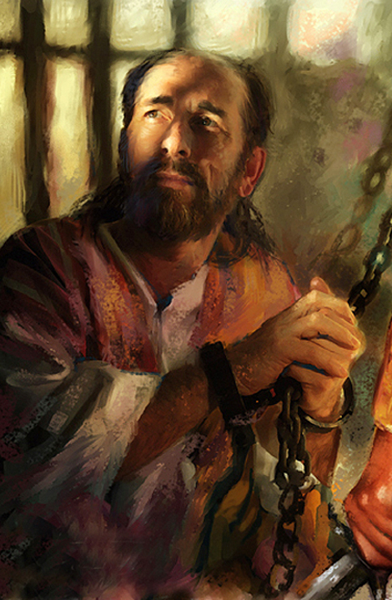
Life Has Crossroads
A) Paul’s fork (Acts 9)
B) Paul found Christ was always there.
C) We need to make Paul’s words our own.

Slide 4
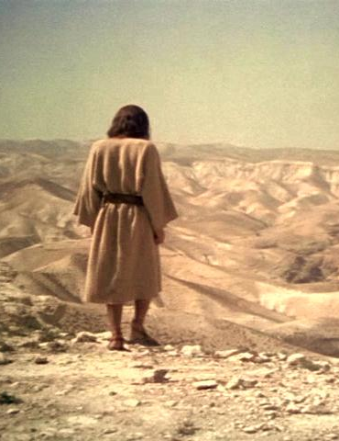
II. Jesus’ Encounter with the Tempter (Matt. 4)
A) Setting (vs. 1-2)
B) Temptations:
1. Personal (v. 3-4)
2. Public (v. 5-7)
3. Power (v. 8-10)

Slide 5
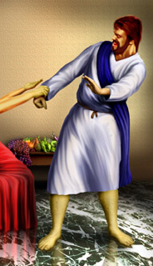
III. When Temptation Crosses Our Path
A) Don’t be alarmed ...
expect it!
B) Don’t be blind . . .
detect it!
C) Don’t be clever . . .
reject it!

