Slide 2
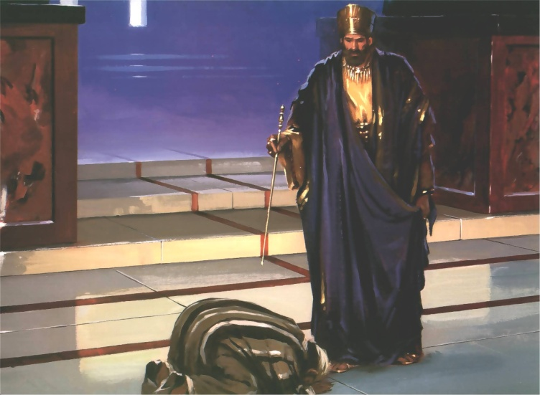
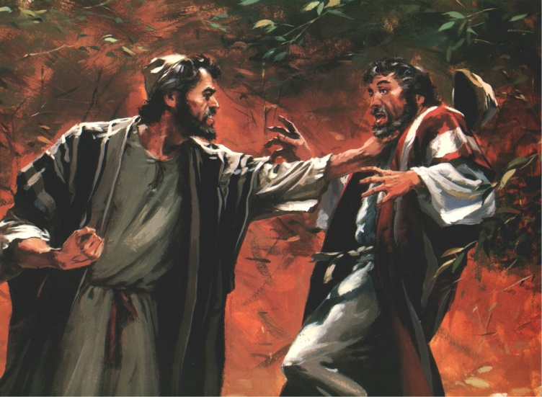
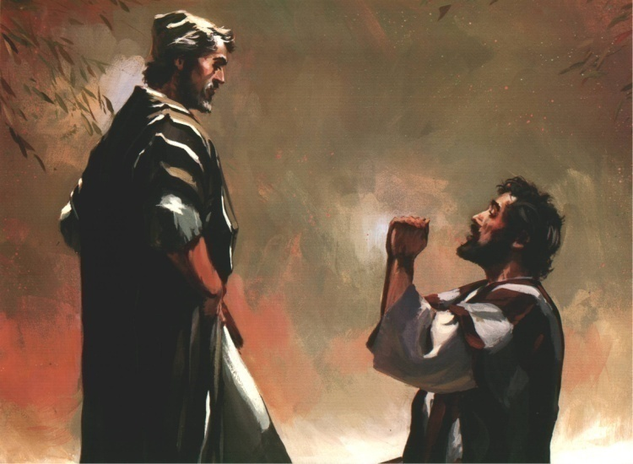

Slide 3
I. Peter's question
A) How often should I forgive a brother?
B) Peter offers 7 as a possible answer
II. The Lord’s Answer
A) Jesus took Peter’s symbolic number for completeness and multiplied it
B) Jesus is teaching that forgiveness should never be exhausted

Slide 4
III. The Parable: Scene One
A) Debt (vs. 23-24)
B) Decree (v. 25)
C) Desperation (v. 26)
D) Deliverance (v. 27)

Slide 5
IV. The Parable: Scene Two
A) Pitiful request (vs. 28-29)
1. We fail to note the insignificance of others debt…
2. Think ourselves superior to others

Slide 6
IV. The Parable: Scene Two
A) Pitiful request (vs. 28-29)
B) Pitiless response (30)
C) v. 31 - Other slaves see and are “deeply grieved.”

Slide 7
V. The Parable: Scene Three
A) Outrage (v. 32)
1. The reminder
2. The rebuke (33)
B) Outcome (v. 34) (2 Peter 2:20-22)

Slide 8
VI. The Overall Lesson
A) If we expect the Lord to forgive…
B) Follow the biblical model:
1. If your brother sins (Lk. 17:3)
2. Must be inexhaustible & immediate (Lk. 17:4)
3. Forgive quickly (Eph. 4:26-27).
4. Keep no record of wrongs (1 Cor. 13:5).
5. Cover sins with love (1 Peter 4:8).

