Slide 2
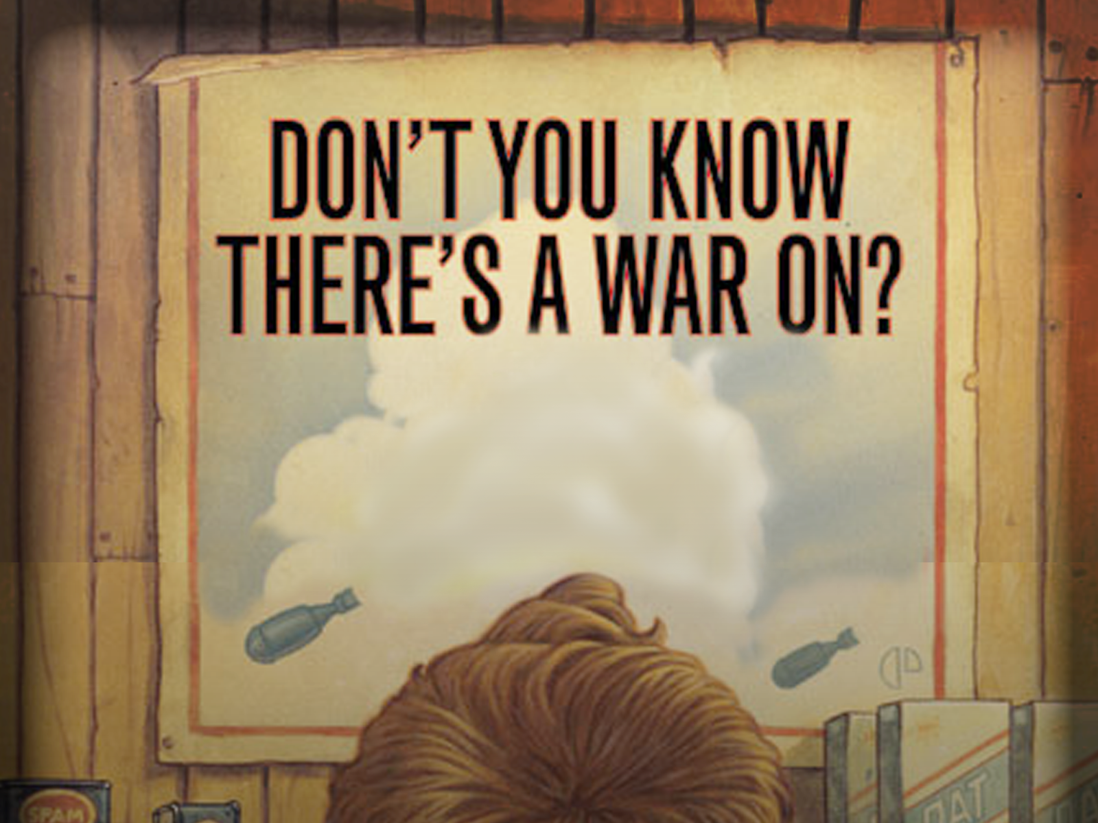

Slide 3
1 Chronicles 12:1
“Now these are the ones who came to David at Ziklag, while he was still restricted because of
Saul the son of Kish; and they were among the mighty men who helped him in war.”

Slide 4
1 Chronicles 12:32
“Of the sons of Issachar, men who understood the times, with knowledge of what Israel should do, their chiefs were two hundred; and all their kinsmen were at their command.”

Slide 5
1 Chronicles 12:32
“Of the sons of Issachar, men who understood the times, with knowledge of what Israel should do, their chiefs were two hundred; and all their kinsmen were at their command.”

Slide 6
1 Corinthians 16:13
“Be on the alert, stand firm in the faith, act like men, be strong.”

Slide 7
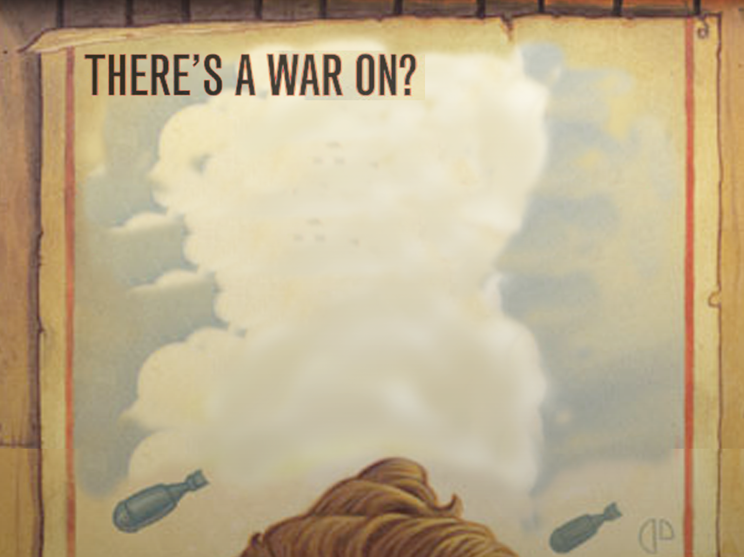
I. “Be on the alert” (Sensitivity)
A) Guard against erosion.
B) Fight passivity.
II. “Stand firm in the faith” (Purity)
A) Simplify your life.
B) Seek accountability.

Slide 8
III. “Act like men” (Maturity)
1 Corinthians 13:11
IV. “Be strong” (Integrity)
1. Strengthen your determination
2. Reaffirm your commitments
3. Provide for your family

