Slide 1
Send Me to
Serve Others!

Slide 2
Mark 10:45
“For even the Son of Man came not to be served but to serve, and to give his life as a ransom for many.”

Slide 3
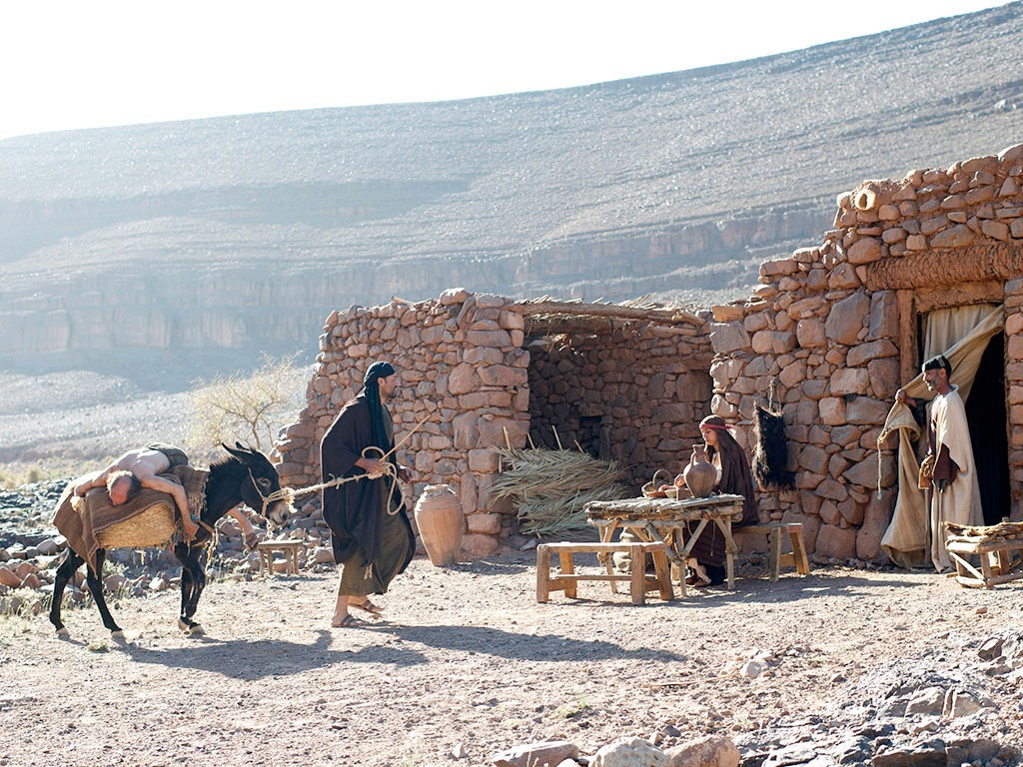
The Good Samaritan Part 1
Why Are Religious People Sometimes Unloving?

Slide 4
Priest (religious) fails to show love.
Levite (religious)
fails to show love.
Samaritan (mixed up religion) shows genuine love.

Slide 5
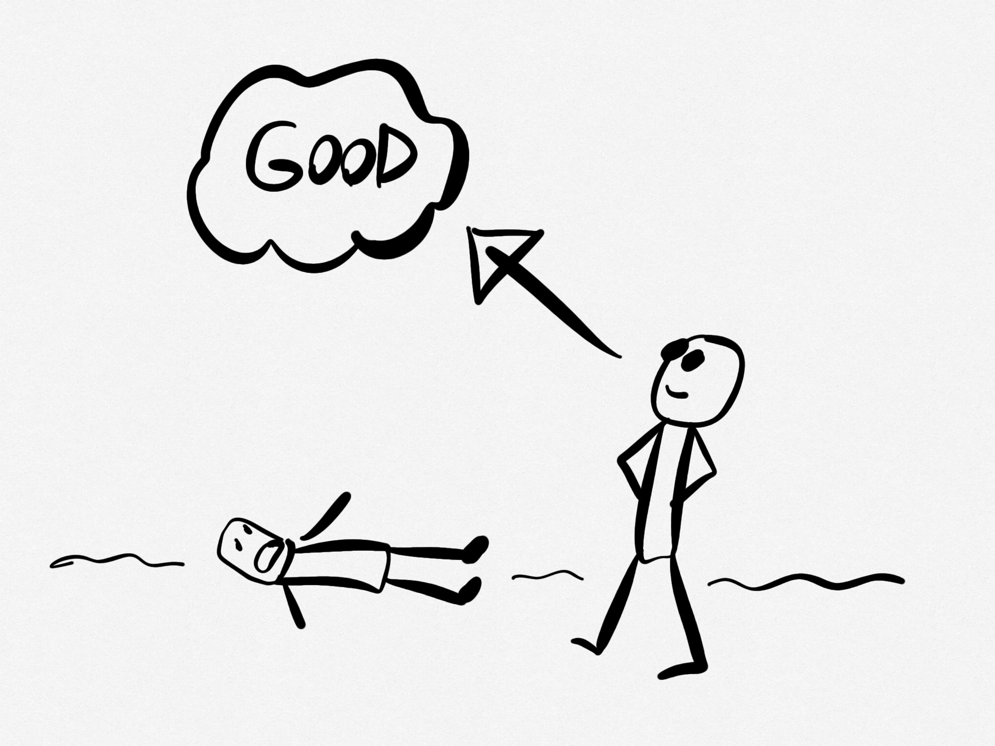
Religion enables me to overlook the needs of others.

Slide 6
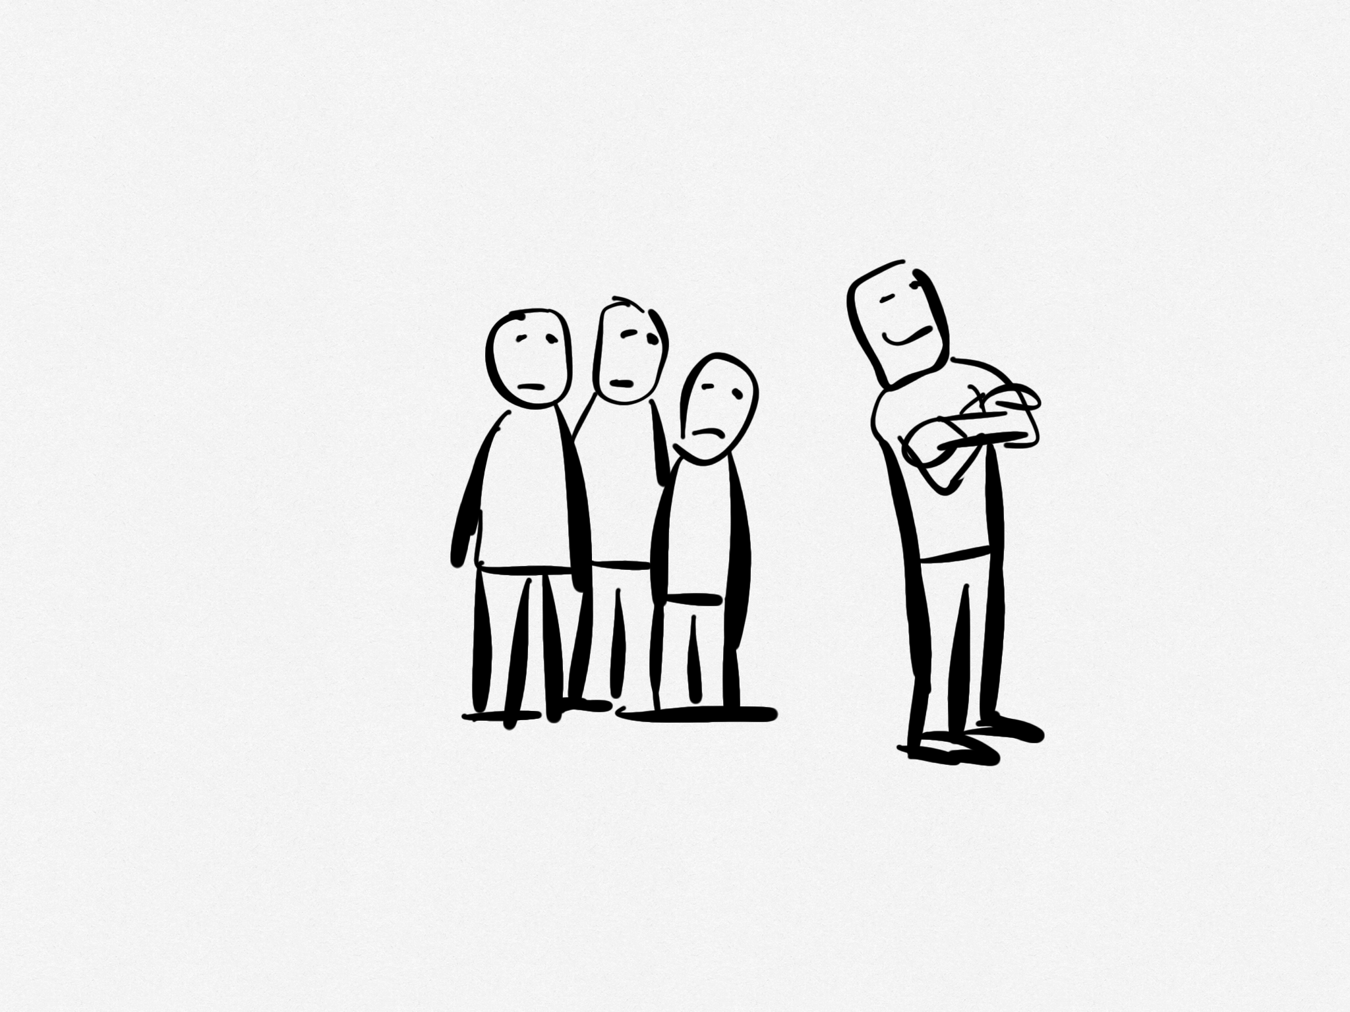
Religion enables me to not associate with the people I don’t like.

Slide 7
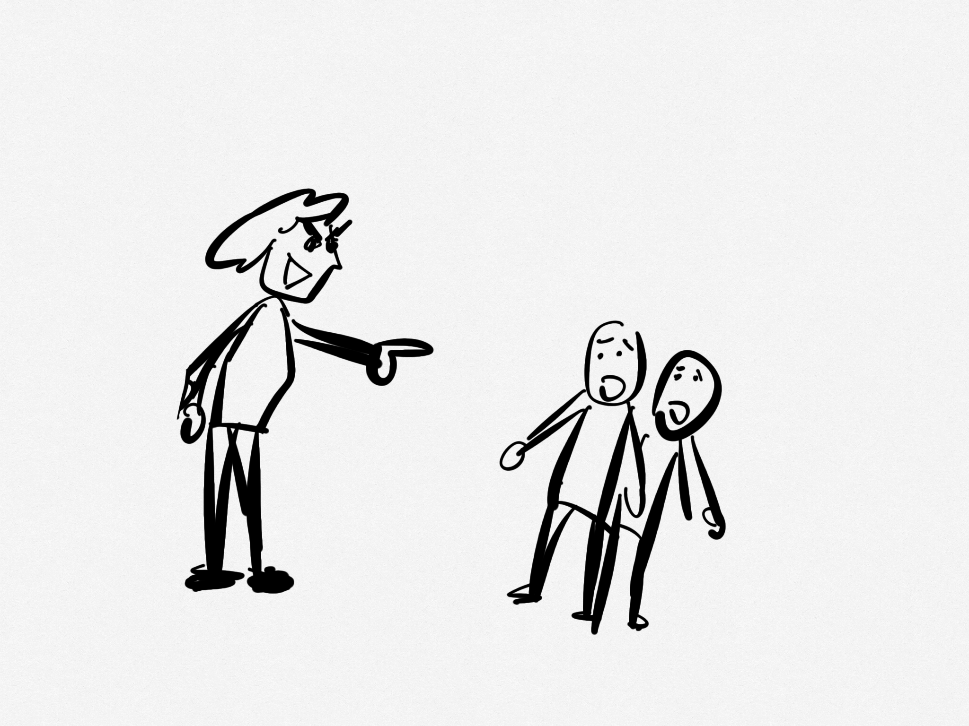
Religion enables me to be overly critical of others.

Slide 8
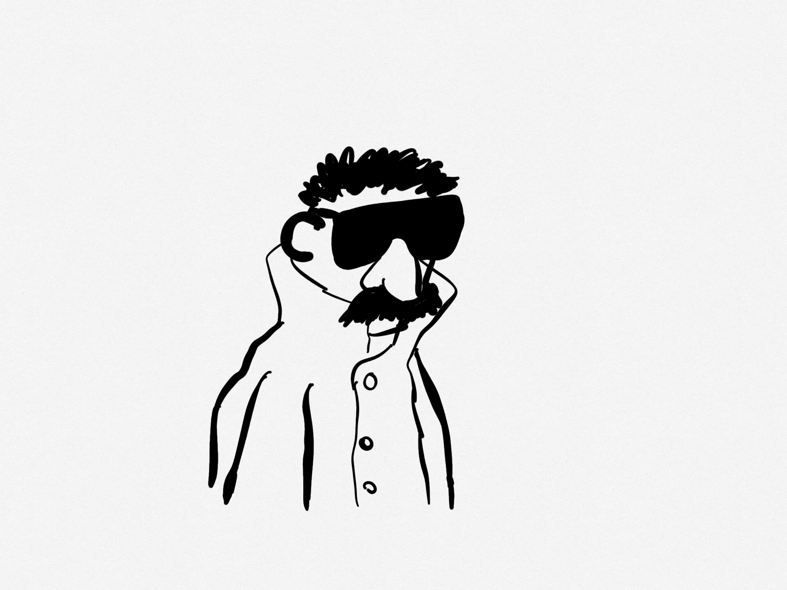
Religion enables me to hide who I really am.

Slide 9
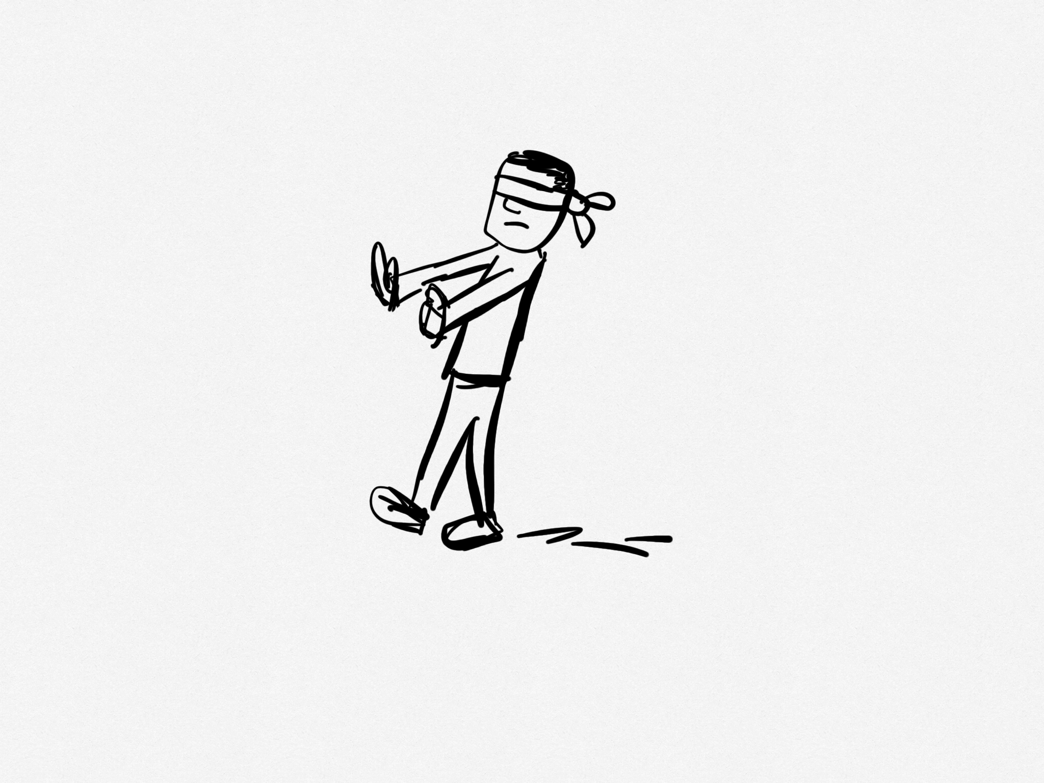
Religion enables me to deceive myself.

Slide 10
So what’s the solution?

Slide 11
“The one who showed him mercy.”

Slide 12
Christianity without the heart of Christ is a very scary thing.

