Slide 1
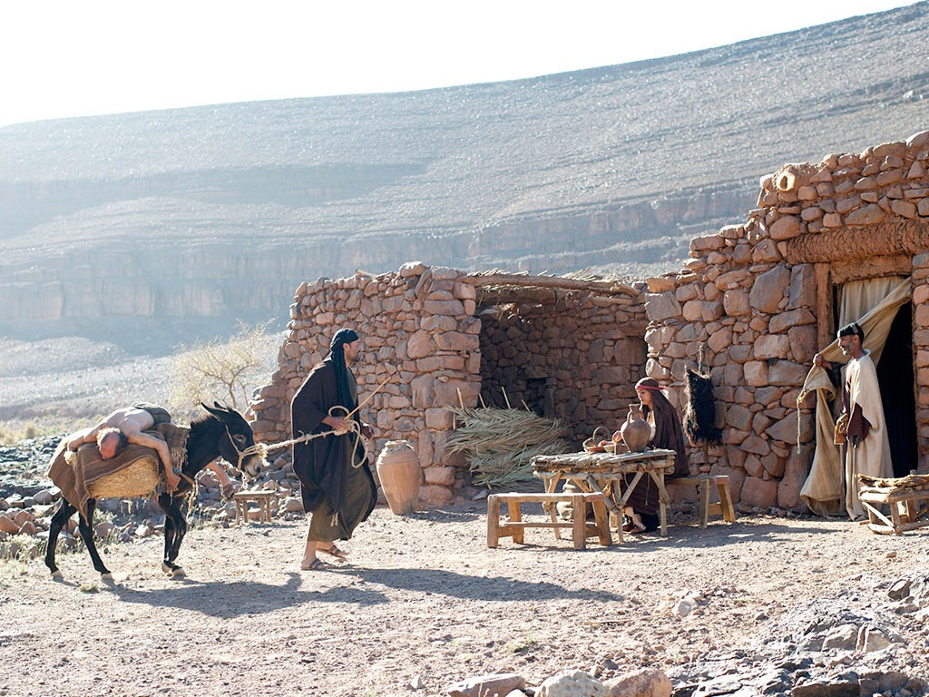
The Good Samaritan Part 2
“When He Saw Him He Had Compassion”

Slide 2
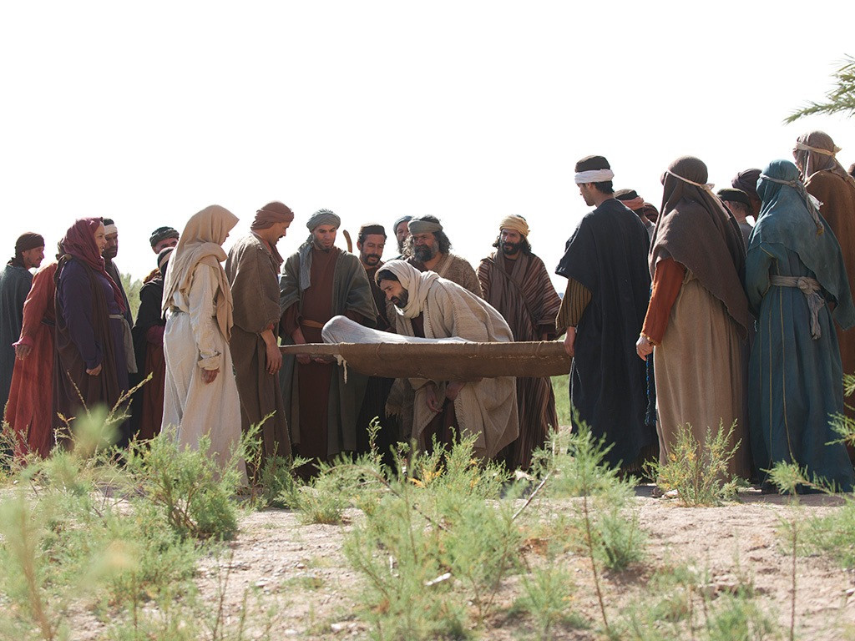
Stopping & Feeling

Slide 3
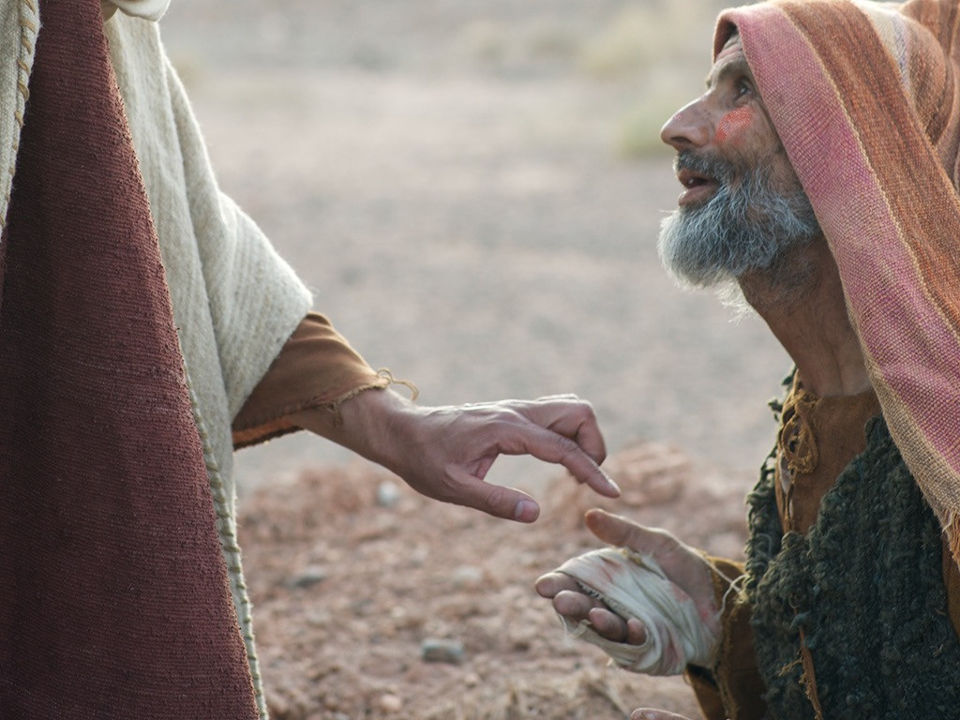
Stopping & Touching

Slide 4
Stopping & Praying

Slide 5
Stopping & Wanting

Slide 6
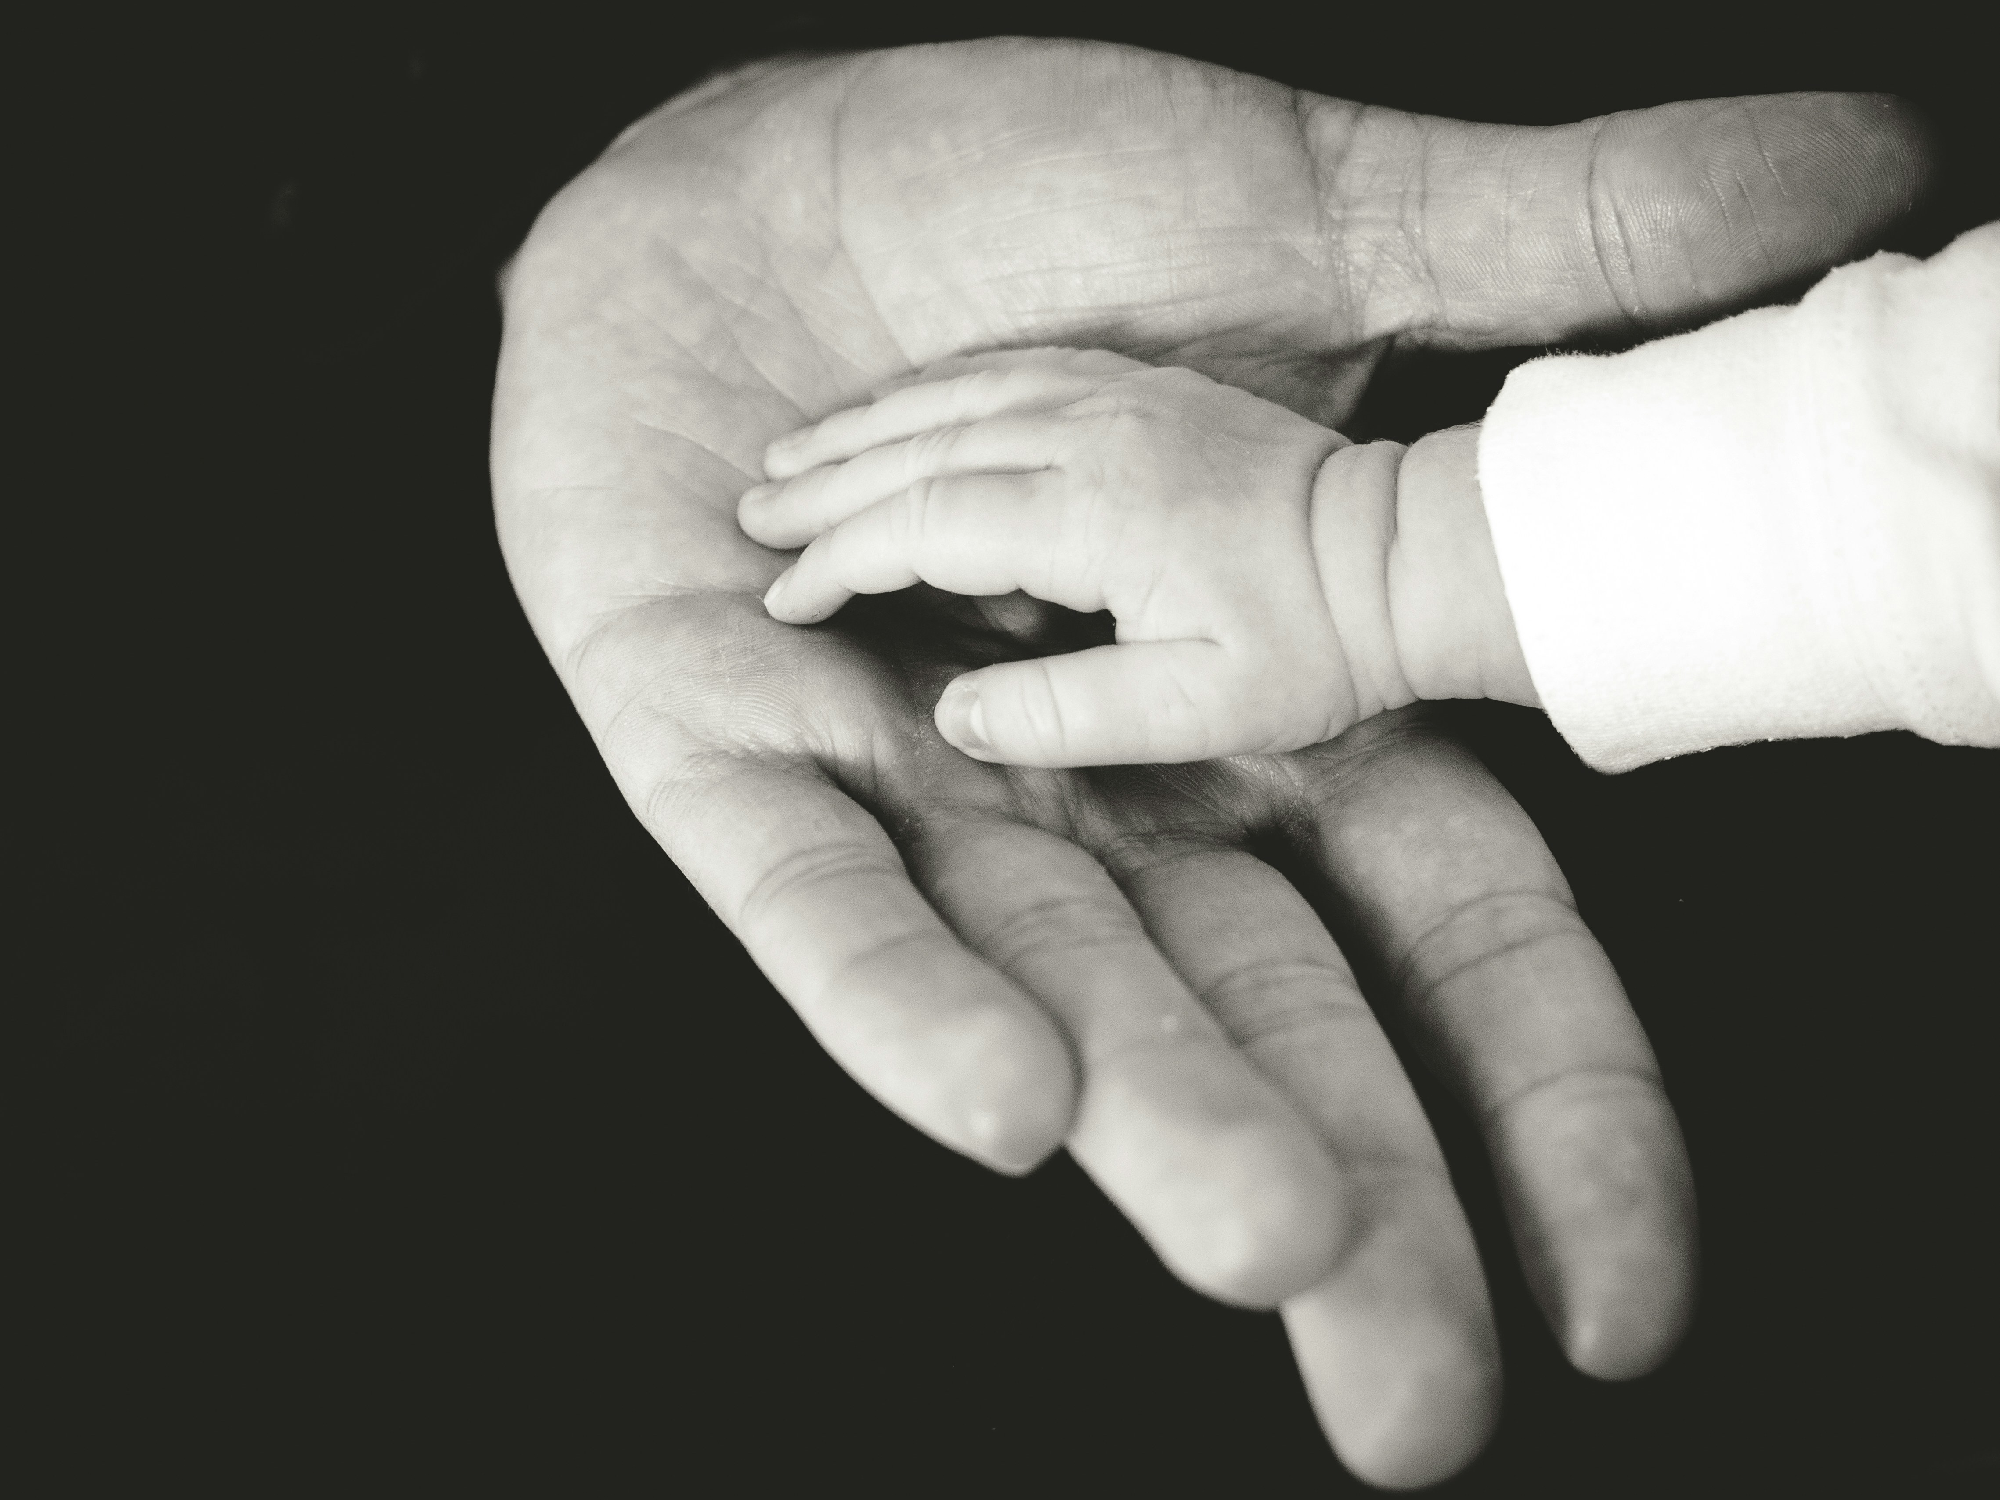
Stopping & Blessing

Slide 7
Stopping & Thinking

Slide 8
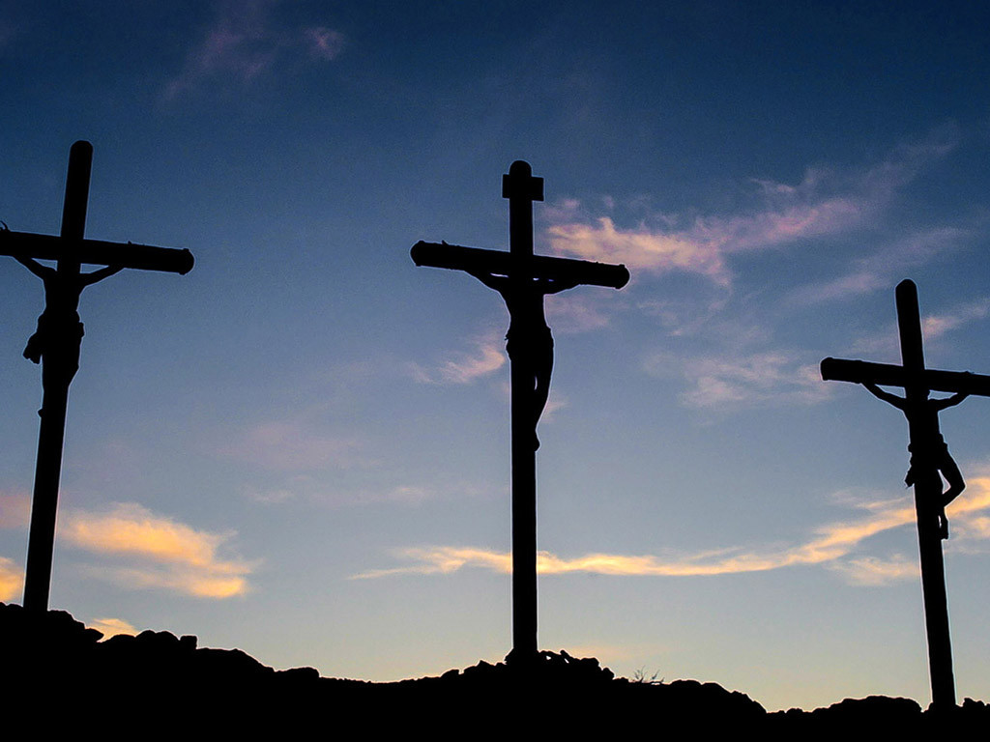
Stopping & Planning

Slide 9
Sometimes the hardest part is stopping.

