Slide 1
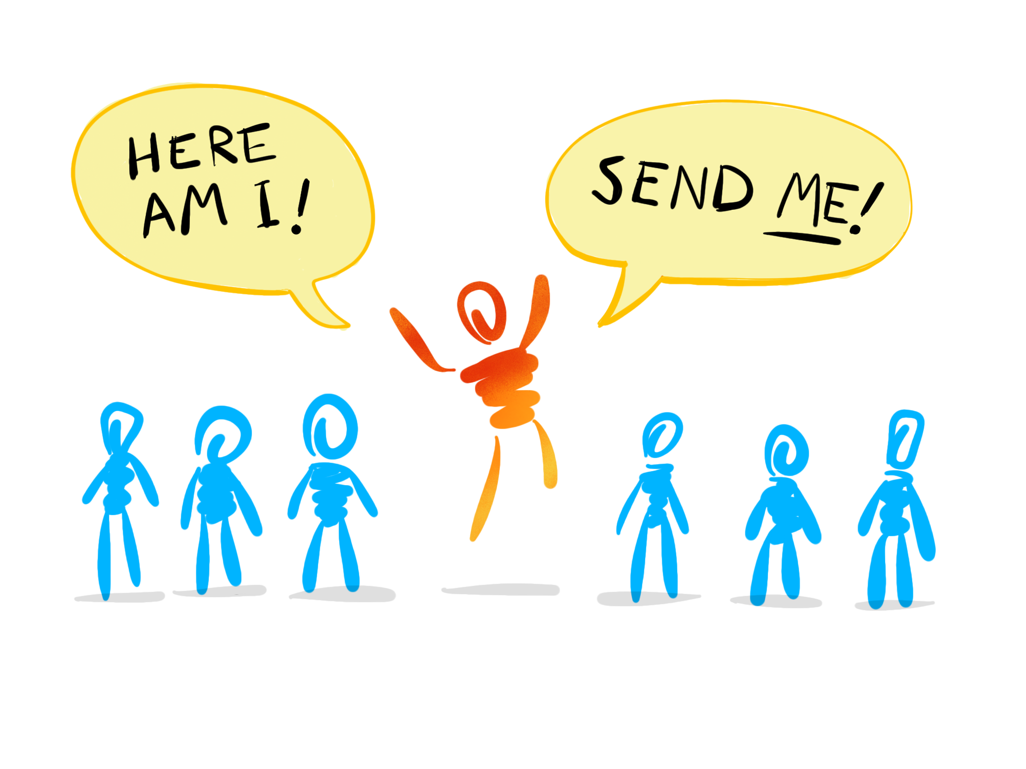
Thinking Like One Sent

Slide 2
John 20:21
Jesus said to them again, “Peace be with you.
As the Father has sent me, even so I am sending you.”
John 6:38
For I have come down from heaven, not to do my own will
but the will of him who sent me.

Slide 3
Will

Slide 4
John 6:38
For I have come down from heaven, not to do my own will but the will of him who sent me.

Slide 5
Dedication

Slide 6
John 4:34
Jesus said to them,
My food is to do the will of him who sent me and to accomplish his work.

Slide 7
Urgency

Slide 8
John 9:4
We must work the works
of him who sent me
while it is day;
night is coming,
when no one can work.

Slide 9
Teaching

Slide 10
John 7:16
So Jesus answered them,
“My teaching is not mine,
but his who sent me.”

Slide 11
John 12:49
For I have not spoken
on my own authority,
but the Father who sent me has himself given me a commandment - what to say and what to speak.

Slide 12
Glory

Slide 13
John 7:18
The one who speaks
on his own authority
seeks his own glory;
but the one who seeks the glory
of him who sent him is true,
and in him there is no falsehood.

Slide 14
Not Alone

Slide 15
John 8:29
And he who sent me is with me.
He has not left me alone,
for I always do the things
that are pleasing to him.

