Slide 1
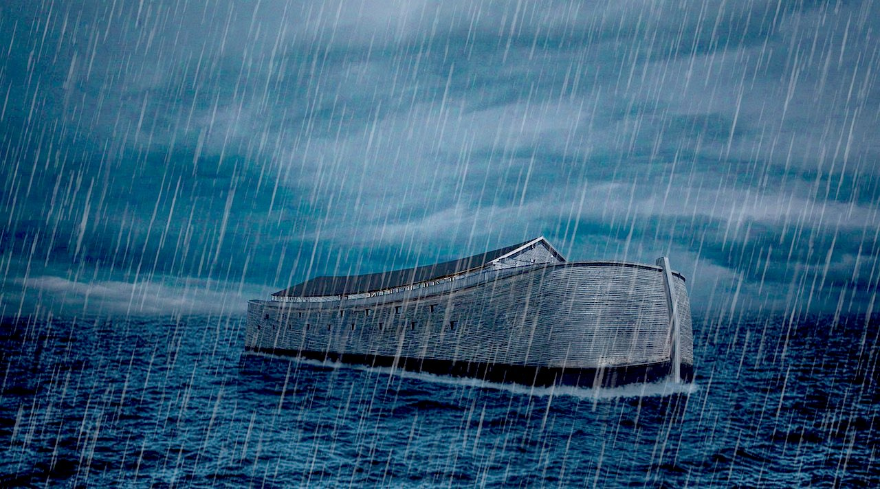
I Want to Obey Like Noah

Slide 2
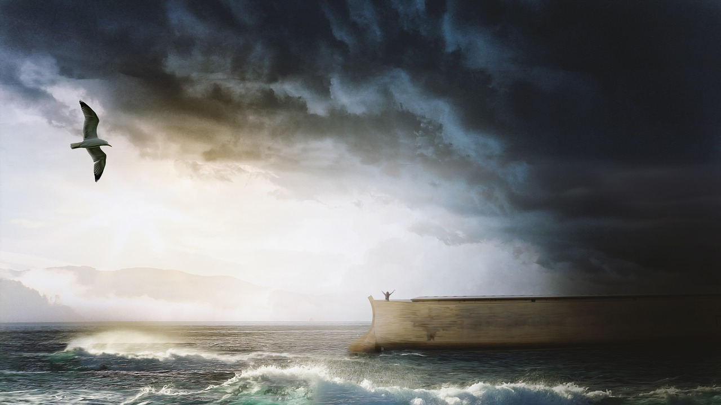
I Want to Obey Like Noah
Hardworking
Thorough
Persevering

Slide 3
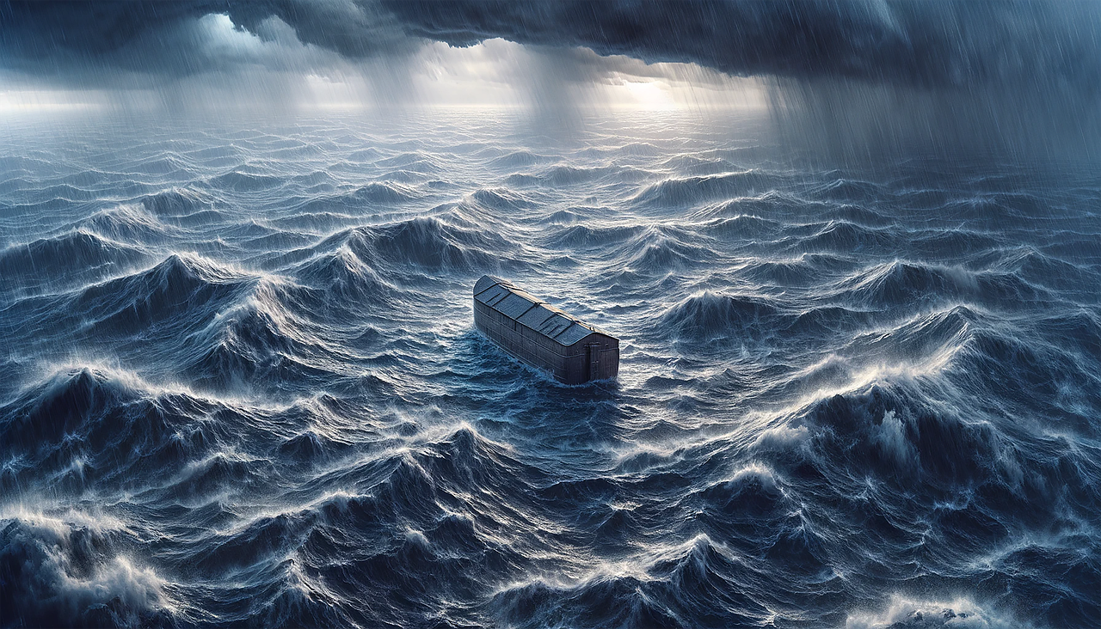
How did he do it?

Slide 4
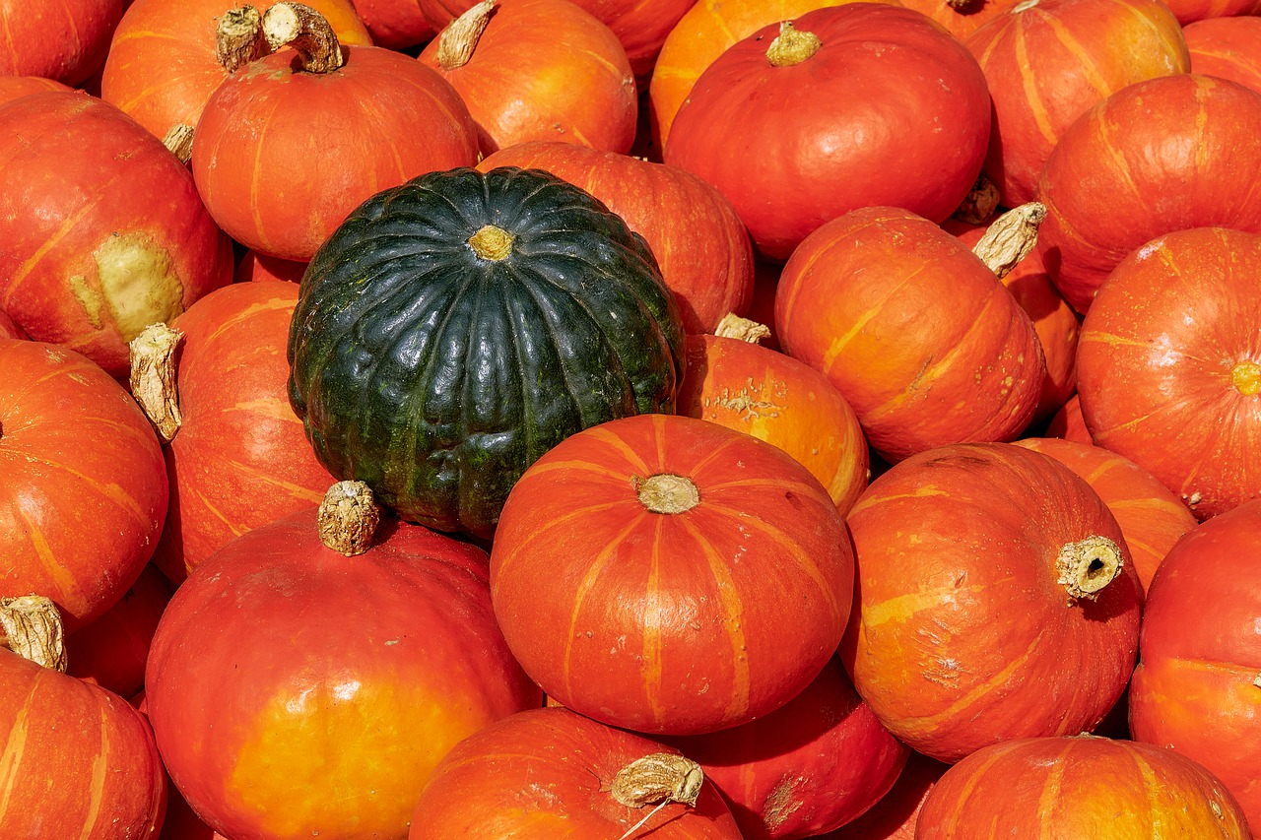
He was already different from the world

Slide 5
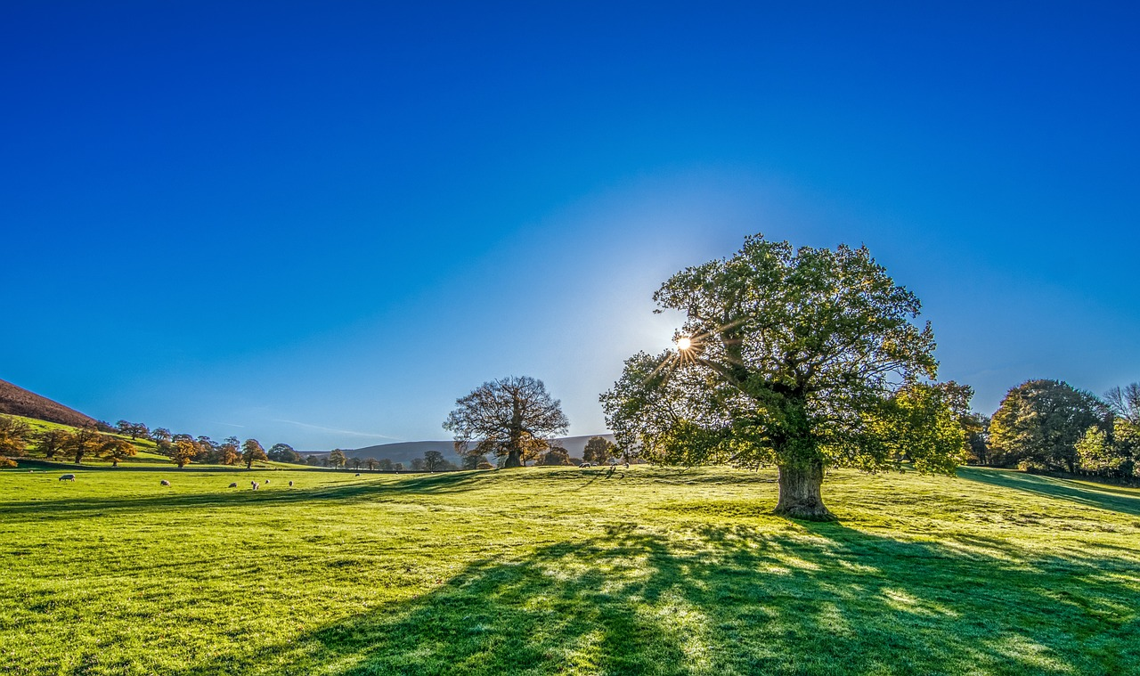
He walked with God
He lived by faith

Slide 6
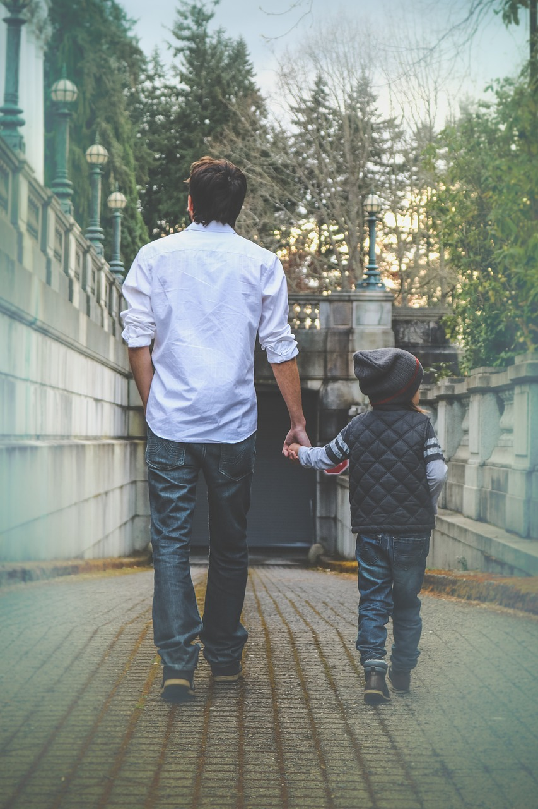
He walked with God

Slide 7
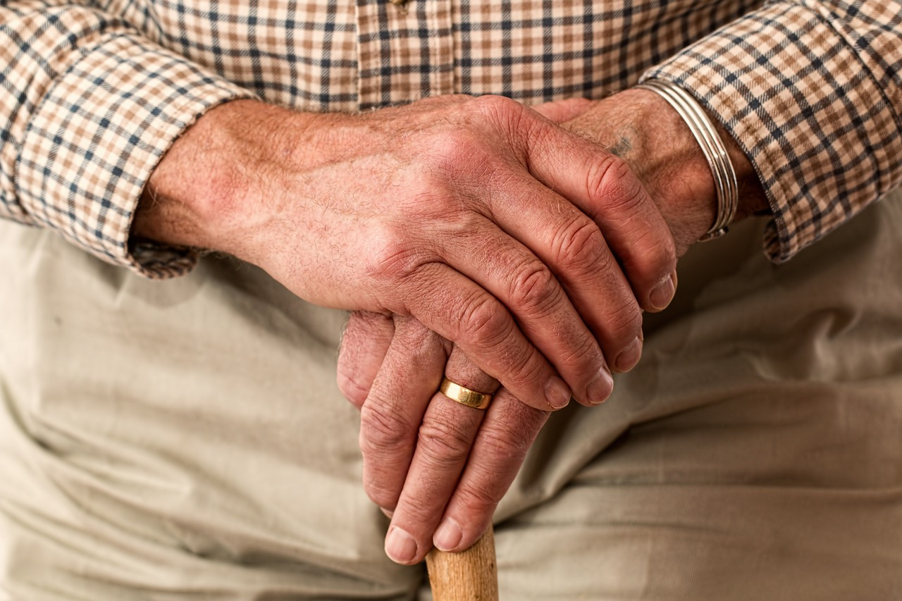
He had a covenant relationship with God

Slide 8
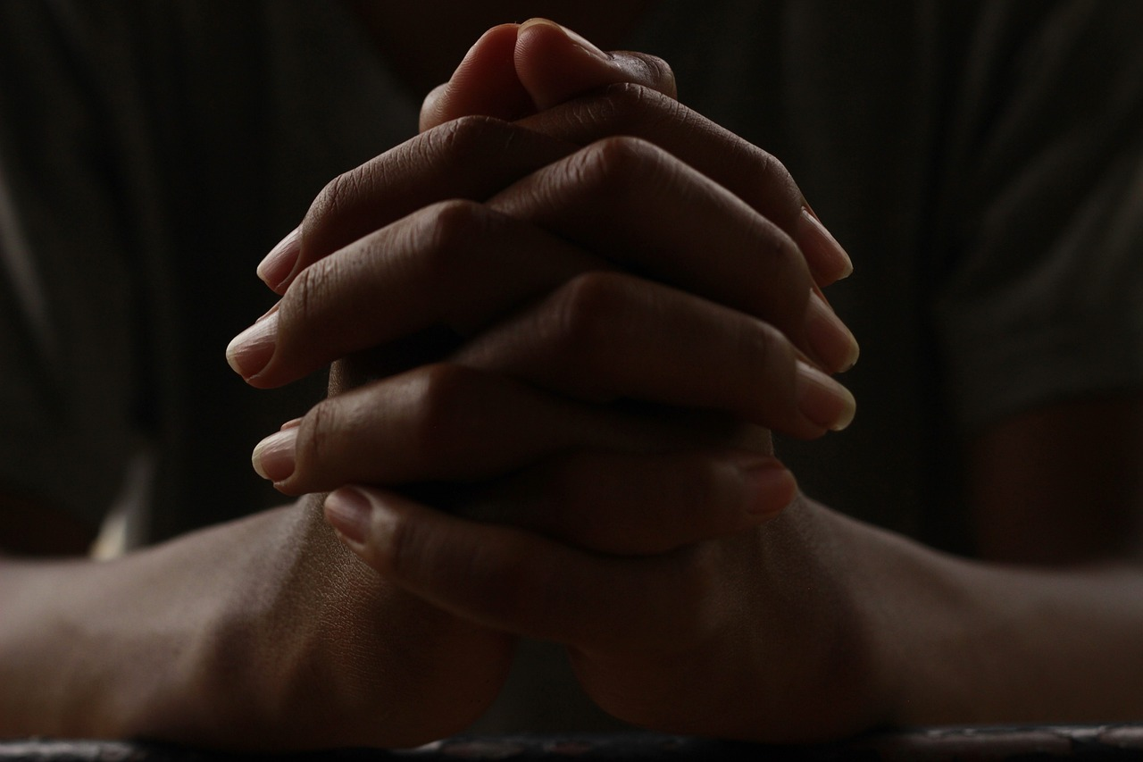
He worshiped

Slide 9
1 John 5:3
For this is the love of God, that we keep his commandments.
And his commandments are not burdensome.

