Slide 1
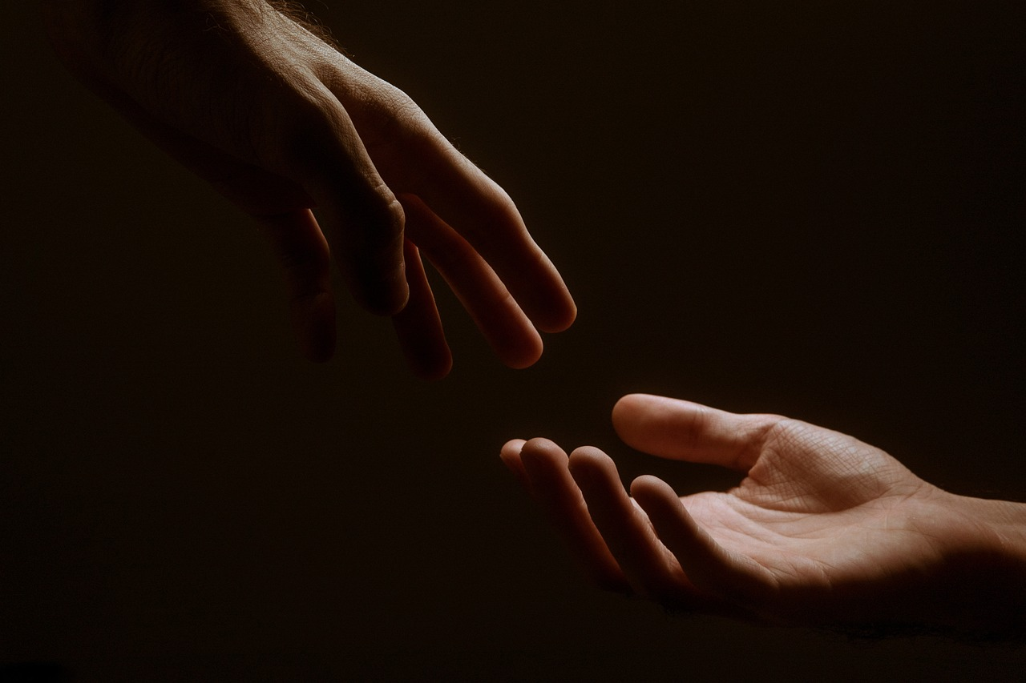
When God Touched Us

Slide 2
Some Background

Slide 3
Exodus 4:22-23
“Then you shall say to Pharaoh, ‘Thus says the Lord, Israel is my firstborn son, and I say to you, “Let my son go that he may serve me.” If you refuse to let him go, behold, I will kill your firstborn son.’ “

Slide 4
Wash your clothes!
Do not touch!

Slide 5
Ten
commandments
Relationship
Wash your clothes!
Do not touch!

Slide 6
Build a tabernacle
Moses
Wash your clothes!
Do not touch!

Slide 7
Wash your clothes!
Do not touch!

Slide 8
1 Corinthians 10:5
But with most of them God was not well pleased, for their bodies were scattered in the wilderness.

Slide 9
Elijah
Trying to bring people back into that relationship

Slide 10
Jesus’
Transfiguration

Slide 11
Moses
Elijah

Slide 12
Shining Face
Washed clothes
Moses
Elijah

Slide 13
Mark 9:2
His clothes became shining, exceedingly white, like snow, such as no launderer on earth can whiten them.

Slide 14
Shining Face
Washed clothes
Moses
Elijah

Slide 15
The Reaction

Slide 16
Build 3 tabernacles?
Moses
Elijah

Slide 17
God Speaks

Slide 18
Son
Loved
Well Pleased

Slide 19
Listen
to Him.

Slide 20
The Reaction

Slide 22
How Jesus Responds

Slide 23
He touches them.

Slide 24
Praise God

