Slide 1
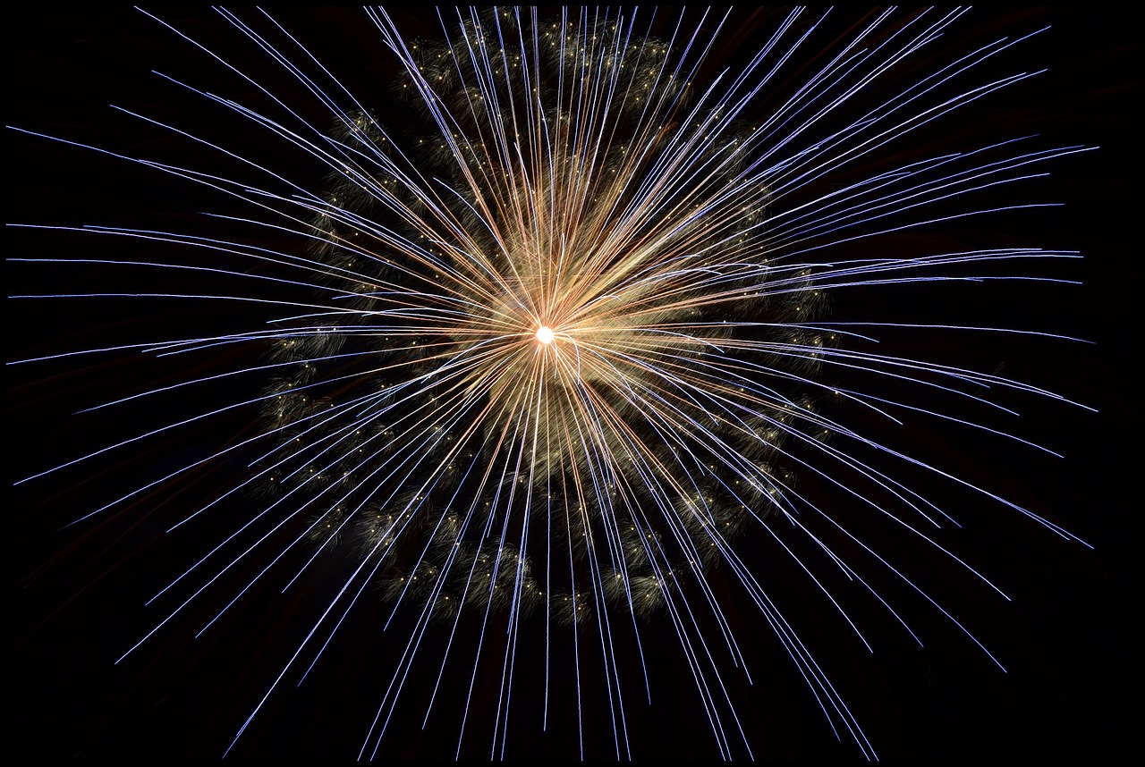
2024
My Prayer for

Slide 2
To See the Infinite
Our Love
Christ’s Love
Christ in Us
God
in Us
Power
Power
God’s Glory
God’s Glory
Family
Family

Slide 3
May this be a year where
we are transformed
from the inside out
so that God powerfully works
in us and through us.

