Slide 1
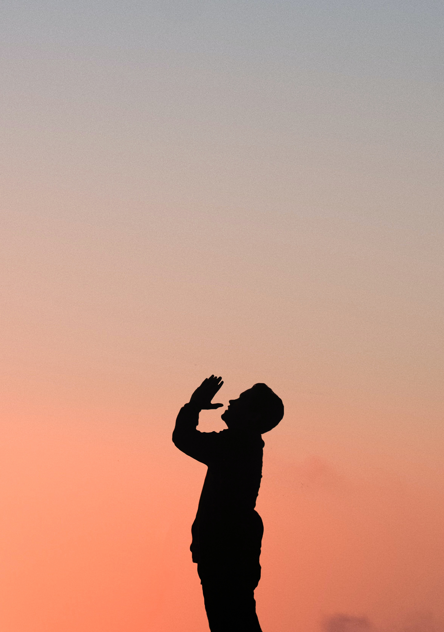
Preparing
Prayer
Ourselves Through

Slide 2
How the
Disciples Failed

Slide 3
Watch
Pray

Slide 4
1 Peter 5:8-9
Be sober-minded; be watchful. Your adversary the devil prowls around like a roaring lion, seeking someone to devour. Resist him, firm in your faith, knowing that the same kinds of suffering are being experienced by your brotherhood throughout the world.

Slide 5
Ephesians 6:16-18
In all circumstances take up the shield of faith, with which you can extinguish all the flaming darts of the evil one; and take the helmet of salvation, and the sword of the Spirit, which is the word of God, praying at all times in the Spirit, with all prayer and supplication. To that end, keep alert with all perseverance, making supplication for all the saints

Slide 6
Watch
Pray
ZZZZZZ

Slide 7
ZZZZZZ
Flesh-Spirit Battle
Emotions

Slide 8
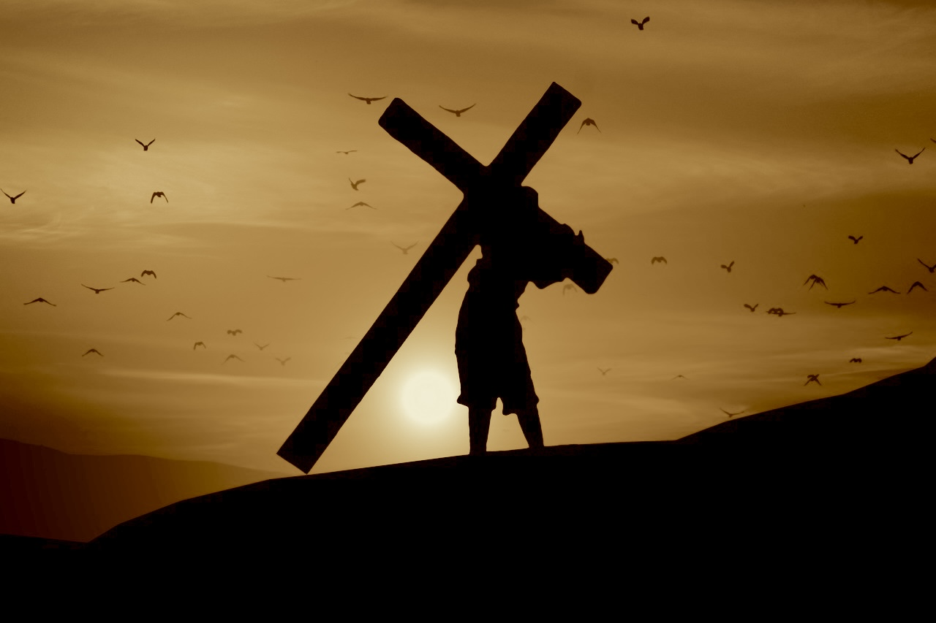
Failure
Failure

Slide 9
How Jesus
Succeeded

Slide 10
Expresses His emotions to God
Asks others to support him
Honest about His desires
And angels comfort Him!
Talks to God about it
Submits Himself to God’s will
Prays repeatedly

Slide 11
1 Peter 5:8-9
Be sober-minded; be watchful. Your adversary the devil prowls around like a roaring lion, seeking someone to devour. Resist him, firm in your faith, knowing that the same kinds of suffering are being experienced by your brotherhood throughout the world.

Slide 12
1 Peter 5:10
And after you have suffered a little while, the God of all grace, who has called you to his eternal glory in Christ, will himself restore, confirm, strengthen, and establish you.

Slide 13
Success
Success

Slide 14
What the Disciples Learned from This

Slide 15
Failure
Failure
Success

Slide 16
Acts 1:14
Acts 4:23-24
Acts 6:4-6
Acts 13:3
Acts 14:23

Slide 17
Let’s do the same.

