Slide 1
A Message Worth Everything

Slide 2
Ashamed of the gospel
Suffering for the gospel

Slide 3
Ashamed of the gospel
Suffering for the gospel

Slide 4
Ashamed of the gospel
Suffering for the gospel

Slide 5
Ashamed of the gospel
Suffering for the gospel

Slide 6
Ashamed of the gospel
Suffering for the gospel

Slide 7
The Gospel

Slide 8
Saved us
Holy calling

Slide 9
Not because of:
Instead because of:

Slide 10
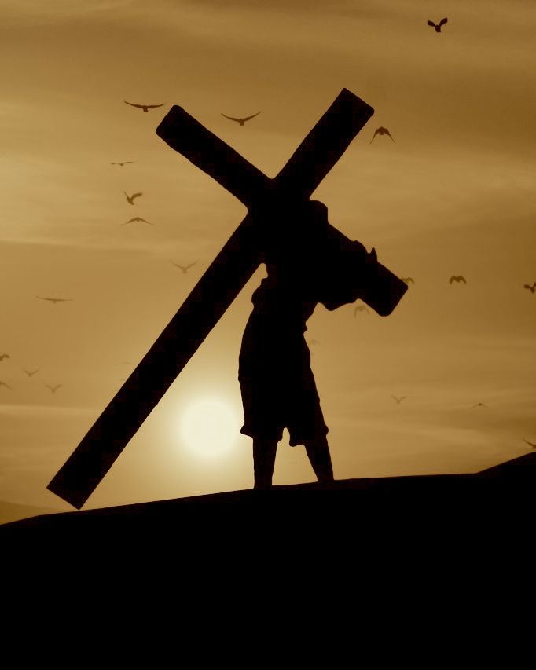
Manifested
now in Jesus
Before the ages began

Slide 11
Brought:
Abolished:

Slide 12
Paul’s Response
to the Gospel

Slide 13
Ashamed of the gospel
Suffering for the gospel
God gave me this message.
God will help me.

Slide 14
Timothy’s Response
to the Gospel

Slide 15
Ashamed of the gospel
Suffering for the gospel
God gave you this message.
God will help you.

Slide 16
Do you understand the gospel?
If you do,
then you’ll give everything for it.

